Slide 1


Slide 2

Web 2.0 and You –
What “tools” are out there?
Presented by
Linda DeVore
October 27, 2012

Slide 3

Web 2.0 and You –
What “tools are out there?
Today’s Agenda:
Office and Business Apps
File Storage
Collaboration Tools
Slide Show Tools
Images
Photo Editors/Tools
Video Tools
Bookmark/Favorites Storage
Disposable Email Addys
Miscellaneous Tools/Apps

Slide 4


Slide 5

Web 2.0 and You –
What “tools are out there?
What is Web 2.0 and how is it different from the “web”?

Slide 6
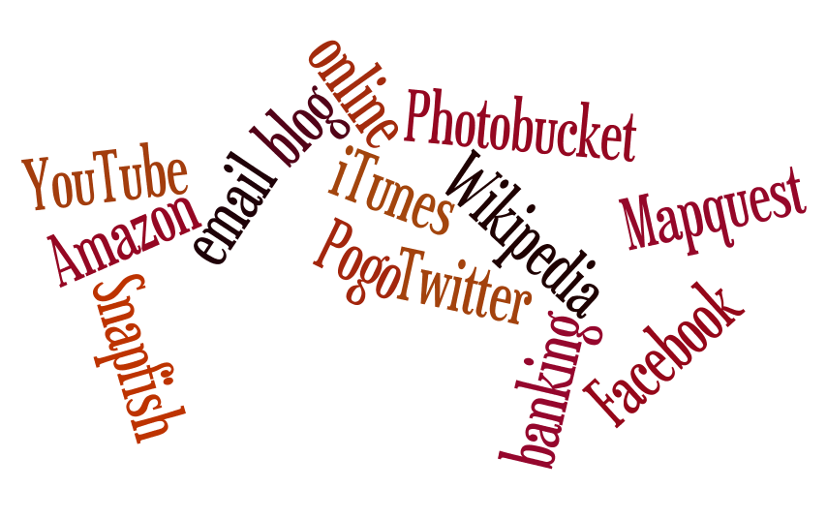
Web 2.0 and You –
What “tools are out there?

Slide 7
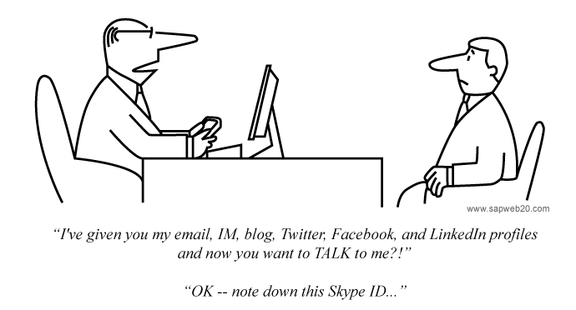
Web 2.0 and You –
What “tools are out there?

Slide 8

Web 2.0 and You –
What “tools are out there?
What is the “cloud”?

Slide 9
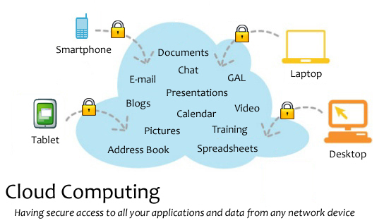
Web 2.0 and You –
What “tools are out there?

Slide 10

Web 2.0 and You –
What “tools are out there?
Started in 1990 originally only included Word, Excel, and PowerPoint.
As of 2009 eighty percent of enterprises were using some form of Office.
Microsoft 2013 is coming out soon & will be $140 to $400, will run on computers and tablets
What can be used as a substitute???

Slide 11


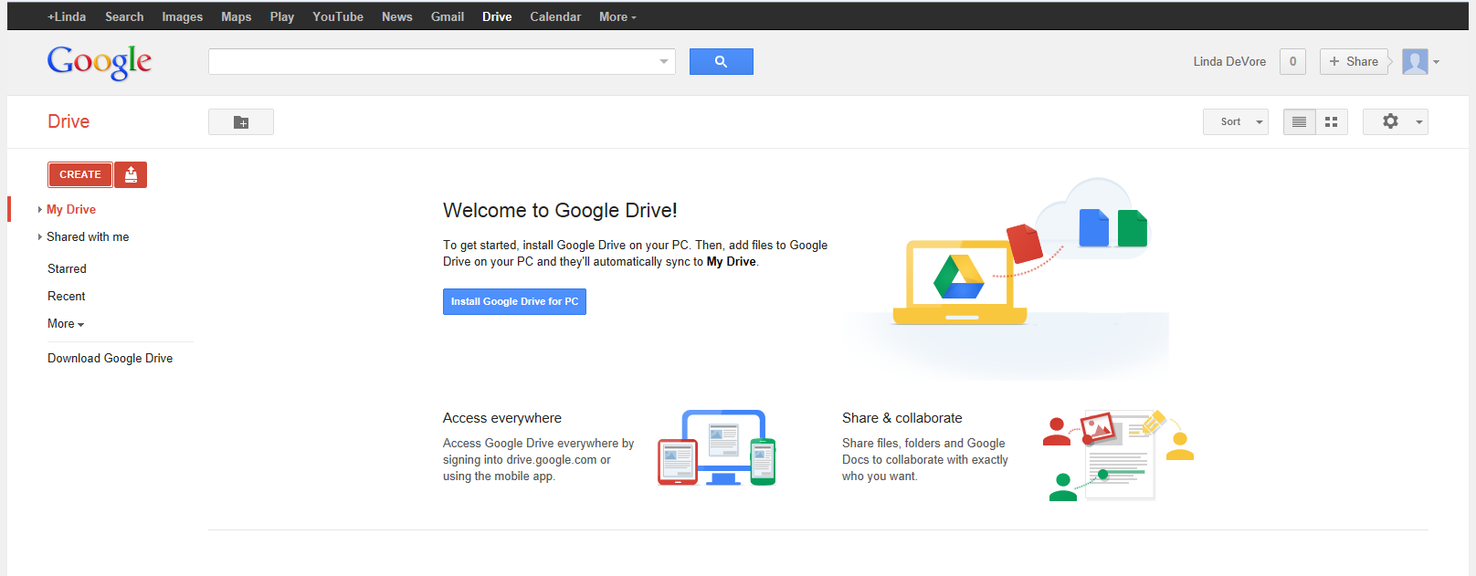
Web 2.0 and You –
What “tools are out there?
Drive
Drive
Notes:
Google Drive also include 5 GB “cloud” storage.

Slide 12

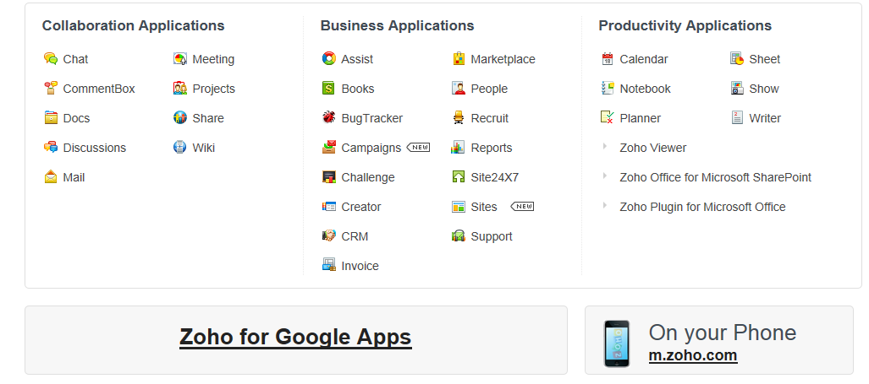
Web 2.0 and You –
What “tools are out there?
Notes:
Click here

Slide 13
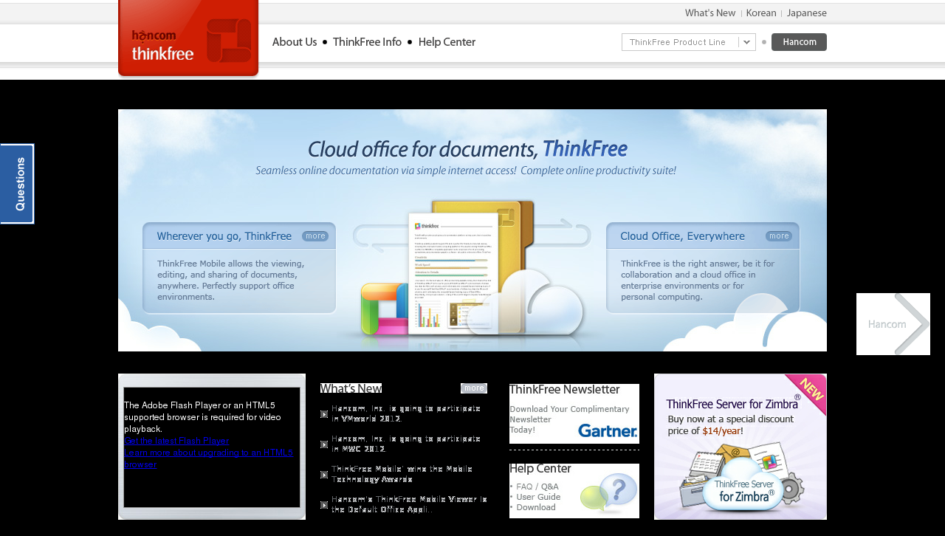
Web 2.0 and You –
What “tools are out there?
ThinkFree

Slide 14



Web 2.0 and You –
What “tools are out there?
Downloadable Options
Lotus Symphony (Windows)
Neo Office (Mac OS X)
(Windows, Mac OS X, Linux)
Calligra Suite has both office & graphic apps (runs on Windows, Linux; as well as mobile version)

Slide 15
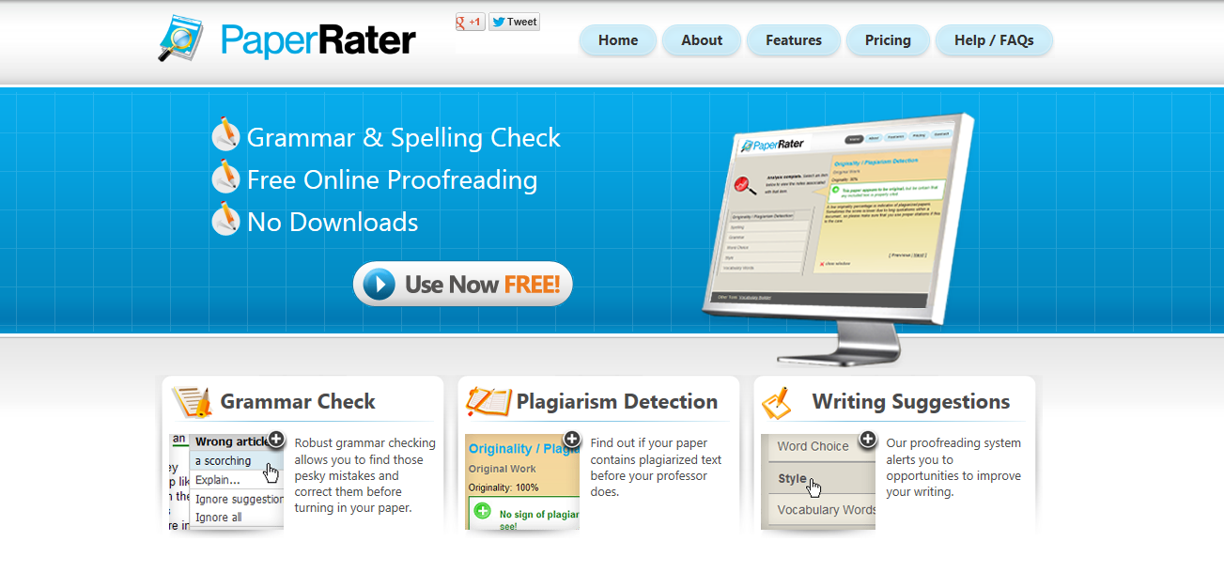
Web 2.0 and You –
What “tools are out there?

Slide 16
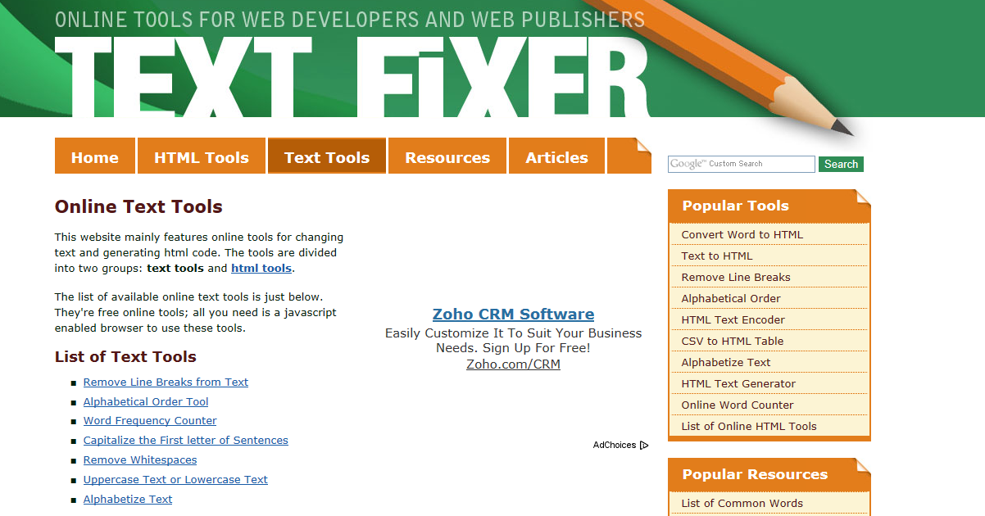
Web 2.0 and You –
What “tools are out there?

Slide 17
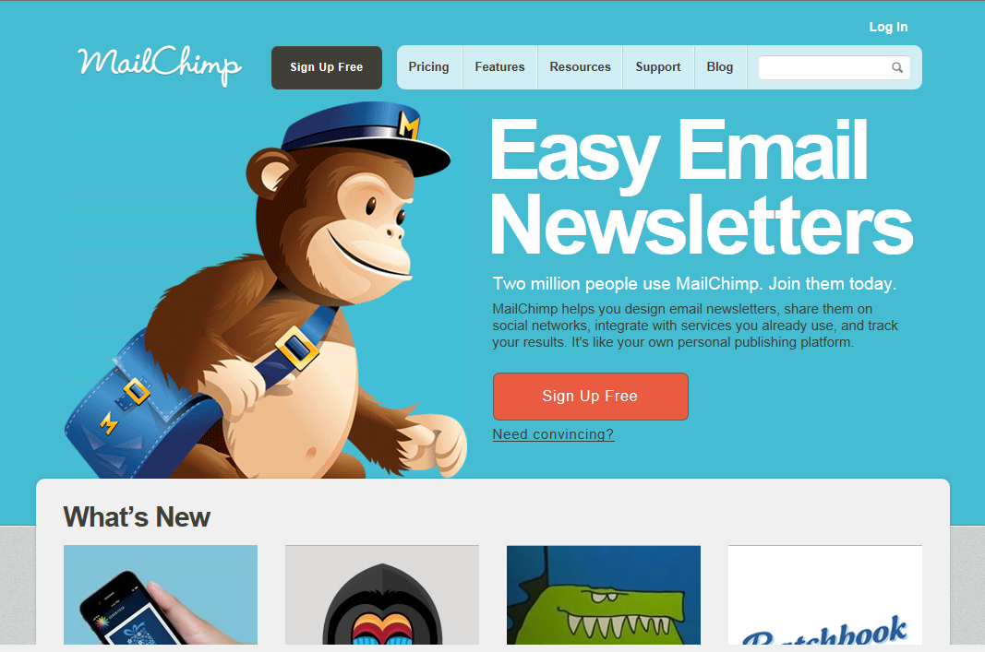
Web 2.0 and You –
What “tools are out there?
Notes:
You can use it for free for your first 2,000 subscribers to your email list.

Slide 18
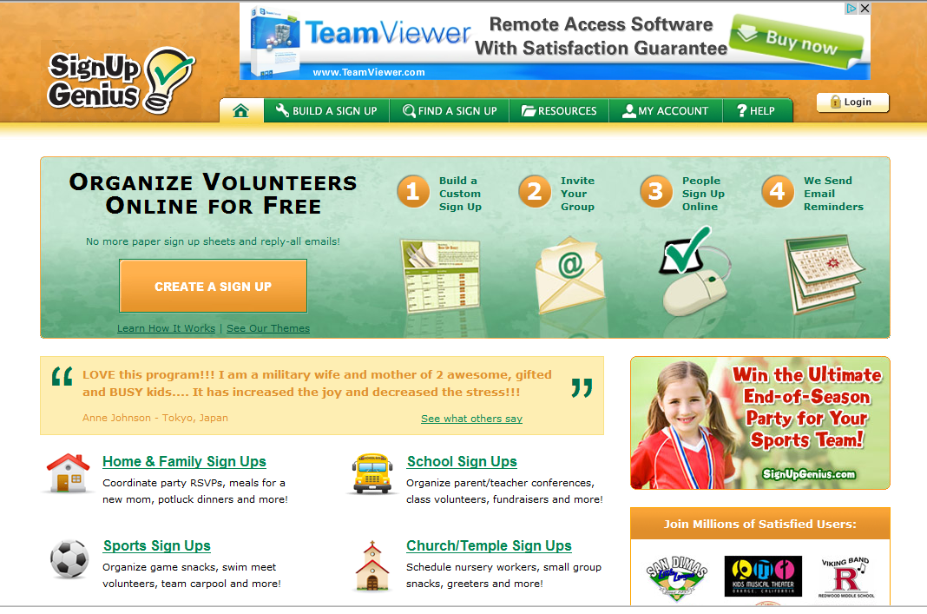
Web 2.0 and You –
What “tools are out there?
Print sign in sheets, calendar summaries and rosters, export data including basic hours

Slide 19
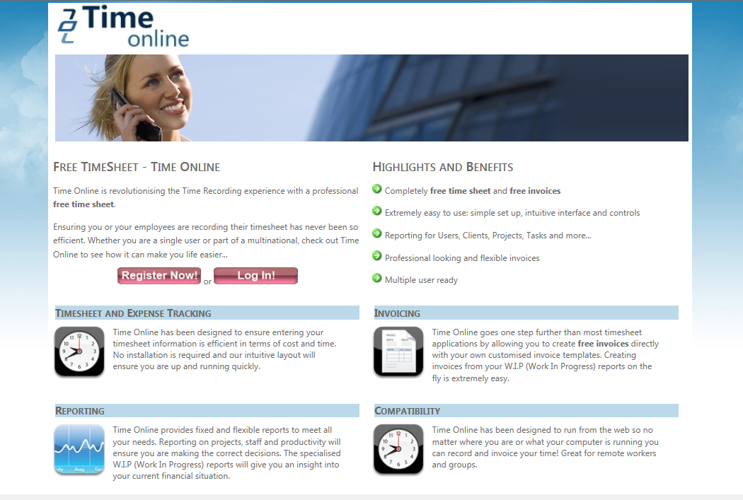
Web 2.0 and You –
What “tools are out there?

Slide 20
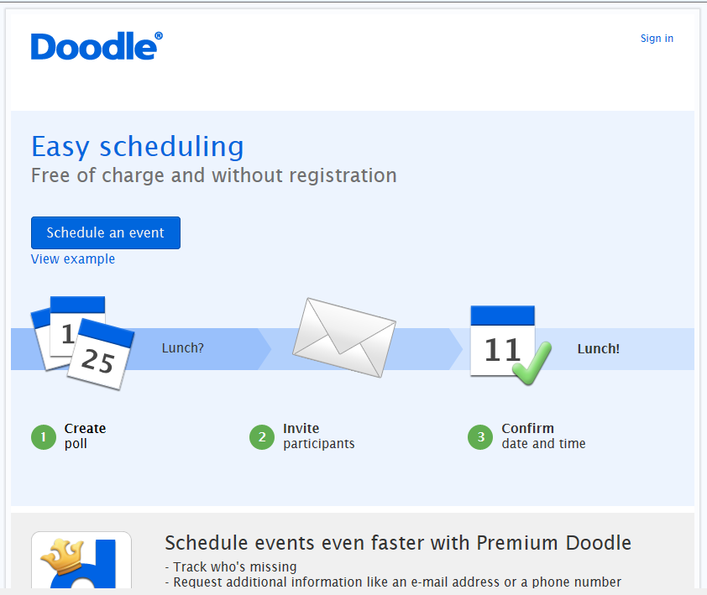
Web 2.0 and You –
What “tools are out there?

Slide 21
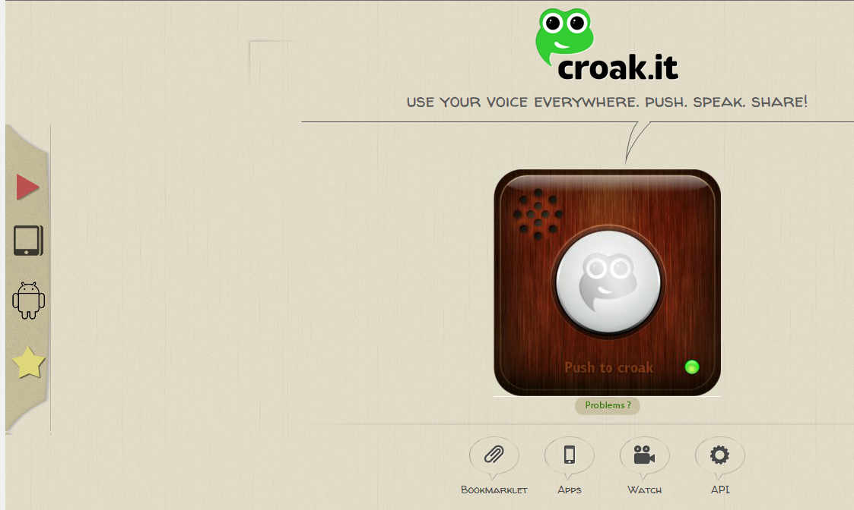
Web 2.0 and You –
What “tools are out there?
Notes:
lets you record a thirty second message with a computer microphone. You then get a unique url address that you can share. No registration is necessary.

Slide 22
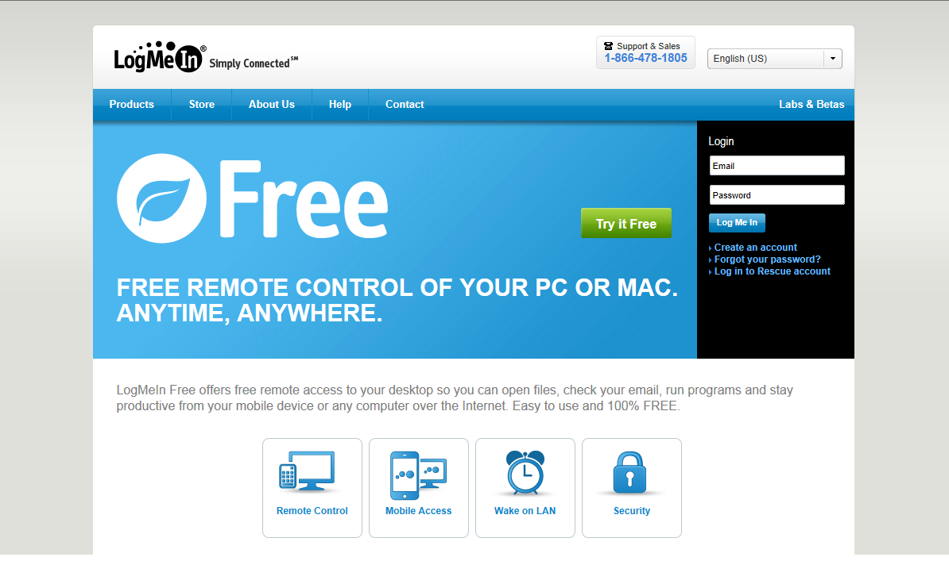
Web 2.0 and You –
What “tools are out there?

Slide 23
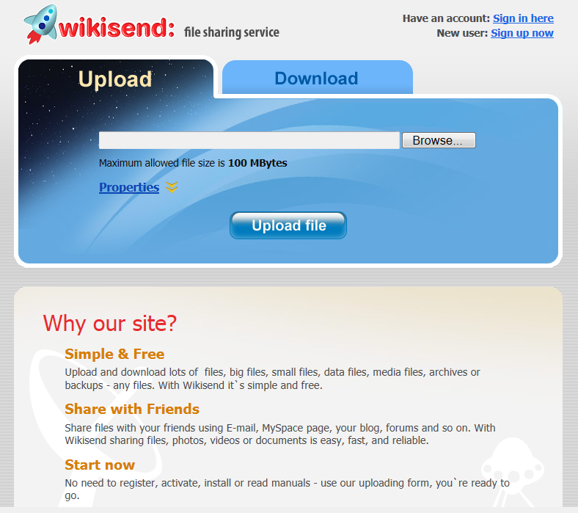
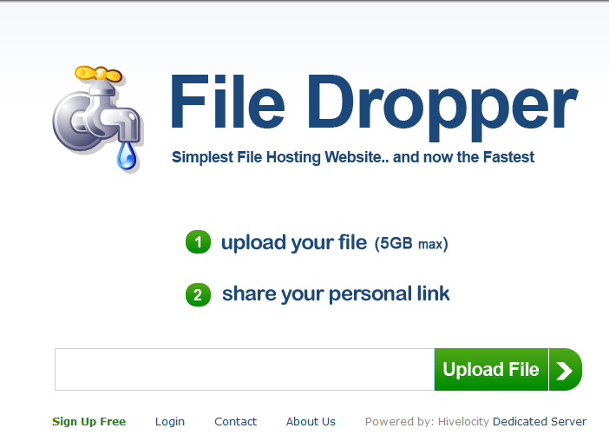
Web 2.0 and You –
What “tools are out there?
Online File Sharing & Storage

Slide 24
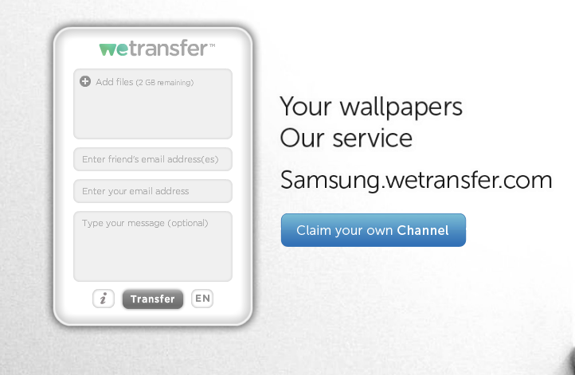
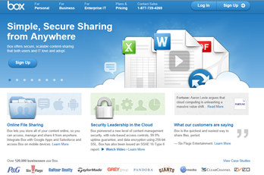
Web 2.0 and You –
What “tools are out there?
2 GB limit/upload - no storage
5 GB storage & 100 MB file size

Slide 25
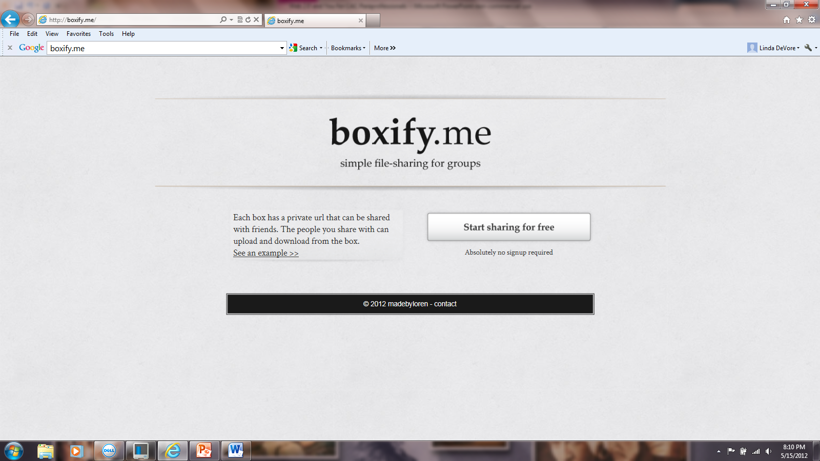
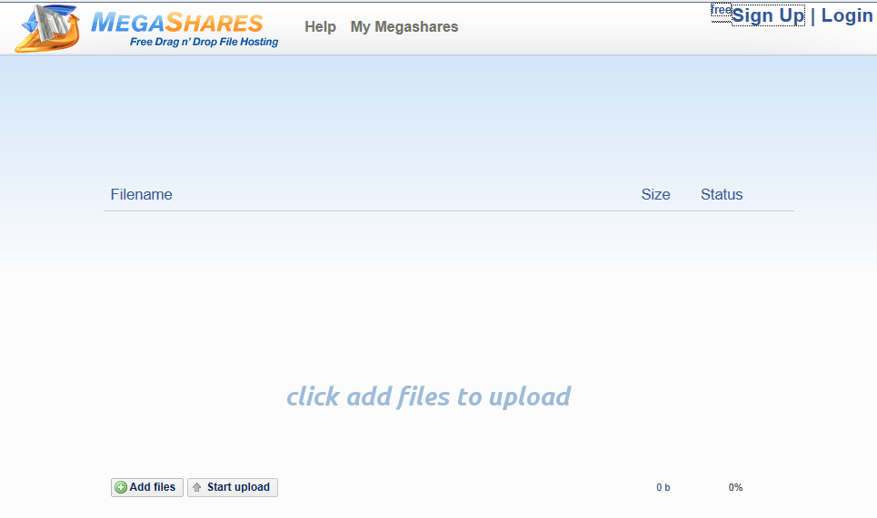
Web 2.0 and You –
What “tools are out there?
Provides a URL for a group to upload & download files.
10 GB upload limit

Slide 26
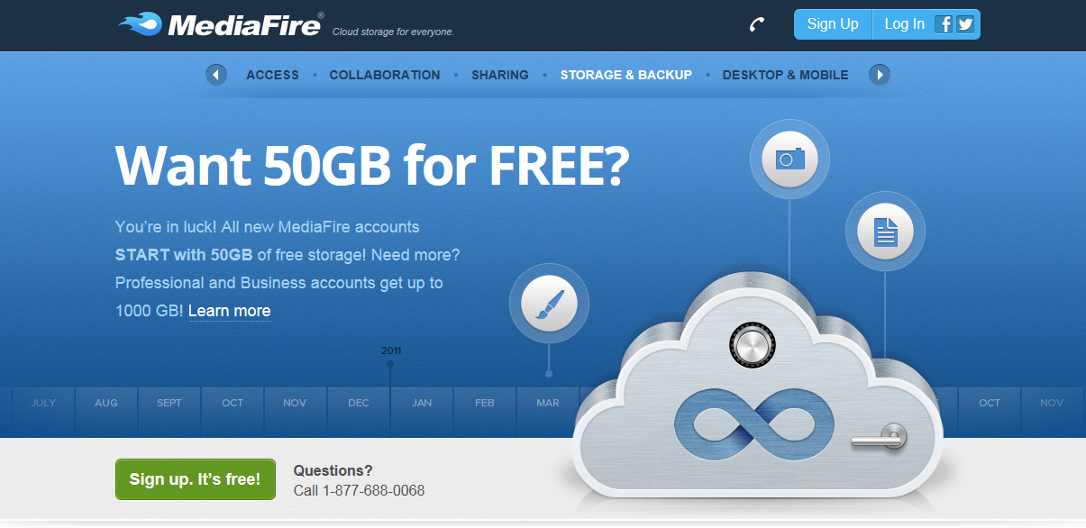
Web 2.0 and You –
What “tools are out there?

Slide 27
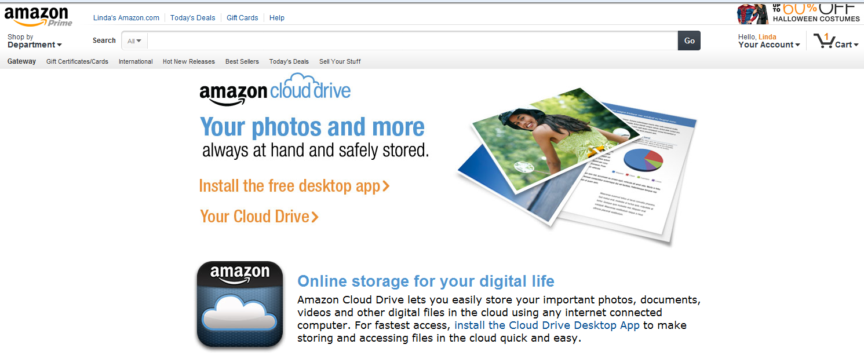
Web 2.0 and You –
What “tools are out there?
5 GB Storage

Slide 28
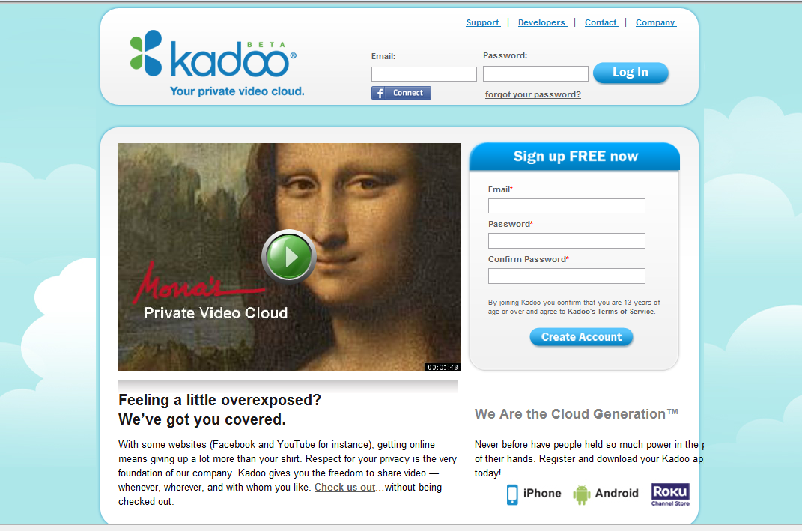
Web 2.0 and You –
What “tools are out there?

Slide 29
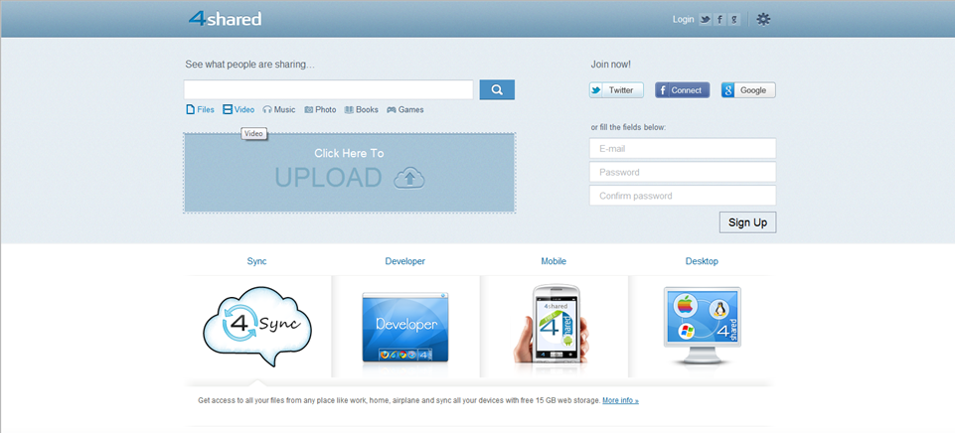
Web 2.0 and You –
What “tools are out there?
Online file sharing and storage - 15 GB free web space. Easy registration. Multiple file transfer. Has a free synchronization program - 4Sync.com.

Slide 30
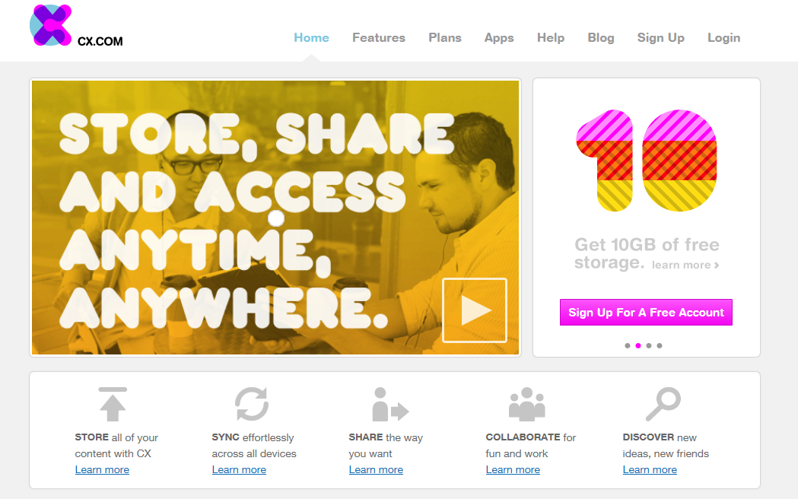
Web 2.0 and You –
What “tools are out there?
Online File Storage – Storage AND Synchronization

Slide 31
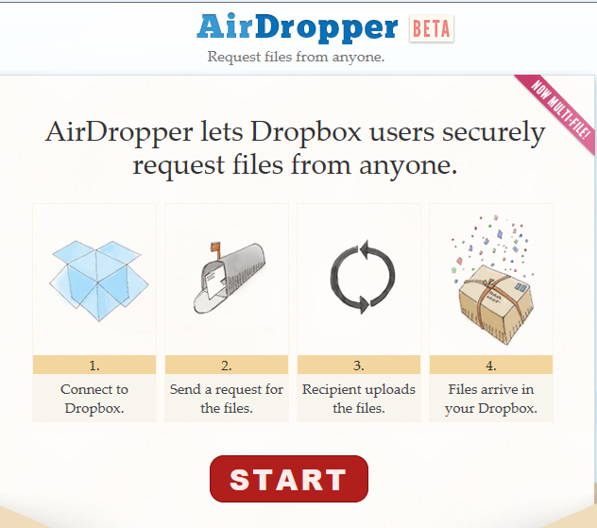
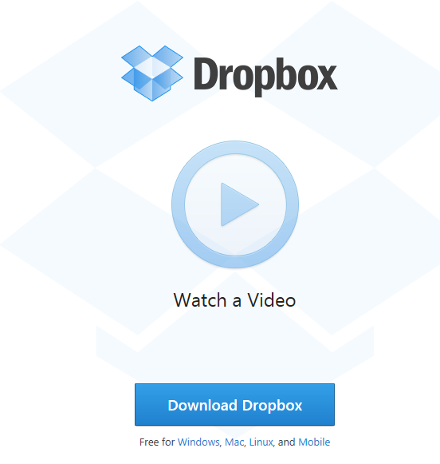
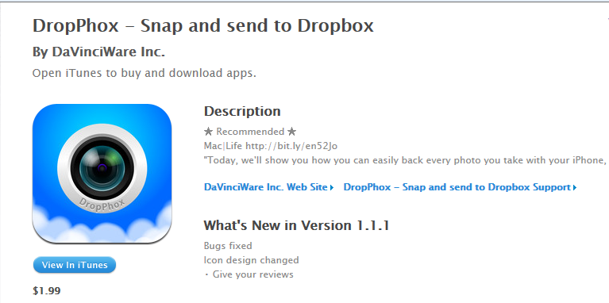
Web 2.0 and You –
What “tools are out there?
2 GB Storage
Notes:
4 million users as of 2010

Slide 32
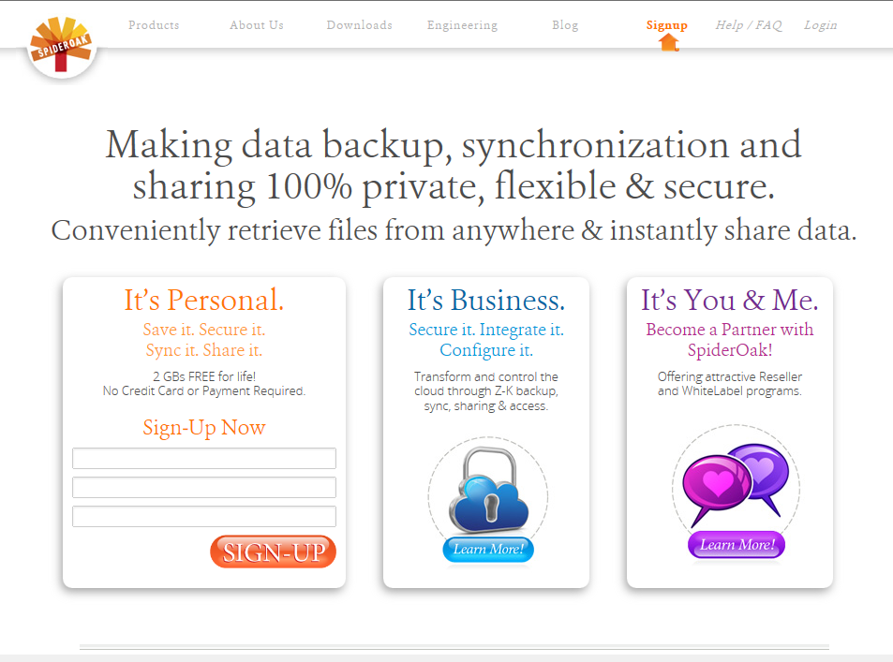
Web 2.0 and You –
What “tools are out there?
SpiderOak
Consolidated online backup, sync, sharing, access & storage solution for Windows, Mac OS X, and Linux. 2 GB for life

Slide 33
Web 2.0 and You –
What “tools are out there?
Collaboration Tools
Criteria for Real Time Online Collaboration Tools:
* No software download is required.
* It’s free.
* No equipment is required other than, in some cases, a microphone. A webcam needs to be optional.
* Multiple users can collaborate at the same time.

Slide 34
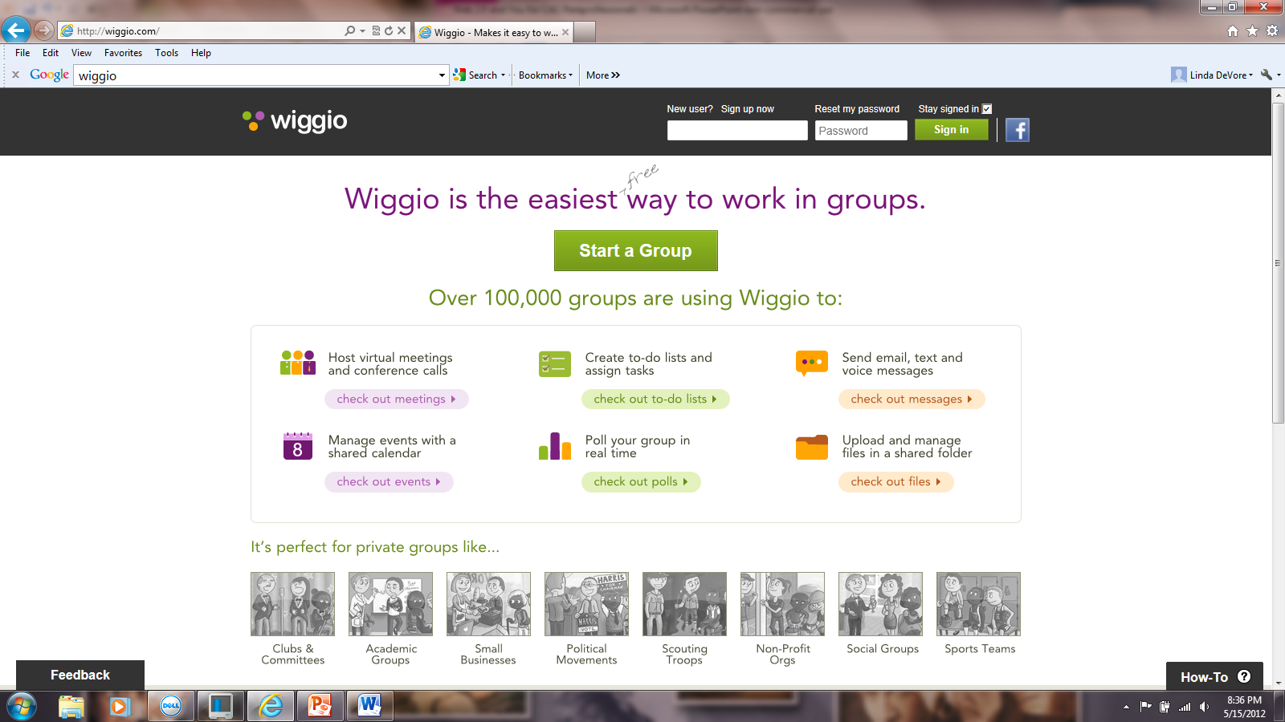
Web 2.0 and You –
What “tools are out there?
Notes:
form online groups and create private listserves and web addresses; shared calendar; send eMail, text, and voice messages; manage files in a shared folder; a to-do list feature, which allows users to assign tasks with due dates to group members, making for mini-projects within a larger project easier and ability of all members to share their computer screens over the network.

Slide 35
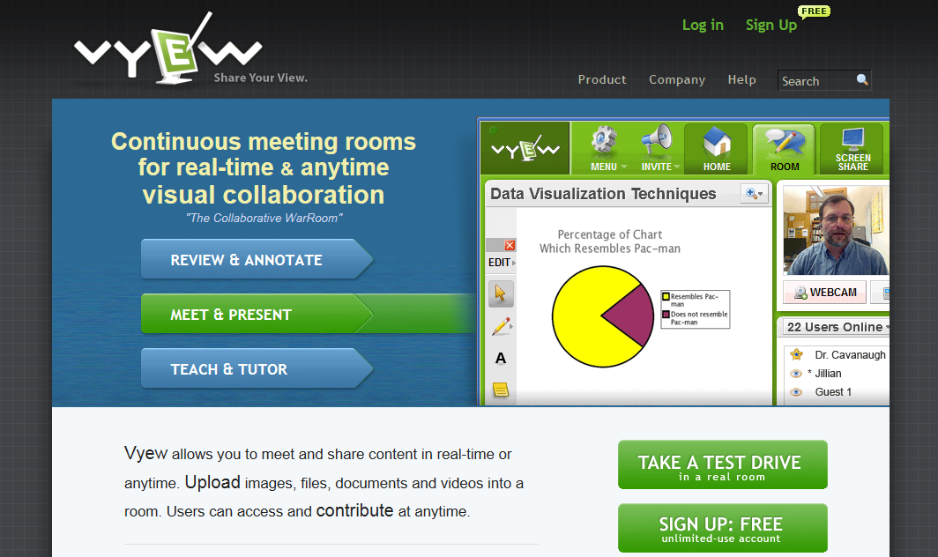
Web 2.0 and You –
What “tools are out there?
Free for up to 10 people. Options for chat or talk.

Slide 36
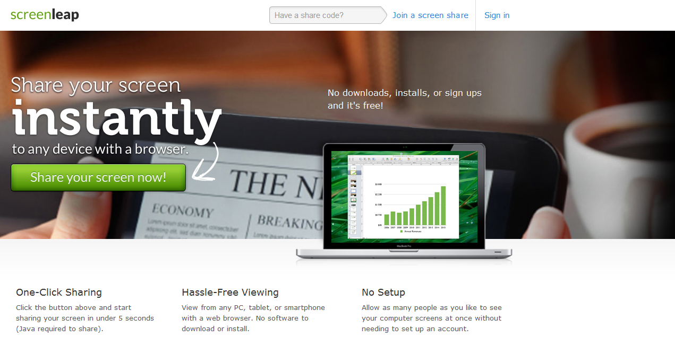
Web 2.0 and You –
What “tools are out there?

Slide 37
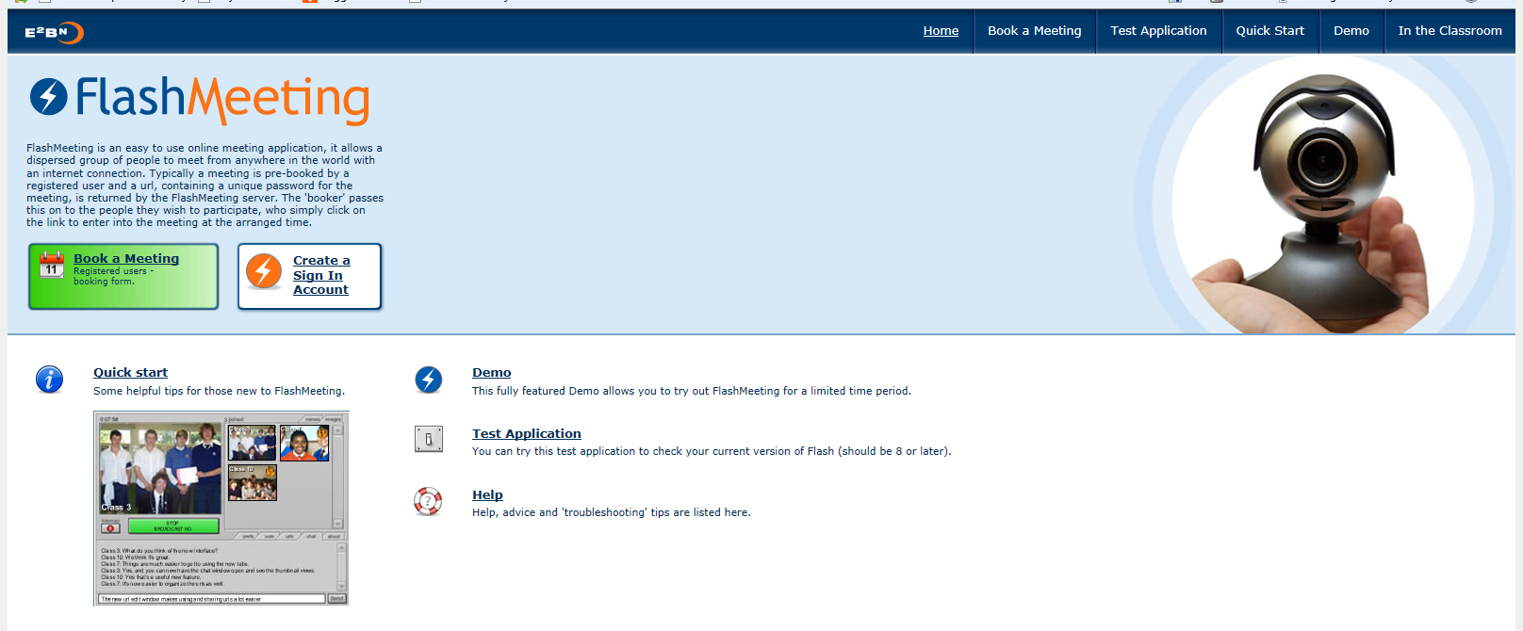
Web 2.0 and You –
What “tools are out there?
Registered user sets up room sends out invite with URL and password. Chat or webcam accessible.
Record your meeting!

Slide 38
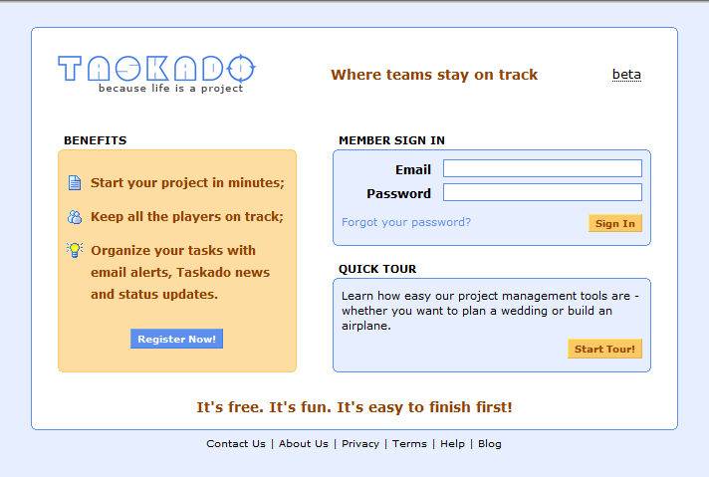
Web 2.0 and You –
What “tools are out there?
Tag items and use the tag cloud to visualize your project
Organize items in folders
Set team member privileges
Attach workflows to tasks
Cross-references items
Edit tracking & history

Slide 39
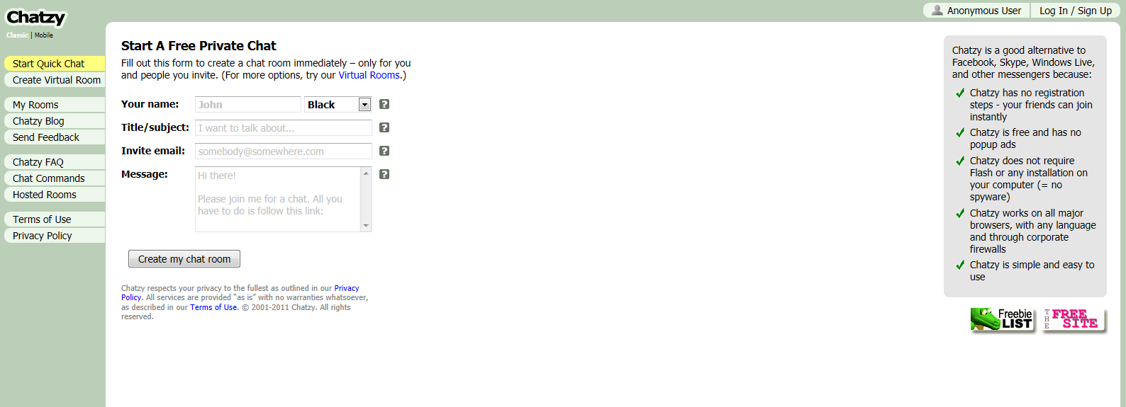
Web 2.0 and You –
What “tools are out there?
Open it up. Send out invites. You can also use videos
from YouTube or Vimeo or an image.

Slide 40
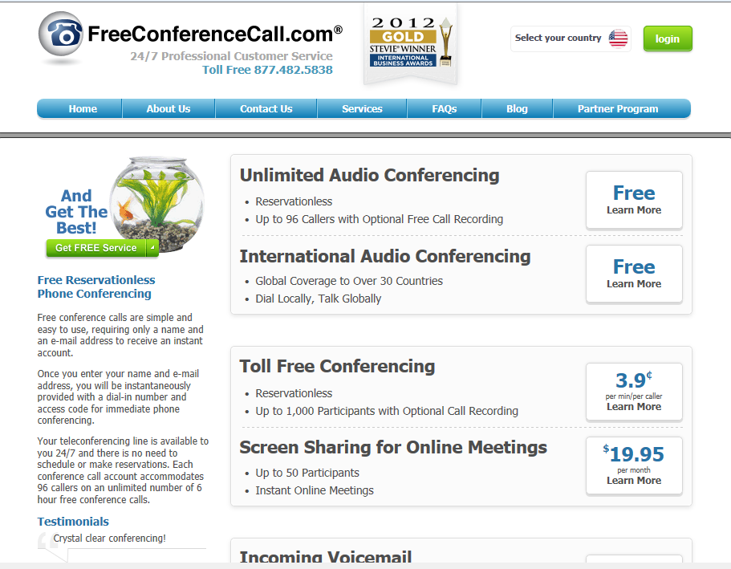
Web 2.0 and You –
What “tools are out there?

Slide 41
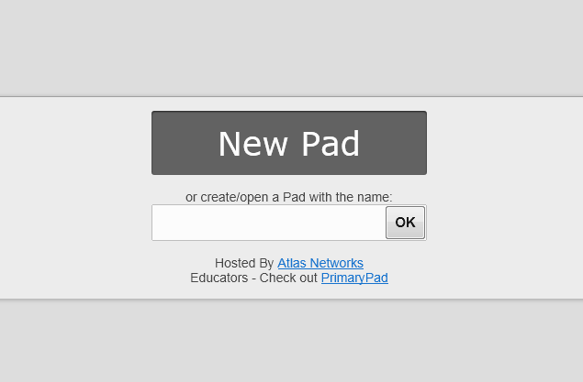
Web 2.0 and You –
What “tools are out there?
Type With Me
Online Text Collaboration Tool
Basic editing tools
Each document viewer sees the text change as it is being edited
Imports and exports
Built-in chat

Slide 42
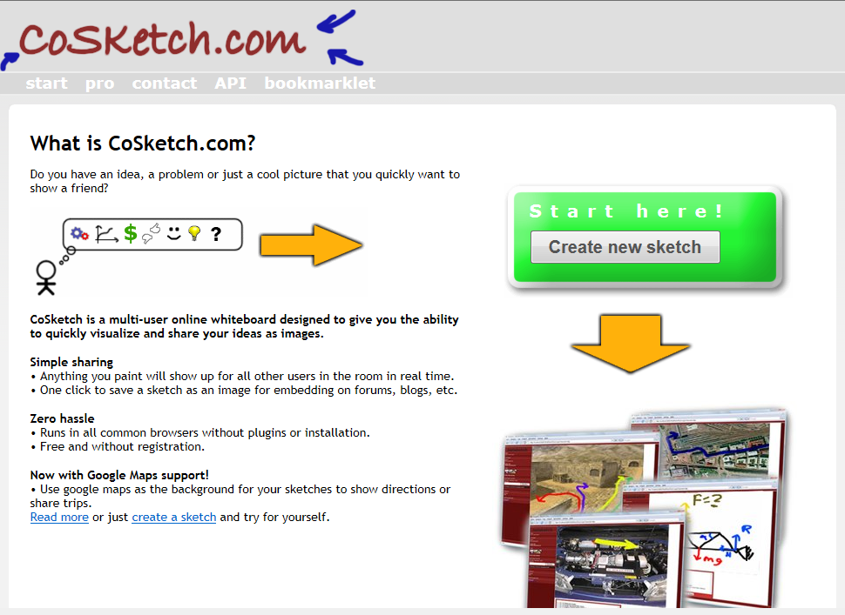
Web 2.0 and You –
What “tools are out there?

Slide 43
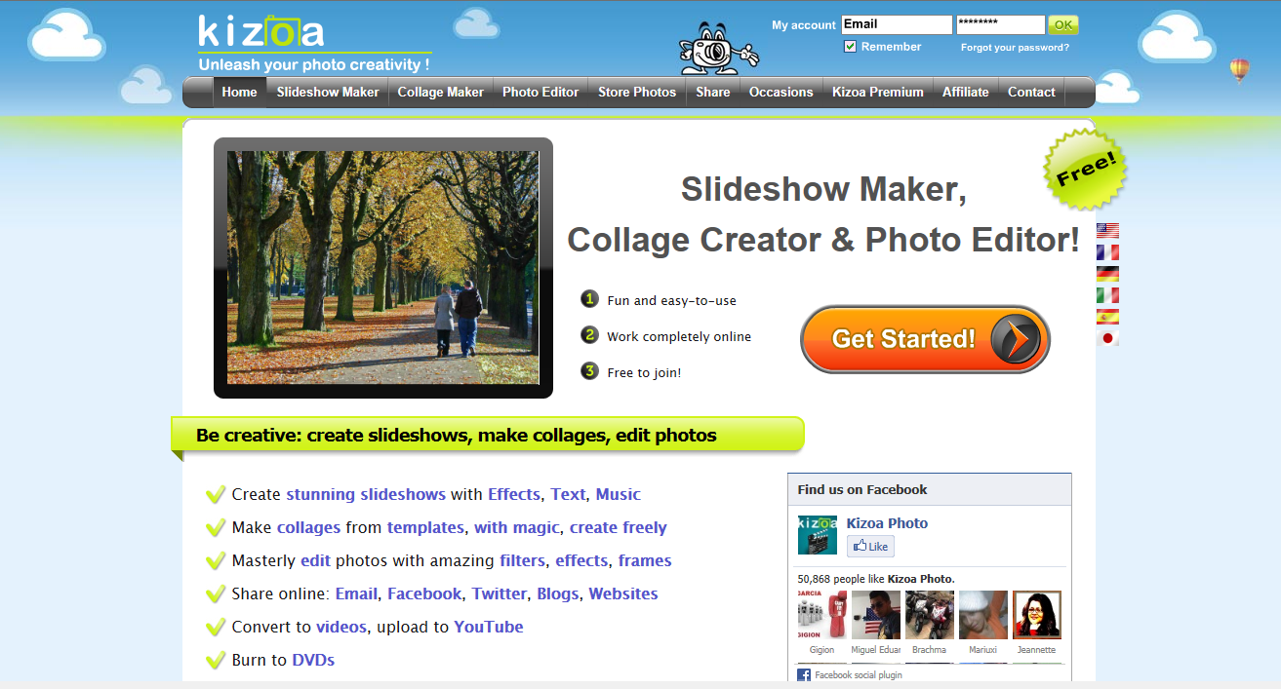
Web 2.0 and You –
What “tools are out there?
Slide Shows:

Slide 44
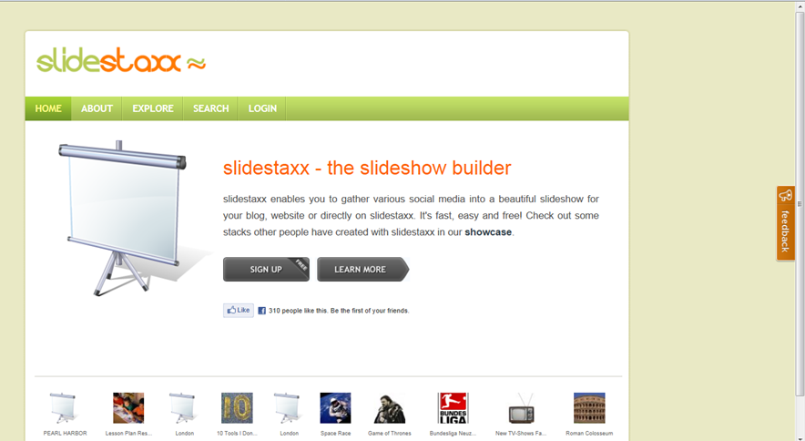
Web 2.0 and You –
What “tools are out there?

Slide 45
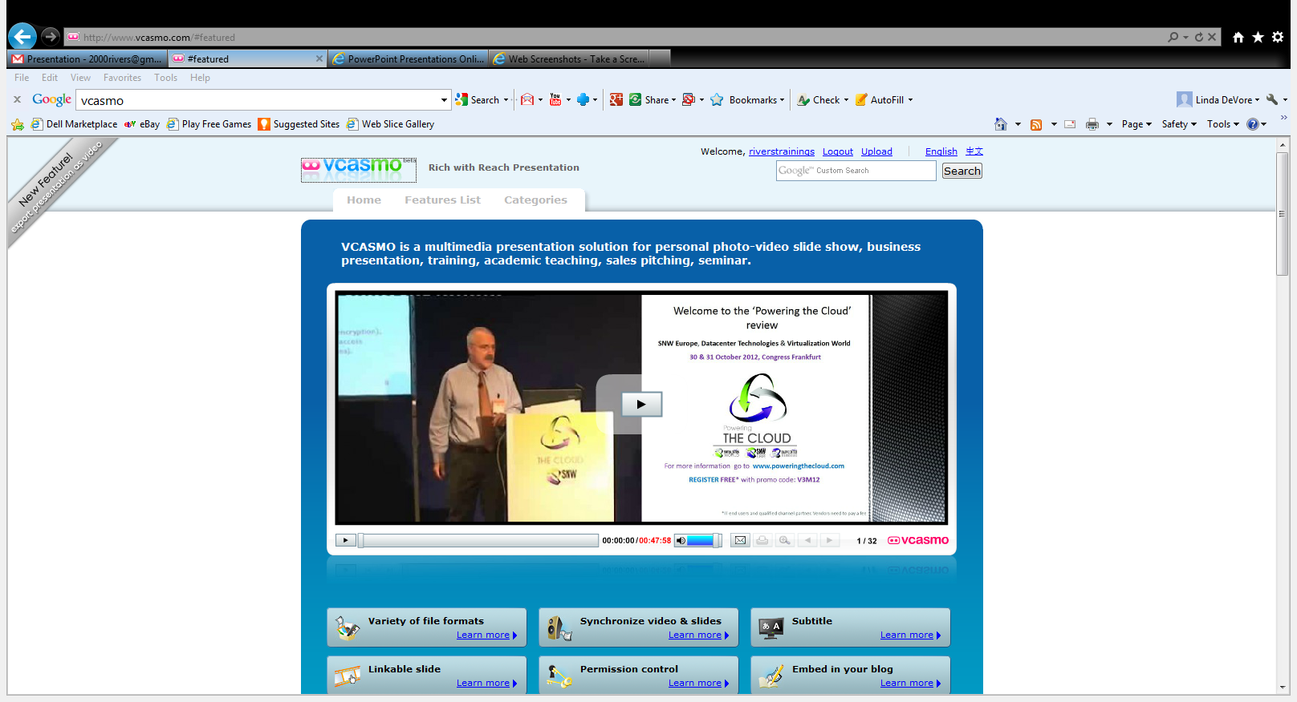
Web 2.0 and You –
What “tools are out there?
Notes:
Click here

Slide 46
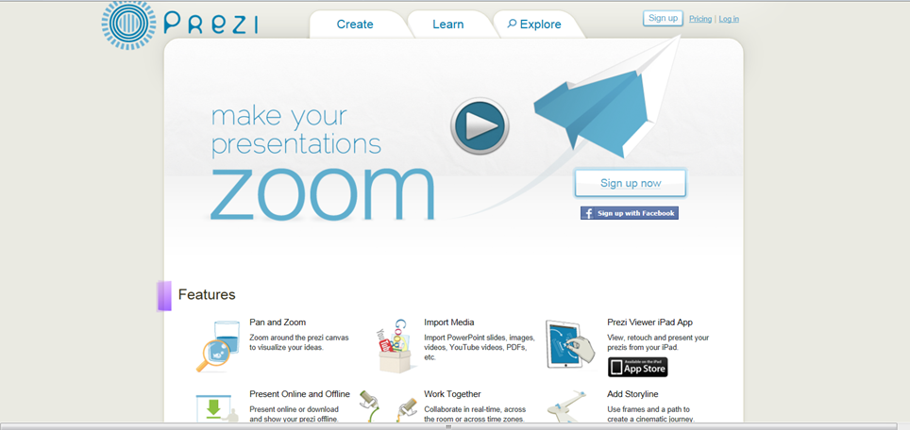
Web 2.0 and You –
What “tools are out there?

Slide 47


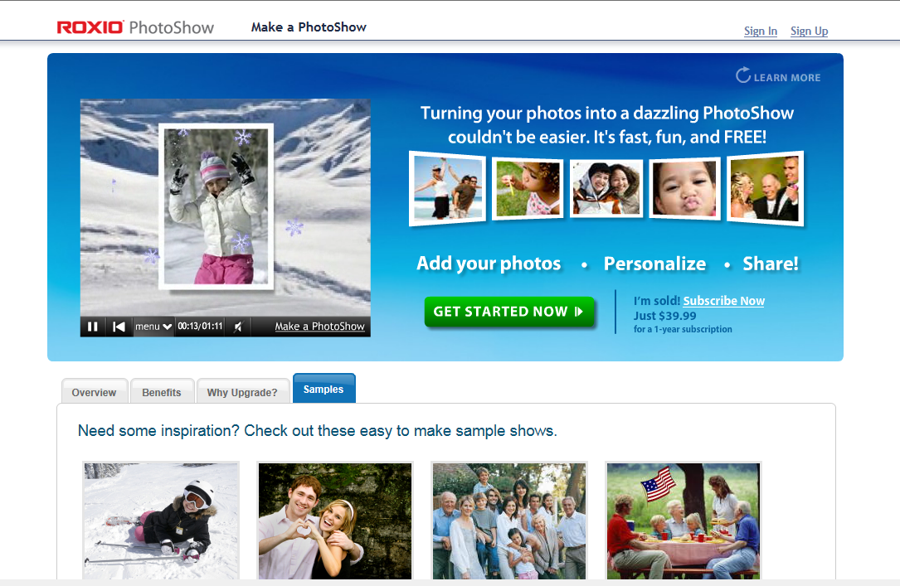
Web 2.0 and You –
What “tools are out there?
Notes:
Click here

Slide 48
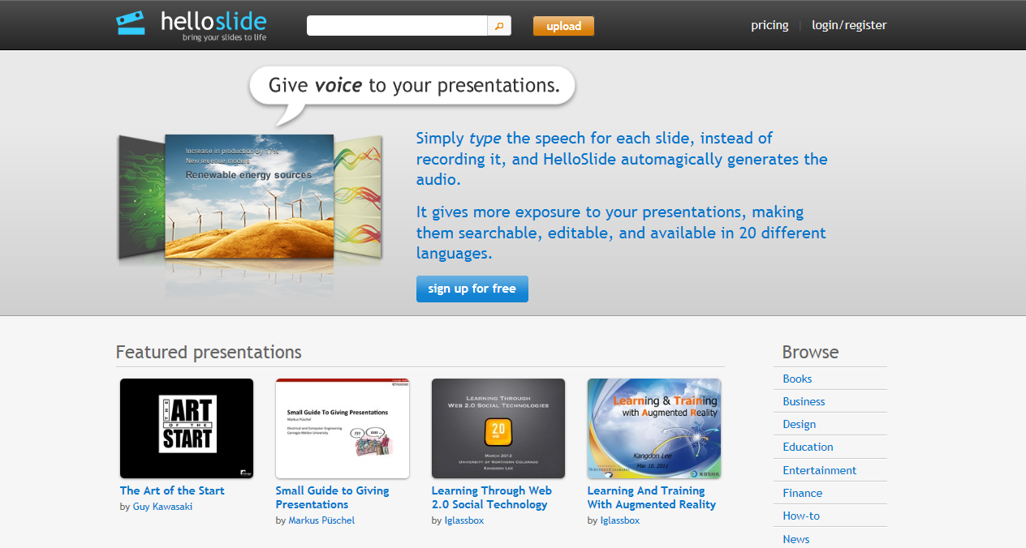
Web 2.0 and You –
What “tools are out there?

Slide 49

Web 2.0 and You –
What “tools are out there?
It's an unlimited "show and tell" for free.
Use it for your business or yourself.
Create voice-over presentations
Make talking photo albums
Upload a video or screencast
Narrate documents
Produce podcasts
Share your content
Buy valuable learning material
Promote what you like

Slide 50

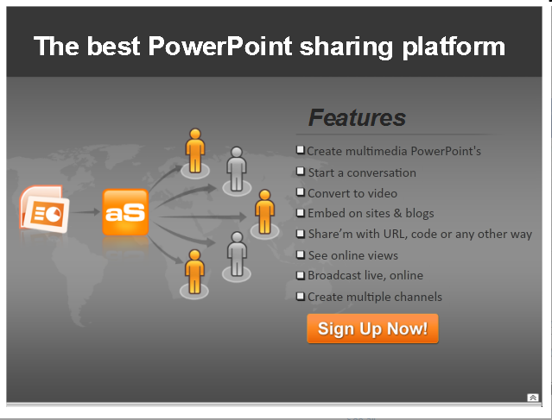
Web 2.0 and You –
What “tools are out there?

Slide 51



Web 2.0 and You –
What “tools are out there?
Alternatives to Google Images:
Free Digital Photos free photos and illustrations
World Images 80,000 images from California State University
WP Clip Art photos and clip art

Slide 52
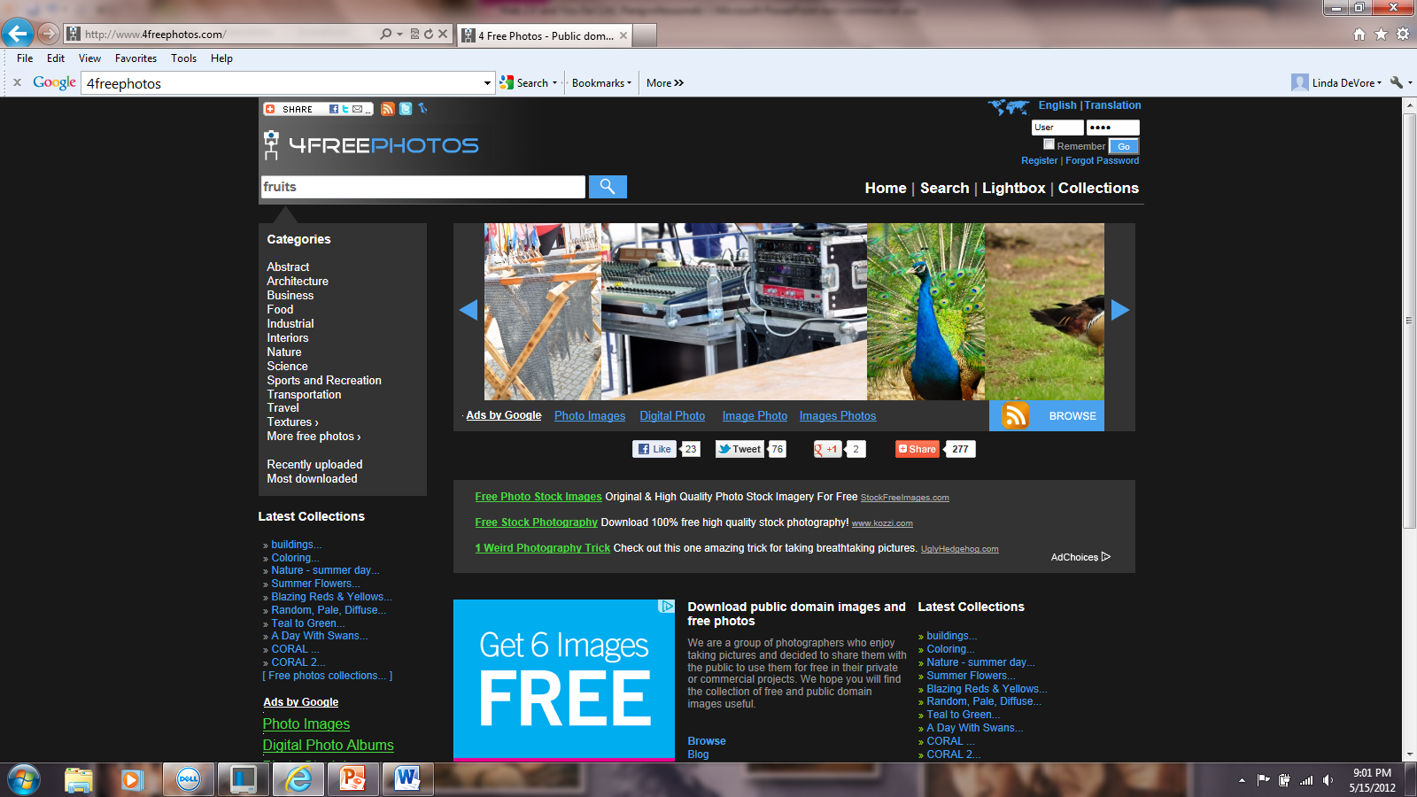
Web 2.0 and You –
What “tools are out there?
Public Domain and free photos from photographers who are willing to share.

Slide 53
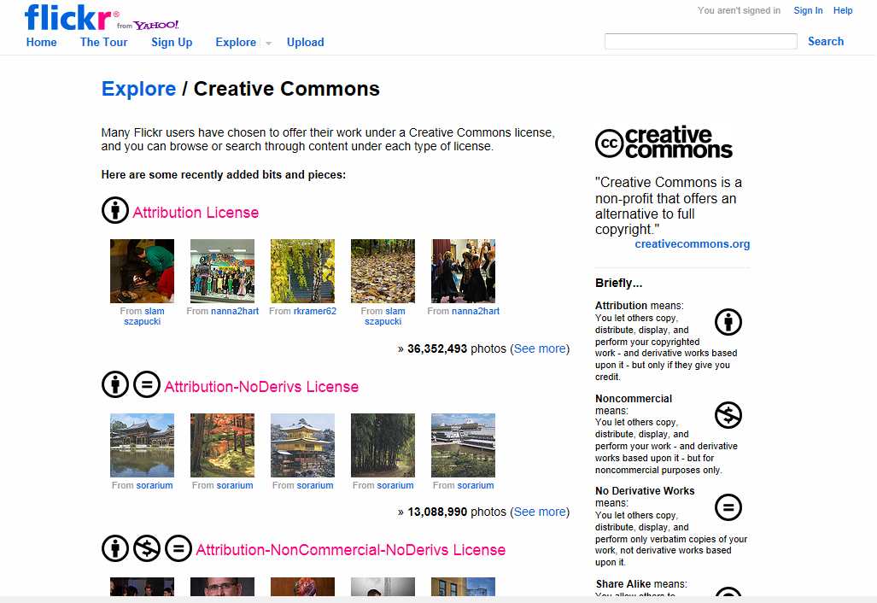
Web 2.0 and You –
What “tools are out there?

Slide 54
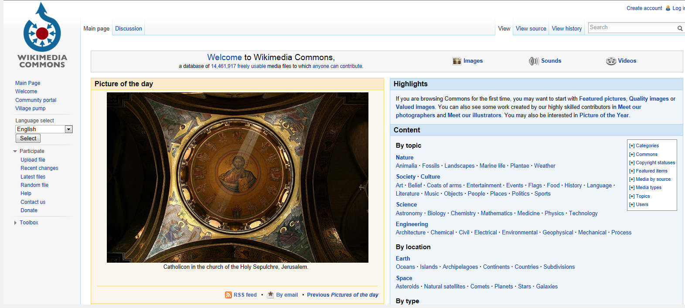
Web 2.0 and You –
What “tools are out there?

Slide 55
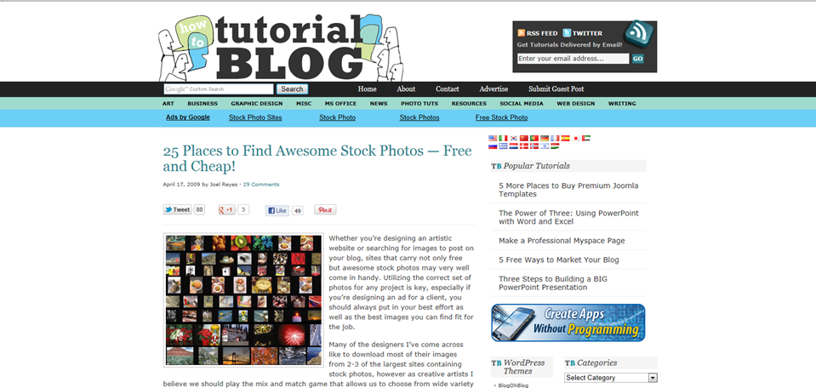
Web 2.0 and You –
What “tools are out there?

Slide 56
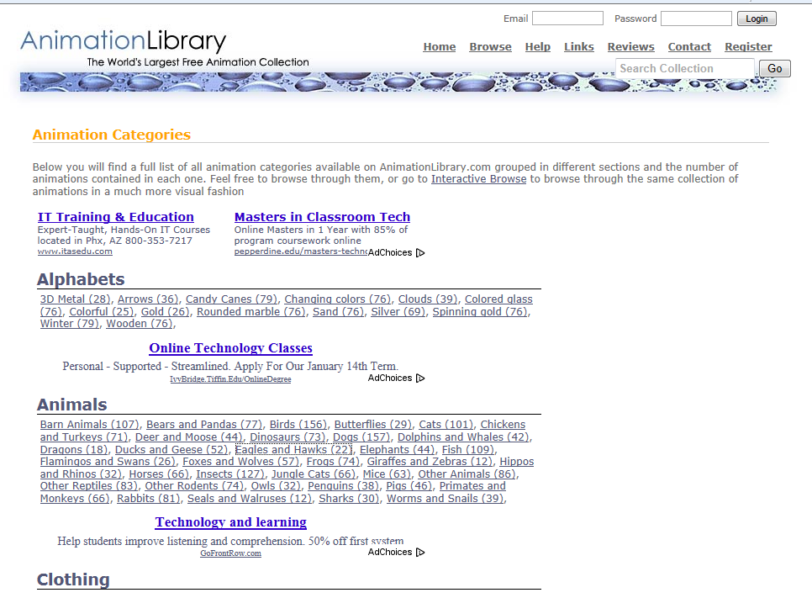
Web 2.0 and You –
What “tools are out there?

Slide 57

Web 2.0 and You –
What “tools are out there?
Photo Editors:
Notes:
Click Pixlr-O-Matic

Slide 58

Web 2.0 and You –
What “tools are out there?
Notes:
effects, fonts, shapes, distortions, doodling, retouching, layers, recolor, morphing, and curves

Slide 59

Web 2.0 and You –
What “tools are out there?

Slide 60

Web 2.0 and You –
What “tools are out there?

Slide 61

Web 2.0 and You –
What “tools are out there?

Slide 62

Web 2.0 and You –
What “tools are out there?

Slide 63

Web 2.0 and You –
What “tools are out there?

Slide 64

Web 2.0 and You –
What “tools are out there?

Slide 65

Web 2.0 and You –
What “tools are out there?

Slide 66

Web 2.0 and You –
What “tools are out there?
Notes:
Click here!

Slide 67

Web 2.0 and You –
What “tools are out there?
Create banners, buttons, signs, license plates, bling and a host of other graphics.

Slide 68

Web 2.0 and You –
What “tools are out there?
Video Tools:
Free streaming video software– you can easily record all your screen and audio activities

Slide 69


Web 2.0 and You –
What “tools are out there?
Instant screencasts: Just click record!

Slide 70

Web 2.0 and You –
What “tools are out there?

Slide 71

Web 2.0 and You –
What “tools are out there?

Slide 72

Web 2.0 and You –
What “tools are out there?

Slide 73

Web 2.0 and You –
What “tools are out there?

Slide 74

Web 2.0 and You –
What “tools are out there?
Bookmark Storage:

Slide 75

Web 2.0 and You –
What “tools are out there?
iKeepBookmarks

Slide 76

Web 2.0 and You –
What “tools are out there?
Only2Clicks

Slide 77

Web 2.0 and You –
What “tools are out there?

Slide 78

Web 2.0 and You –
What “tools are out there?
Notes:
collect and organize anything-- bookmarks, highlights, note, pictures, and screenshots.

Slide 79

Web 2.0 and You –
What “tools are out there?

Slide 80

Web 2.0 and You –
What “tools are out there?

Slide 81


Web 2.0 and You –
What “tools are out there?
Temporary & Disposable Email Addys
Keeps your email for 8 days

Slide 82


Web 2.0 and You –
What “tools are out there?
Lasts 60 minutes only!
Create your own email address then it receives your spam and deletes it in a few hours. Cannot send from this account!

Slide 83

Web 2.0 and You –
What “tools are out there?

Slide 84

Web 2.0 and You –
What “tools are out there?
Miscellaneous Resources:

Slide 85

Web 2.0 and You –
What “tools are out there?

Slide 86

Web 2.0 and You –
What “tools are out there?
On the right are key facts, videos, images,
and websites.

Slide 87

Web 2.0 and You –
What “tools are out there?

Slide 88

Web 2.0 and You –
What “tools are out there?

Slide 89

Web 2.0 and You –
What “tools are out there?
Explore 100 cities, famous landmarks and buildings, museums, campuses, and even outer space!

Slide 90

Web 2.0 and You –
What “tools are out there?
Notes:
video courses and academic lectures from leading colleges and universities

Slide 91

Web 2.0 and You –
What “tools are out there?

Slide 92
Web 2.0 and You –
What “tools are out there?
Popurls – perfect site for the news junkie!
TravelZoo Find bargains in travel in AZ and around the world!
VitalCheck go here for birth, death, marriage and divorce certificates across the US
Howjsay- a free online talking pronunciation dictionary

Slide 93
Web 2.0 and You –
What “tools are out there?
References & Resources I
8 of the Best Online Backup Services for Linux. Auza, Jun. 22 Jul 2011. Tech Source <http://www.junauza.com/2010/06/8-of-best-online-backup-services-for.html >
"40+ Temporary & Disposable Email Services, Quickies!." To the PC. N.p., 105 Apr 2008. Web. 24 Jul 2011. <http://www.tothepc.com/archives/40-temporary-disposable-email-services-quickies/>.
Chan, Min Li, Fritz Holznagel, and Michael Krantz. "20 Things I Learned About Browsers and the Web." Google, 2010. Web. 22 Jul 2011. <http://www.20thingsilearned.com/en-US/>.

Slide 94
Web 2.0 and You –
What “tools are out there?
References & Resources II
"Cloud computing." Wikipedia. 2011. Web. <http://en.wikipedia.org/wiki/Cloud_computing>.
Fitzppatrick, Jason. "Five Best Bookmark Management Tools." Lifehackers. 15 May 2010. Web. 23 Jul 2011. <http://lifehacker.com/5540019/five-best-bookmark-management-tools>.
Griffith, Eric. "The Best Free Web Apps of 2011." PC Magazine. N.p., 13 Jul 2011. Web. 22 Jul 2011. <http://www.pcmag.com/article2/0,2817,2388384,00.asp>.

Slide 95
Web 2.0 and You –
What “tools are out there?
References & Resources III
Guay, Stephen . "100 Web Apps to Rule Them All." App Storm. N.p., 31 May 2011. Web. 23 Jul 2011. <http://web.appstorm.net/roundups/100-web-apps-to-rule-them-all/>.
Karaoğlu, Özge. "A-Z Web tools:A+B." TL Advisor Blog . Tech Learning, 22 Jan 2011. Web. 24 Jul 2011. <http://www.techlearning.com/blogs/35972>.
Karaoğlu, Özge. "A-Z Web tools:C+D." TL Advisor Blog . Tech Learning, 02 Mar 2011. Web. 03 Mar 2011. <http://www.techlearning.com/blogs/37254>.
Verhellen, Eva. “Web ?.0.” Stageblog. Web. 22 Nov 2009.

