Slide 1
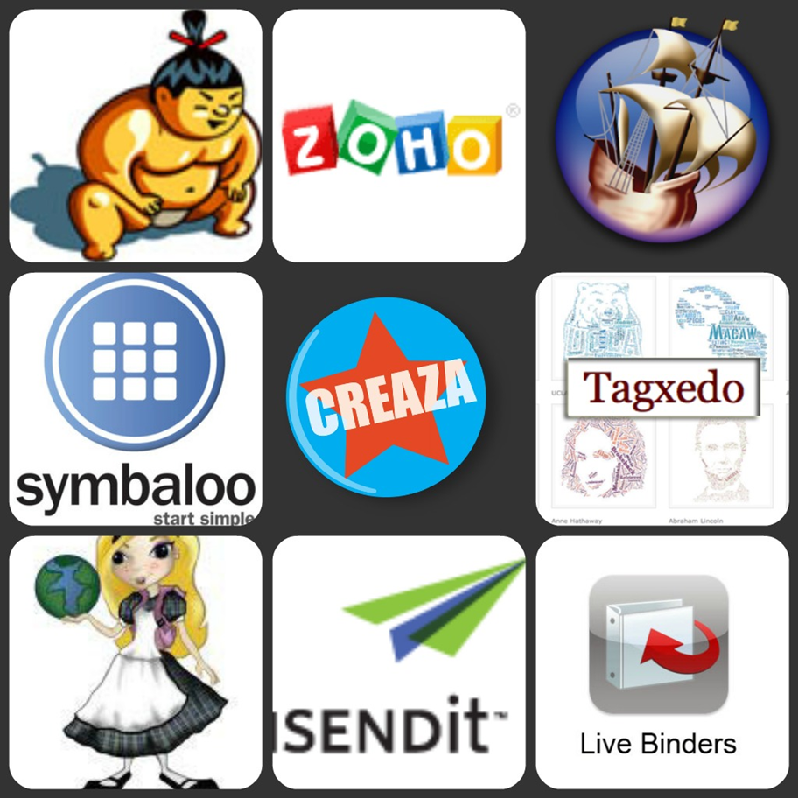

Slide 2

Web 2.0 and You –
What “tools” are out there?
Presented by
Linda DeVore
October 27, 2012

Slide 3

Web 2.0 and You –
What “tools are out there?
Today’s Agenda:
Office and Business Apps
File Storage
Collaboration Tools
Slide Show Tools
Images
Photo Editors/Tools
Video Tools
Bookmark/Favorites Storage
Disposable Email Addys

Slide 4


Slide 5

Web 2.0 and You –
What “tools are out there?
What is Web 2.0 and how is it different from the “web”?

Slide 6

Web 2.0 and You –
What “tools are out there?

Slide 7
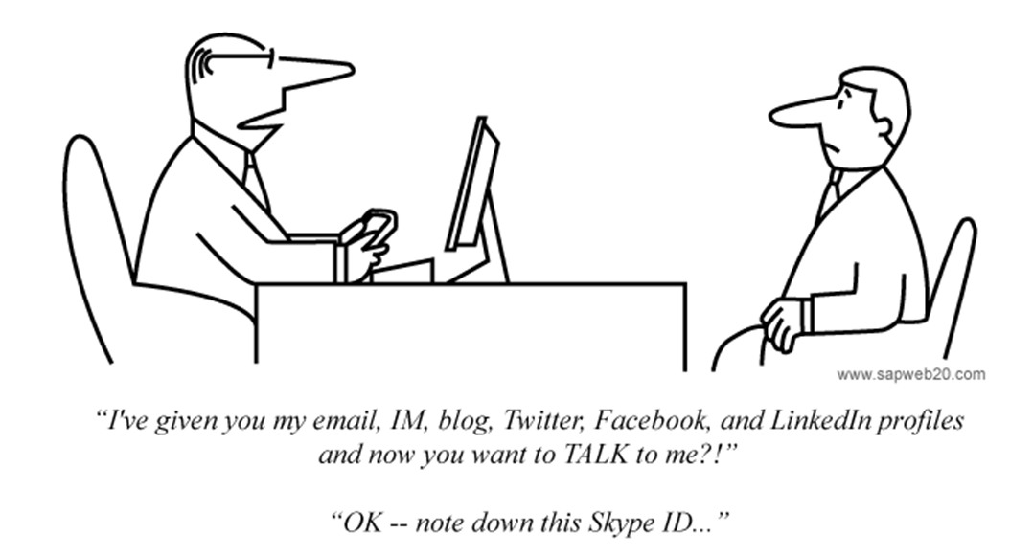
Web 2.0 and You –
What “tools are out there?

Slide 8

Web 2.0 and You –
What “tools are out there?
What is the “cloud”?

Slide 9
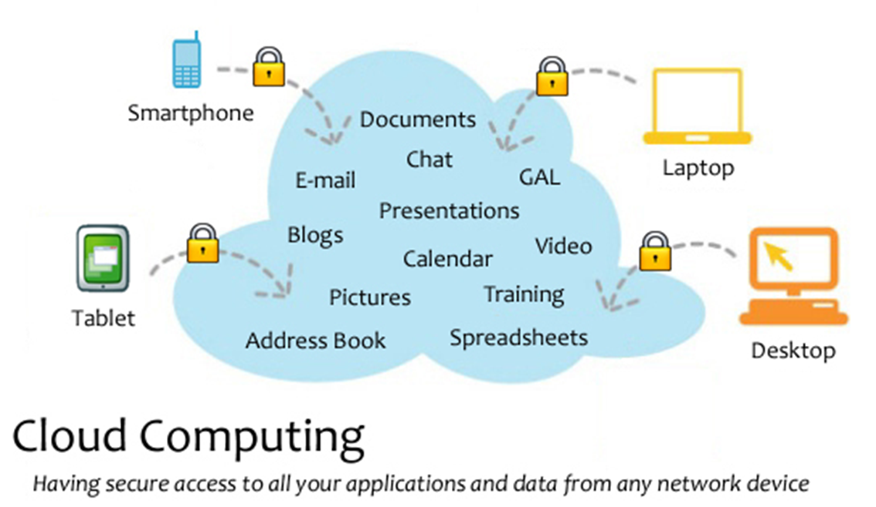
Web 2.0 and You –
What “tools are out there?

Slide 10

Web 2.0 and You –
What “tools are out there?
Started in 1990 originally only included Word, Excel, and PowerPoint.
As of 2009 eighty percent of enterprises were using some form of Office.
Microsoft 2013 is coming out soon & will be $140 to $400 will run on computers and tablets
What can be used as a substitute???

Slide 11

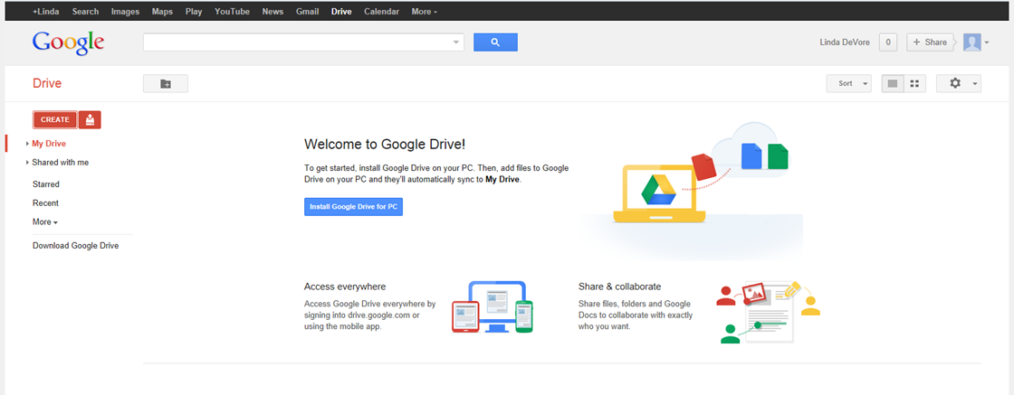
Web 2.0 and You –
What “tools are out there?

Slide 12

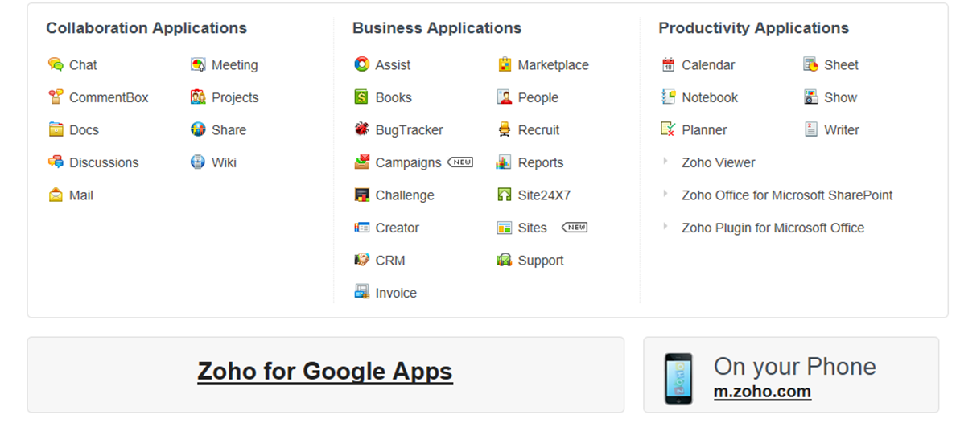
Web 2.0 and You –
What “tools are out there?

Slide 13
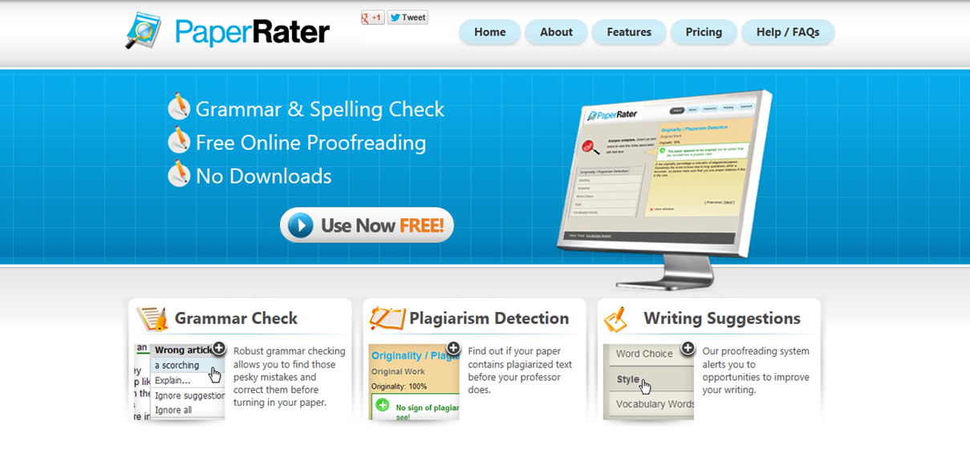
Web 2.0 and You –
What “tools are out there?

Slide 14
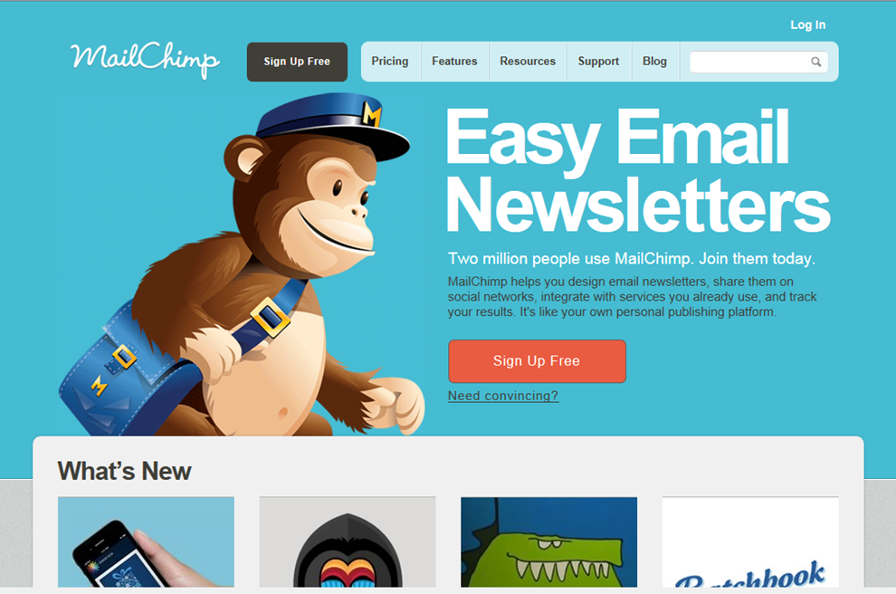
Web 2.0 and You –
What “tools are out there?
Notes:
Free for up to 2,000 subscribers

Slide 15
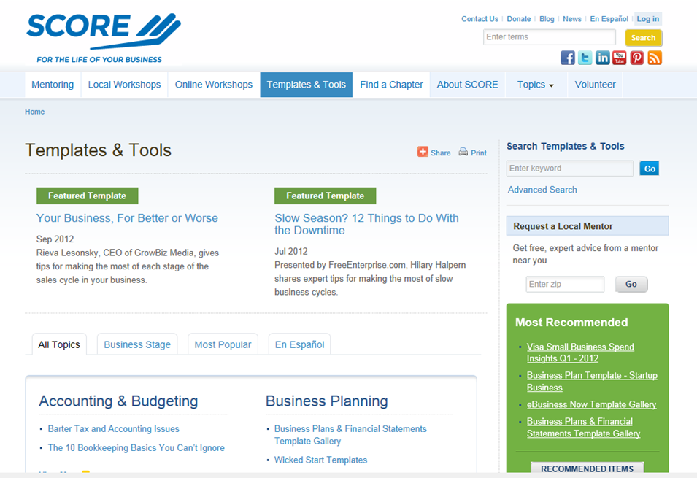
Web 2.0 and You –
What “tools are out there?

Slide 16
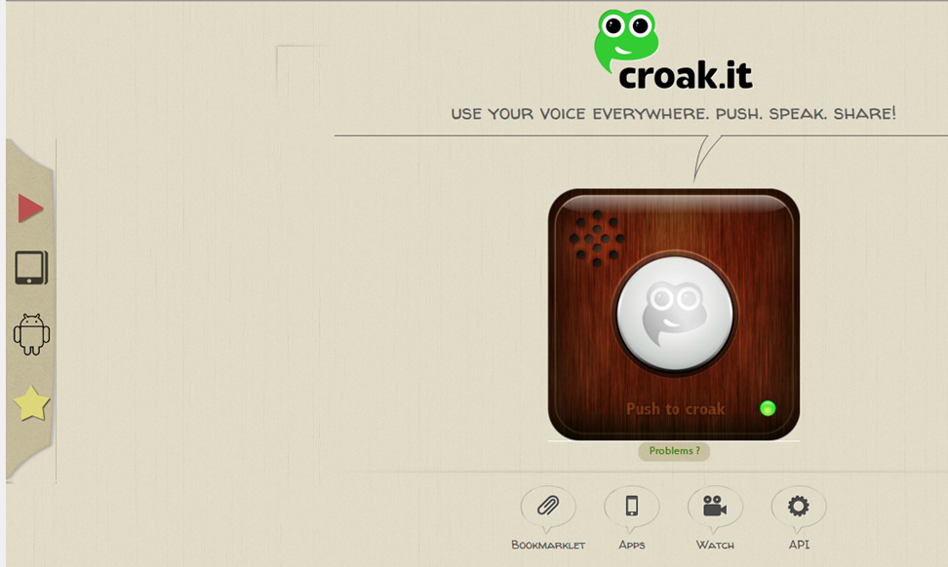
Web 2.0 and You –
What “tools are out there?

Slide 17
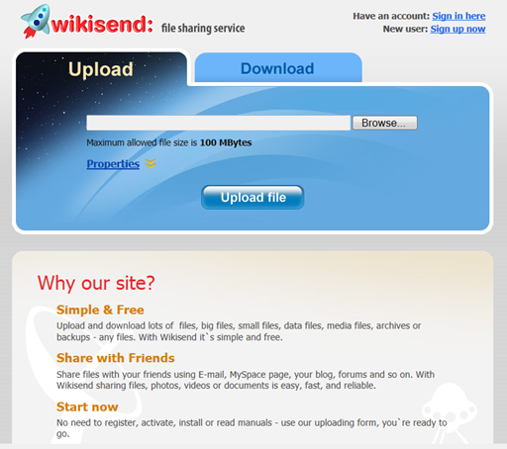
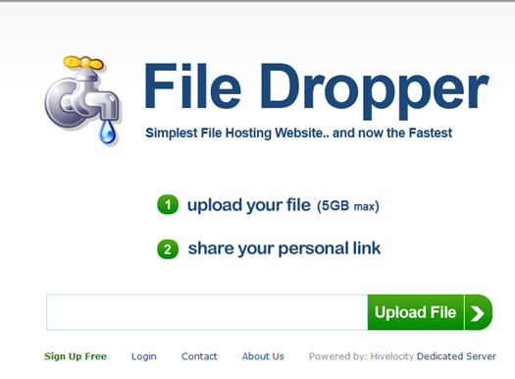
Web 2.0 and You –
What “tools are out there?
Online File Sharing & Storage

Slide 18
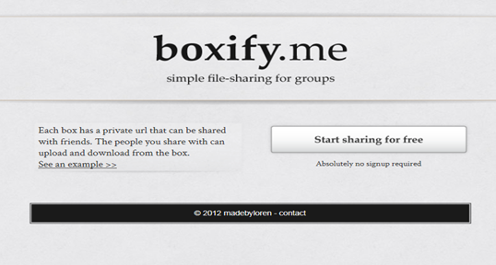
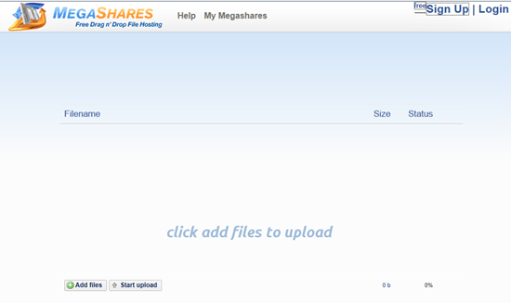
Web 2.0 and You –
What “tools are out there?
Provides a URL for a group to upload & download files.
10 GB Upload Limit

Slide 19
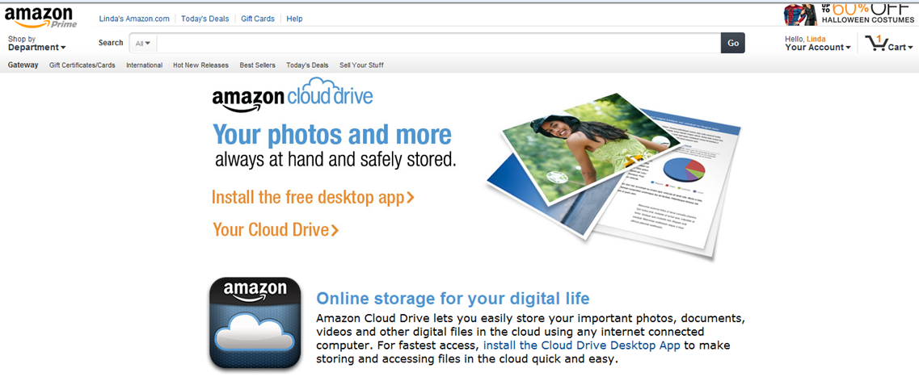
Web 2.0 and You –
What “tools are out there?
5 GB Storage

Slide 20
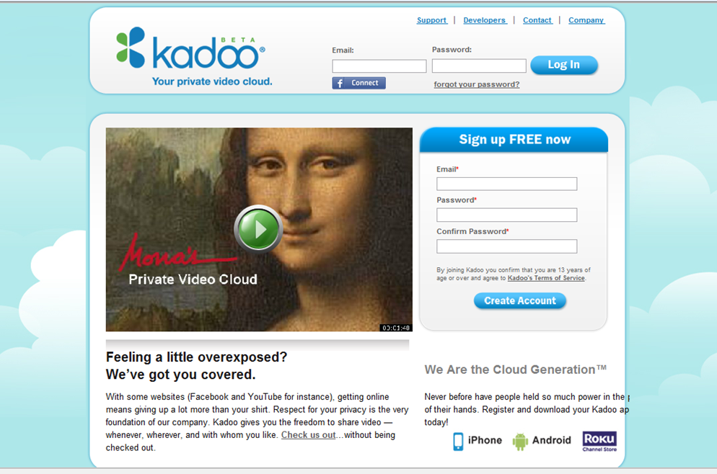
Web 2.0 and You –
What “tools are out there?

Slide 21
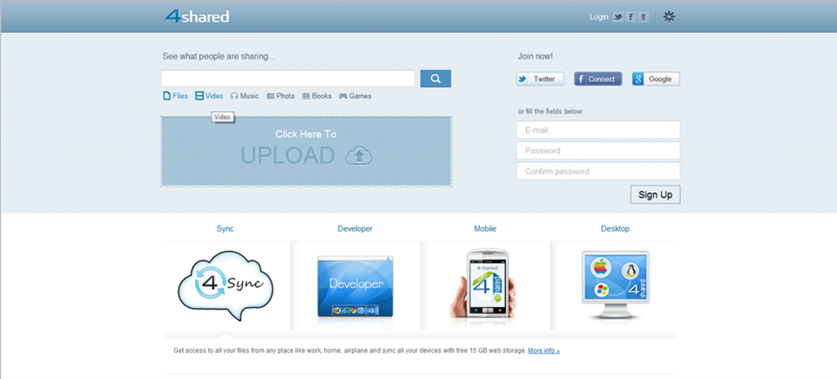
Web 2.0 and You –
What “tools are out there?
Online file sharing and storage - 15 GB free web space. Easy registration. Multiple file transfer. Has a free synchronization program - 4Sync.com.

Slide 22
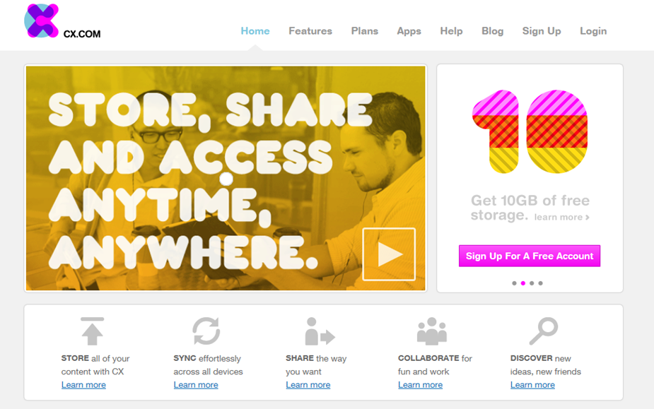
Web 2.0 and You –
What “tools are out there?
Online File Storage – Storage AND Synchronization

Slide 23
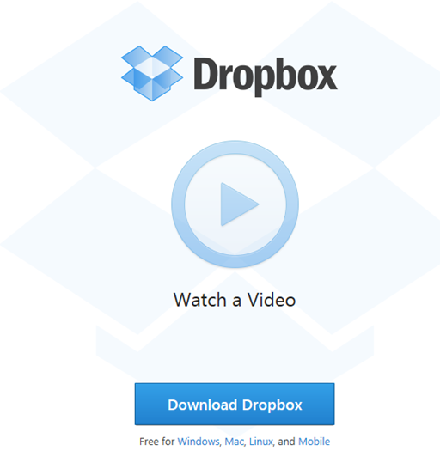
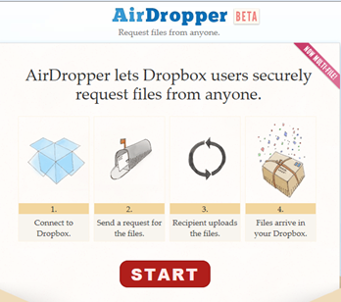
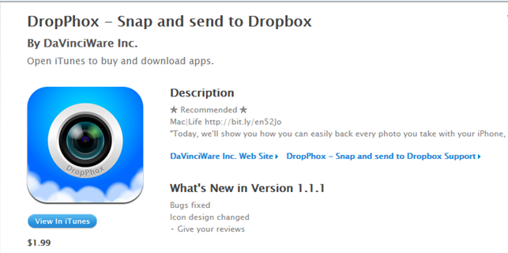
Web 2.0 and You –
What “tools are out there?
2 GB Storage

Slide 24
Web 2.0 and You –
What “tools are out there?
Collaboration Tools
Criteria for Real Time Online Collaboration Tools:
* No software download is required.
* It’s free.
* No equipment is required other than, in some cases, a microphone. A webcam needs to be optional.
* Multiple users can collaborate at the same time.

Slide 25
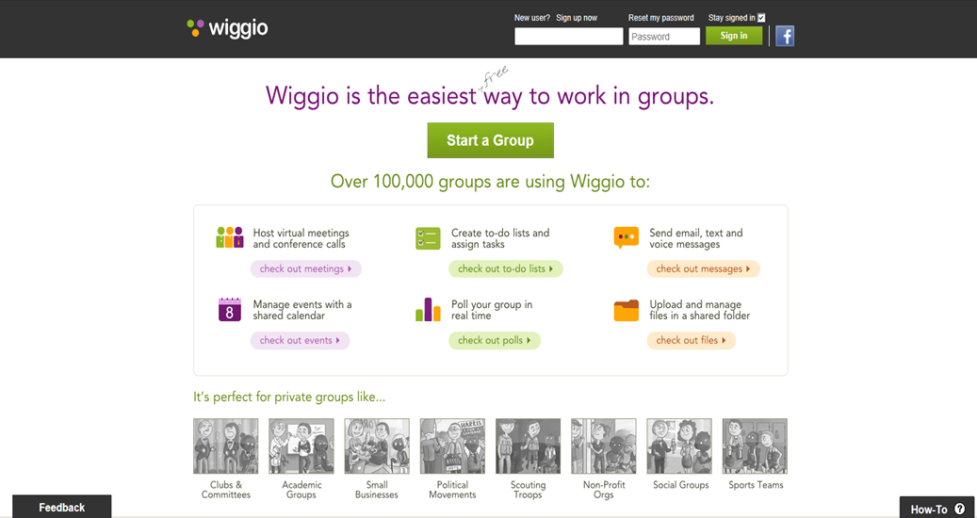
Web 2.0 and You –
What “tools are out there?
Notes:
form online groups and create private listserves and web addresses; shared calendar; send eMail, text, and voice messages; manage files in a shared folder; a to-do list feature, which allows users to assign tasks with due dates to group members, making for mini-projects within a larger project easier and ability of all members to share their computer screens over the network.

Slide 26
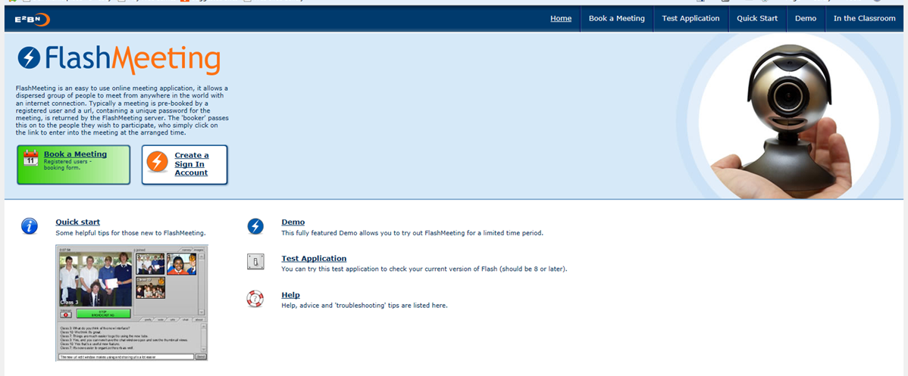
Web 2.0 and You –
What “tools are out there?
Registered user sets up room sends out invite with URL and password. Chat or webcam accessible.
Record your meeting!

Slide 27
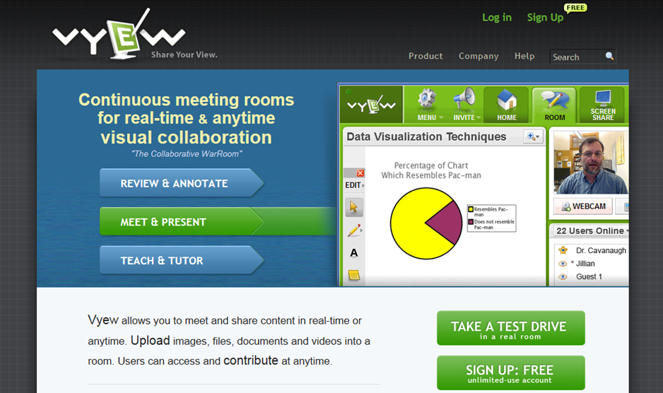
Web 2.0 and You –
What “tools are out there?
Free for up to 10 people. Options for chat or talk.

Slide 28
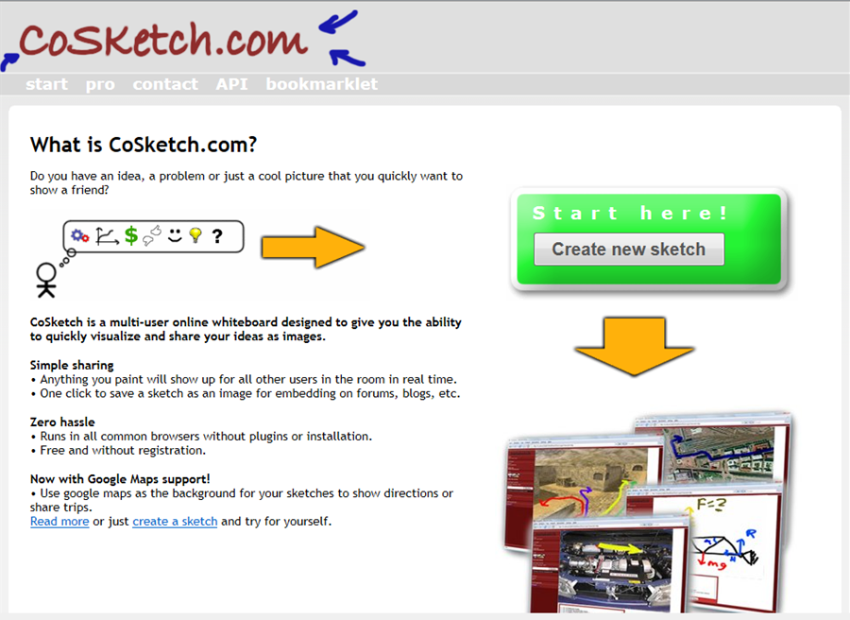
Web 2.0 and You –
What “tools are out there?

Slide 29
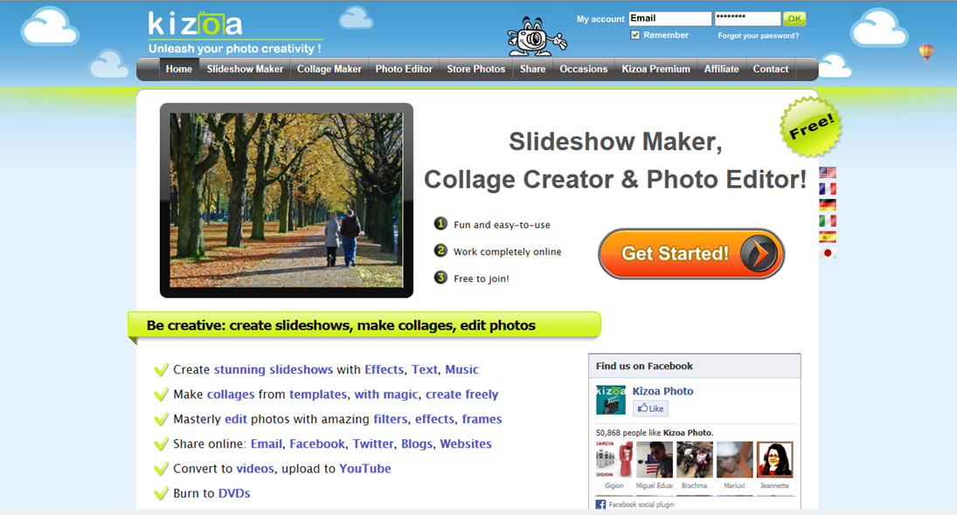
Web 2.0 and You –
What “tools are out there?
Slide Shows:

Slide 30
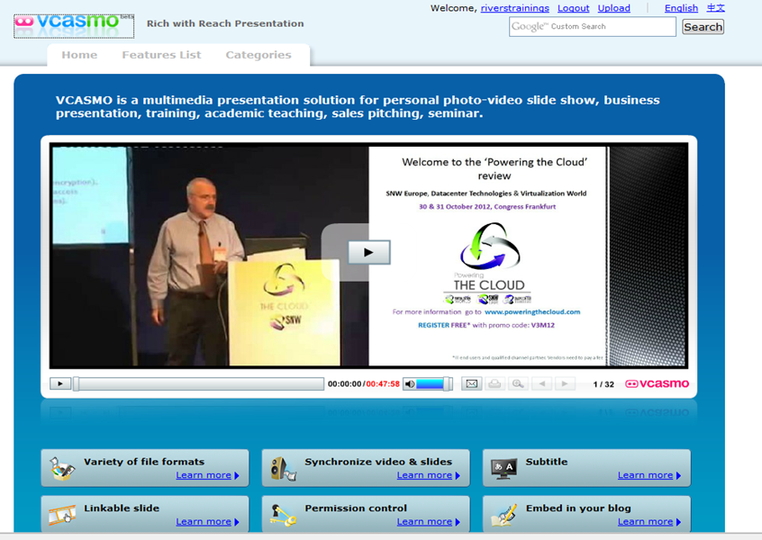
Web 2.0 and You –
What “tools are out there?

Slide 31
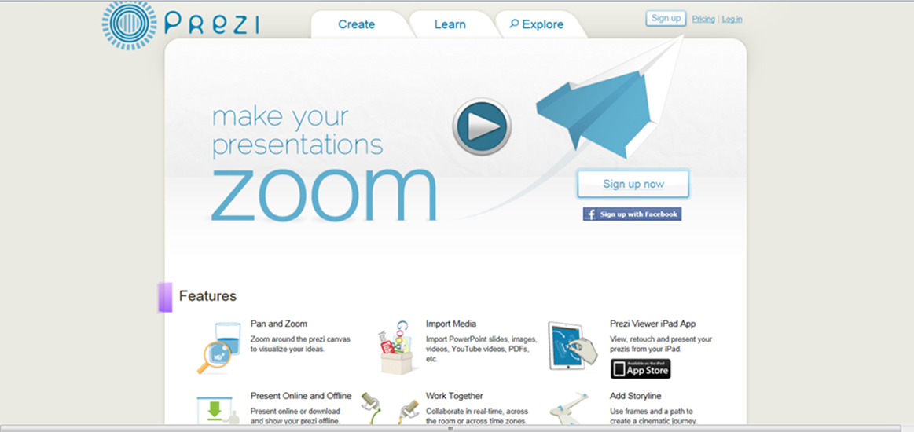
Web 2.0 and You –
What “tools are out there?
PREZI

Slide 32

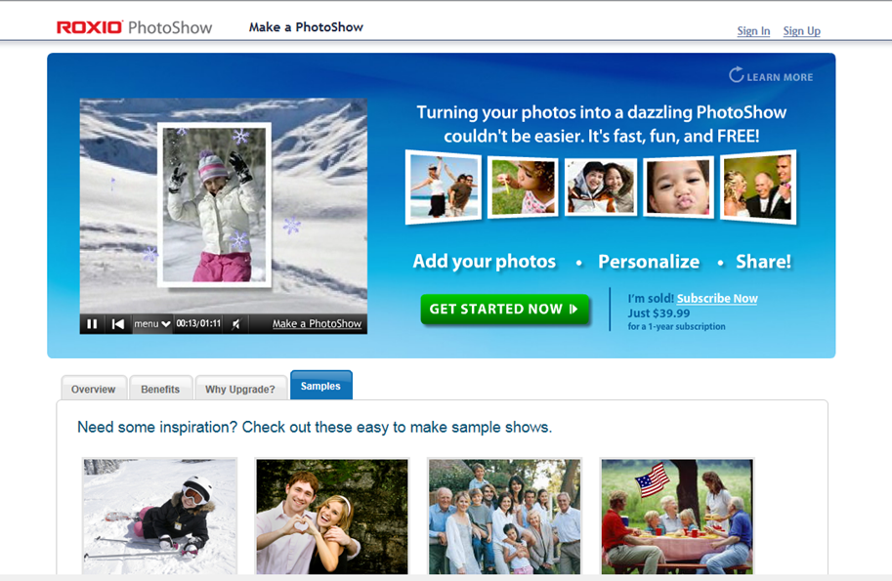
Web 2.0 and You –
What “tools are out there?

Slide 33
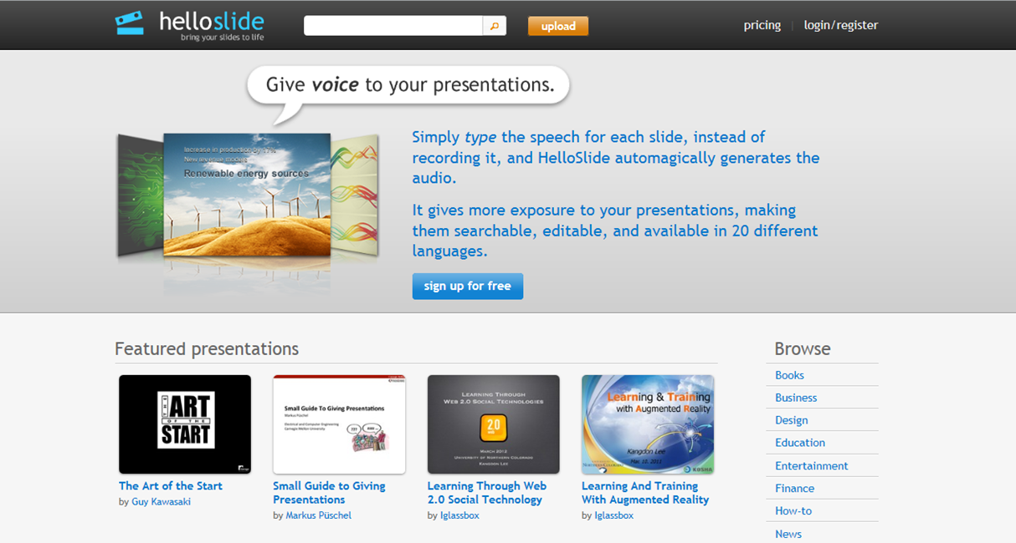
Web 2.0 and You –
What “tools are out there?

Slide 34



Web 2.0 and You –
What “tools are out there?
Alternatives to Google Images:
Free Digital Photos free photos and illustrations
World Images 80,000 images from California State University
WP Clip Art photos and clip art

Slide 35
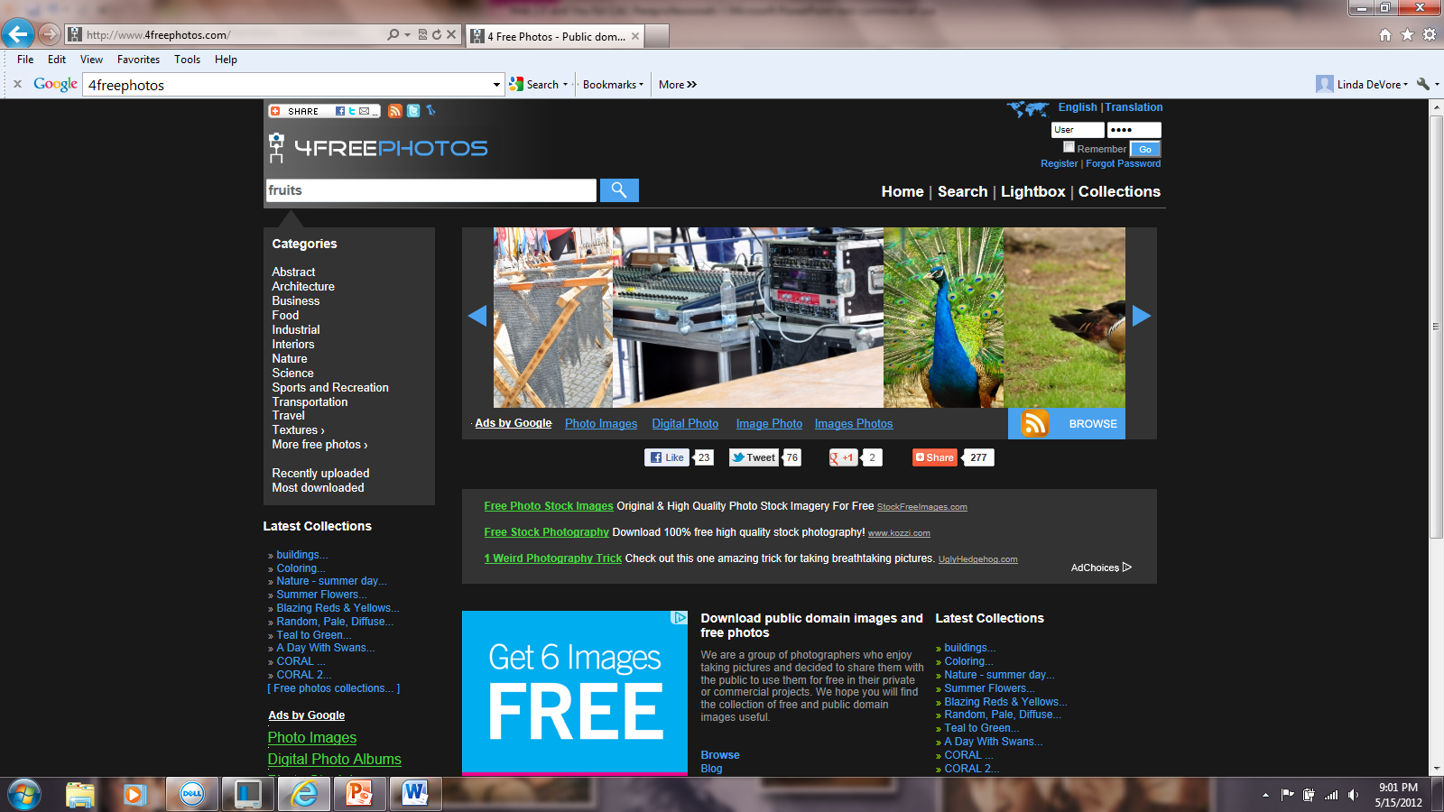
Web 2.0 and You –
What “tools are out there?
Public Domain and free photos from photographers who are willing to share.

Slide 36
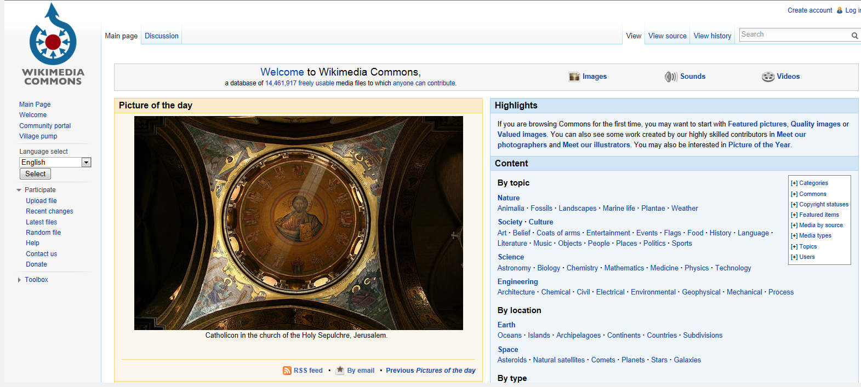
Web 2.0 and You –
What “tools are out there?

Slide 37
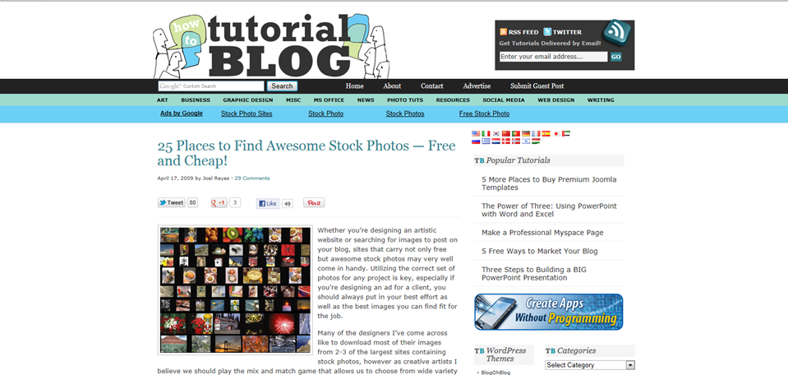
Web 2.0 and You –
What “tools are out there?

Slide 38
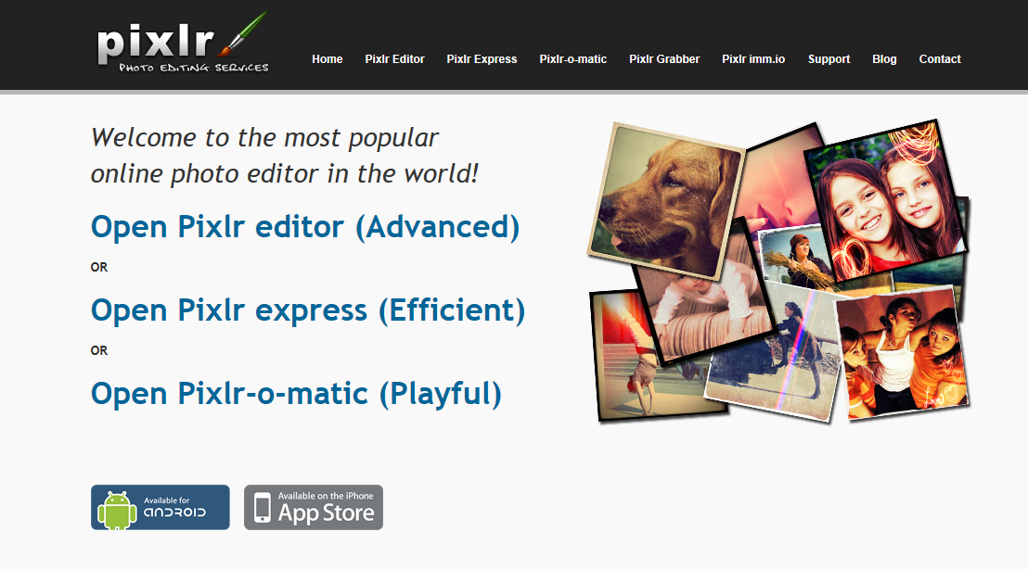
Web 2.0 and You –
What “tools are out there?
Photo Editors:

Slide 39
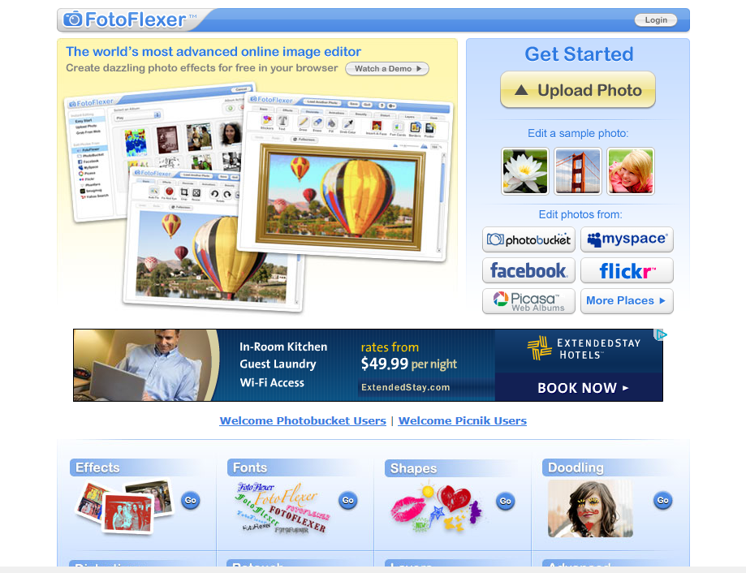
Web 2.0 and You –
What “tools are out there?

Slide 40
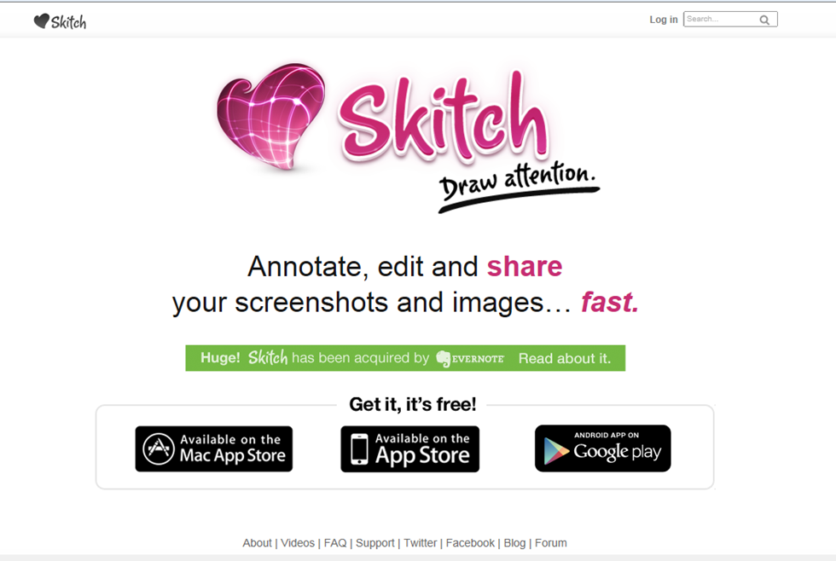
Web 2.0 and You –
What “tools are out there?

Slide 41
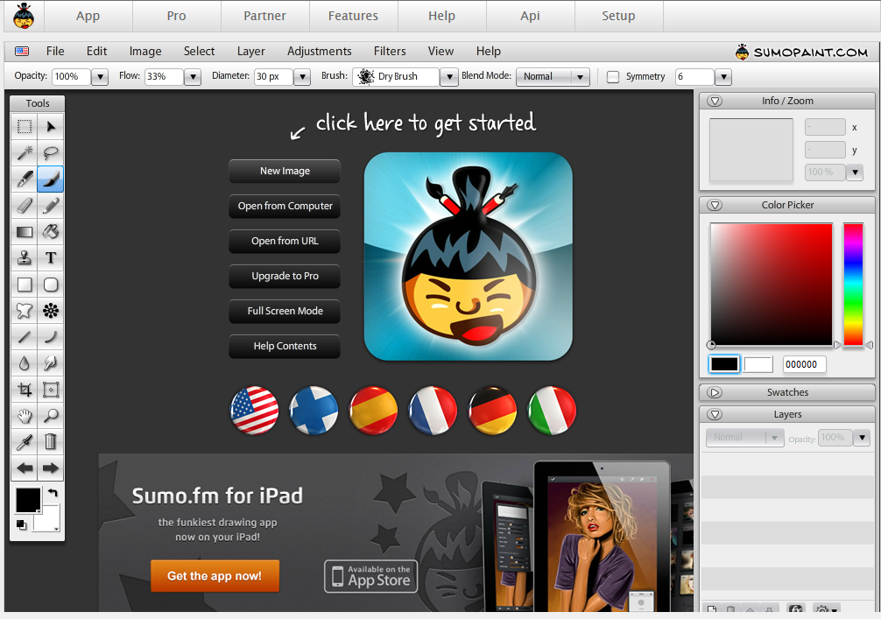
Web 2.0 and You –
What “tools are out there?

Slide 42
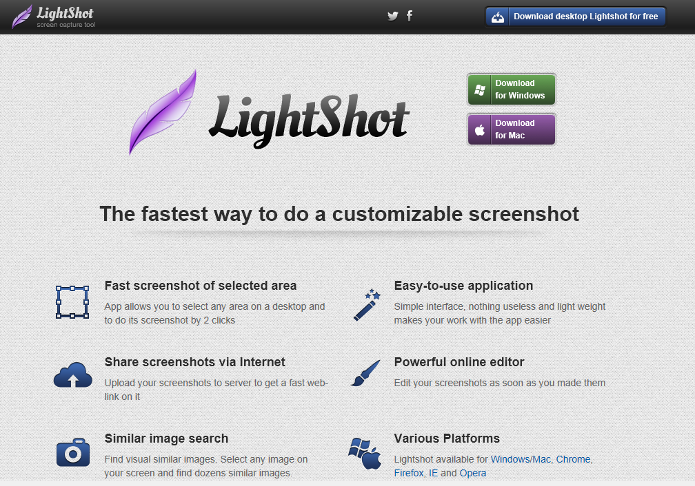
Web 2.0 and You –
What “tools are out there?

Slide 43
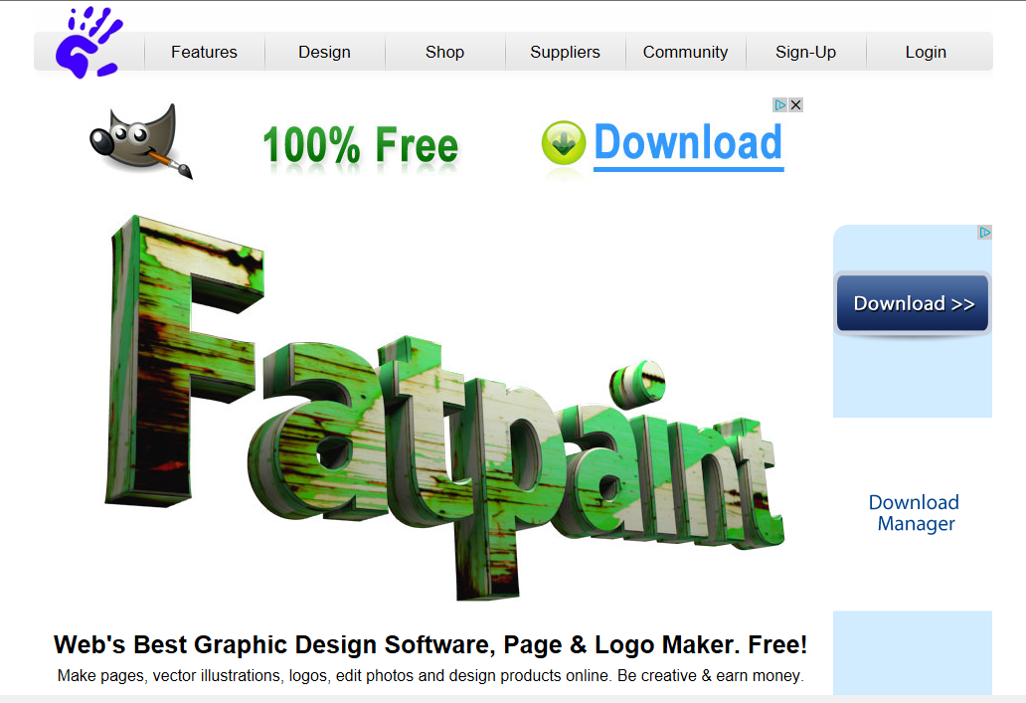
Web 2.0 and You –
What “tools are out there?

Slide 44
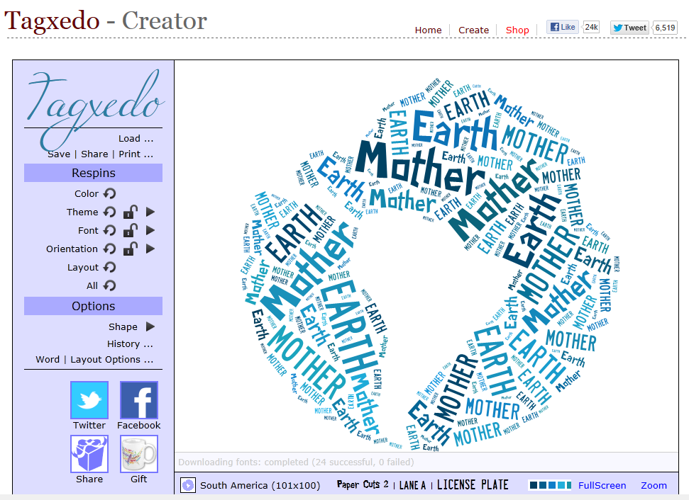
Web 2.0 and You –
What “tools are out there?

Slide 45
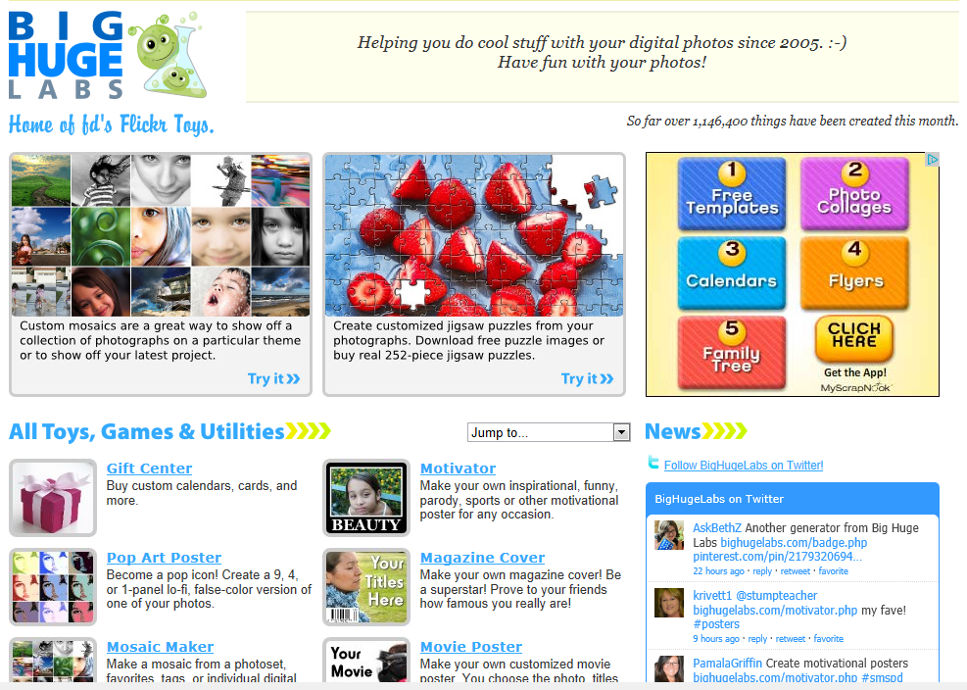
Web 2.0 and You –
What “tools are out there?

Slide 46
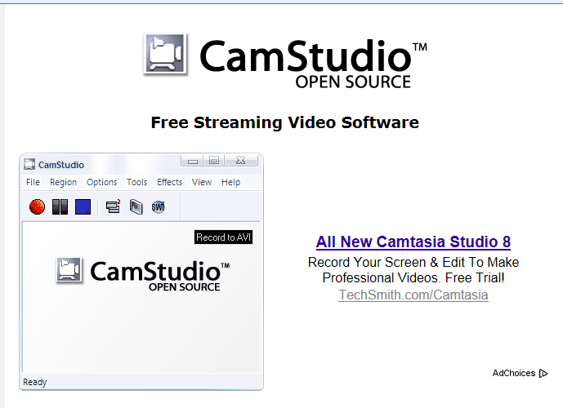
Web 2.0 and You –
What “tools are out there?
Video Tools:
Free streaming video software– you can easily record all your screen and audio activities

Slide 47
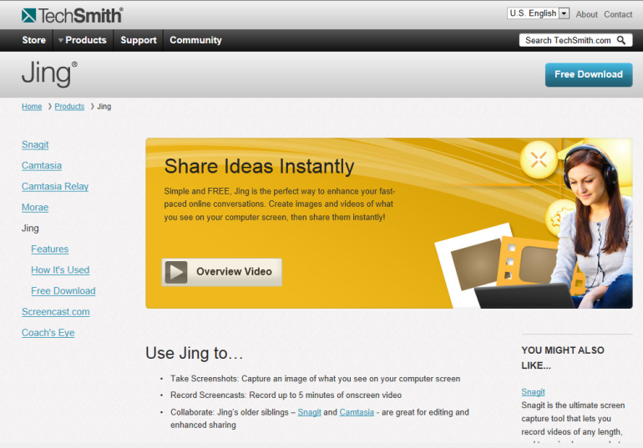
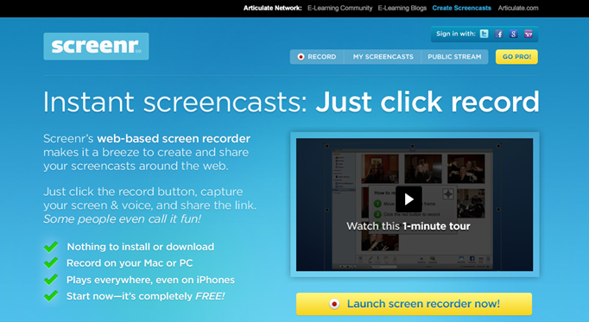
Web 2.0 and You –
What “tools are out there?
Instant screencasts: Just click record!

Slide 48
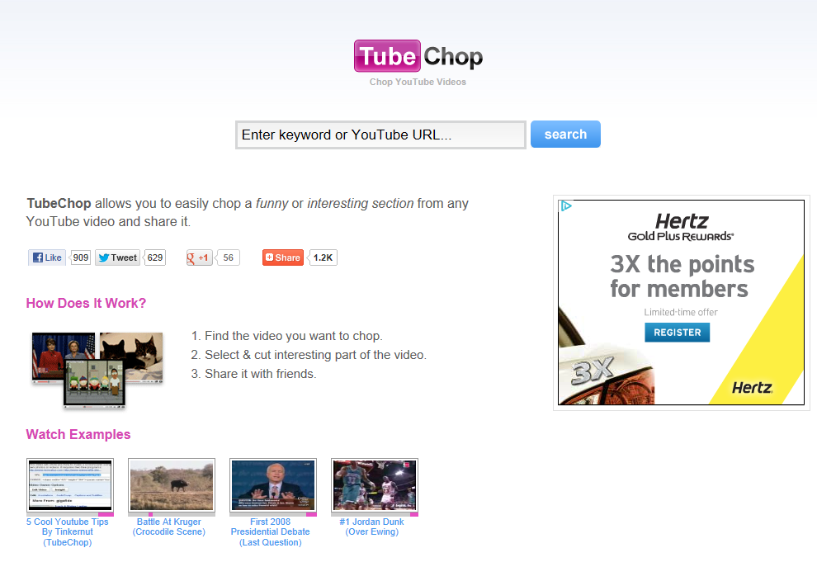
Web 2.0 and You –
What “tools are out there?

Slide 49
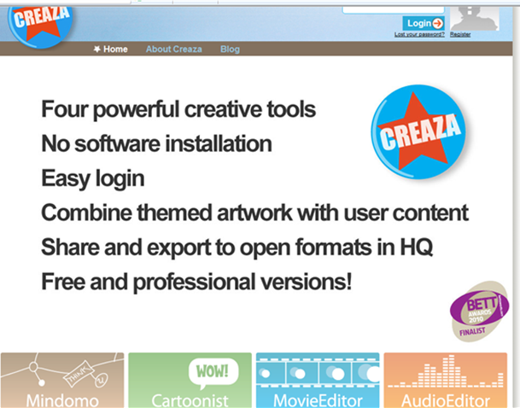
Web 2.0 and You –
What “tools are out there?

Slide 50
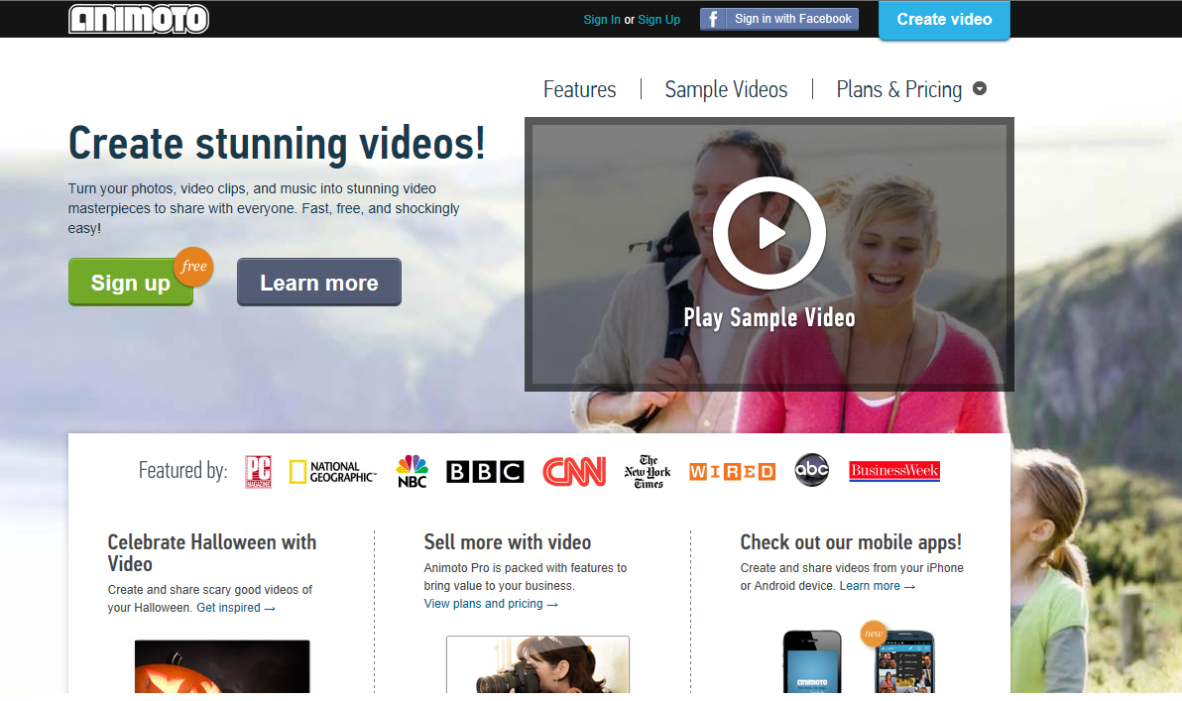
Web 2.0 and You –
What “tools are out there?

Slide 51
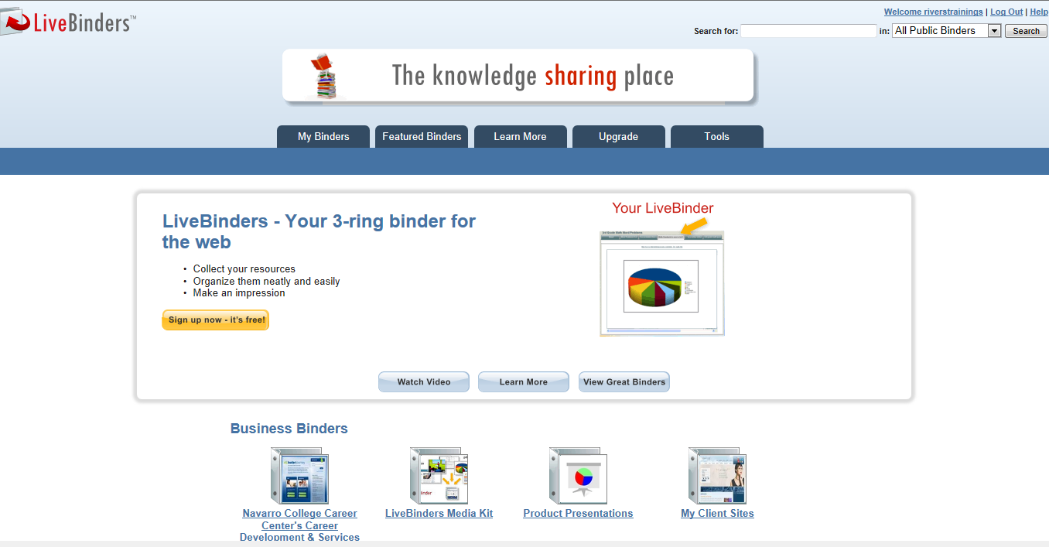
Web 2.0 and You –
What “tools are out there?
Bookmark Storage:

Slide 52
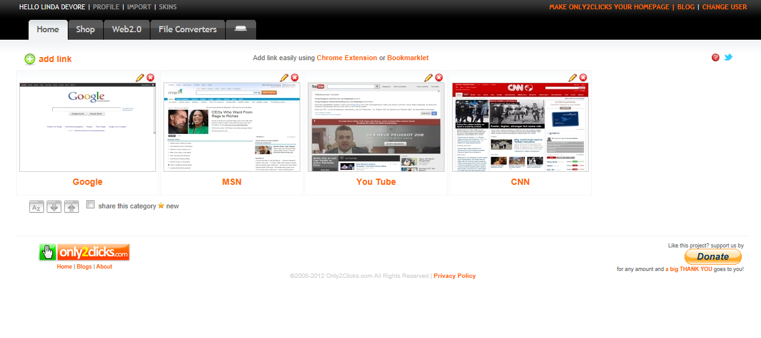
Web 2.0 and You –
What “tools are out there?
Only2Clicks

Slide 53
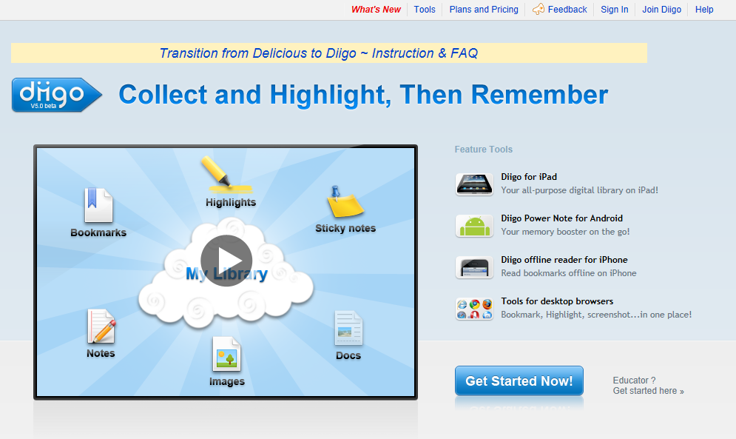
Web 2.0 and You –
What “tools are out there?

Slide 54
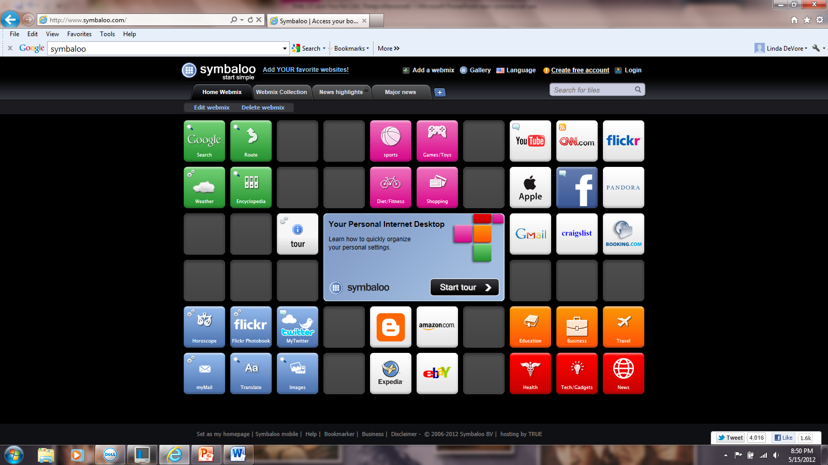
Web 2.0 and You –
What “tools are out there?

Slide 55


Web 2.0 and You –
What “tools are out there?
Temporary & Disposable Email Addys
Keeps your email for 8 days

Slide 56

Web 2.0 and You –
What “tools are out there?

Slide 57
Web 2.0 and You –
What “tools are out there?
References & Resources I
8 of the Best Online Backup Services for Linux. Auza, Jun. 22 Jul 2011. Tech Source <http://www.junauza.com/2010/06/8-of-best-online-backup-services-for.html >
"40+ Temporary & Disposable Email Services, Quickies!." To the PC. N.p., 105 Apr 2008. Web. 24 Jul 2011. <http://www.tothepc.com/archives/40-temporary-disposable-email-services-quickies/>.
Chan, Min Li, Fritz Holznagel, and Michael Krantz. "20 Things I Learned About Browsers and the Web." Google, 2010. Web. 22 Jul 2011. <http://www.20thingsilearned.com/en-US/>.

Slide 58
Web 2.0 and You –
What “tools are out there?
References & Resources II
"Cloud computing." Wikipedia. 2011. Web. <http://en.wikipedia.org/wiki/Cloud_computing>.
Fitzppatrick, Jason. "Five Best Bookmark Management Tools." Lifehackers. 15 May 2010. Web. 23 Jul 2011. <http://lifehacker.com/5540019/five-best-bookmark-management-tools>.
Griffith, Eric. "The Best Free Web Apps of 2011." PC Magazine. N.p., 13 Jul 2011. Web. 22 Jul 2011. <http://www.pcmag.com/article2/0,2817,2388384,00.asp>.

Slide 59
Web 2.0 and You –
What “tools are out there?
References & Resources III
Guay, Stephen . "100 Web Apps to Rule Them All." App Storm. N.p., 31 May 2011. Web. 23 Jul 2011. <http://web.appstorm.net/roundups/100-web-apps-to-rule-them-all/>.
Karaoğlu, Özge. "A-Z Web tools:A+B." TL Advisor Blog . Tech Learning, 22 Jan 2011. Web. 24 Jul 2011. <http://www.techlearning.com/blogs/35972>.
Karaoğlu, Özge. "A-Z Web tools:C+D." TL Advisor Blog . Tech Learning, 02 Mar 2011. Web. 03 Mar 2011. <http://www.techlearning.com/blogs/37254>.

