Slide 1
Web 2.0 and Community Service -- Part I
Presented by
Linda DeVore

Slide 2
Web 2.0 and Community Service
What is the “cloud”?

Slide 3
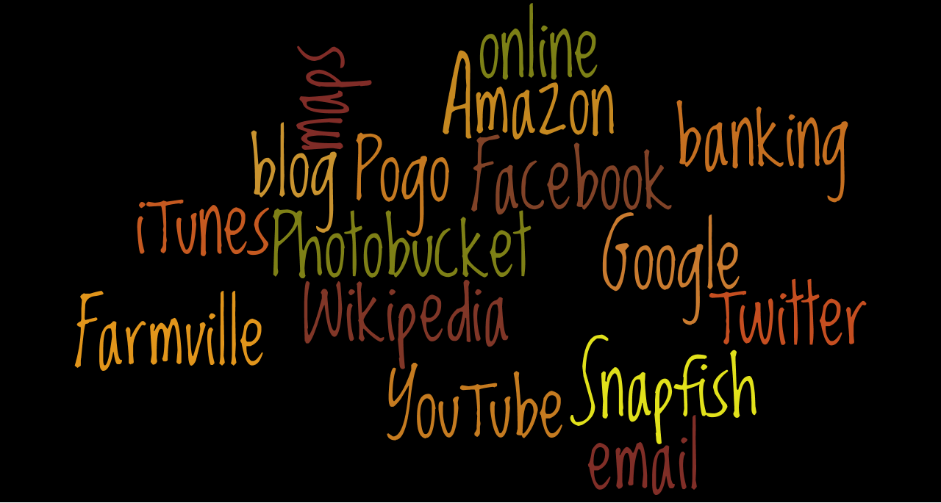
Web 2.0 and Community Service
You are in the “cloud”, if you

Slide 4
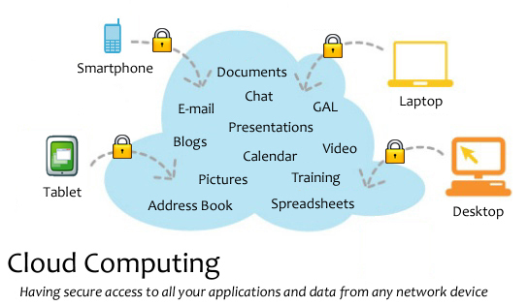
Web 2.0 and Community Service
<http://en.wikipedia.org/wiki/Cloud_computing>.
Notes:
If you should lose your computer or it should crash, what would you lose? Your email? Your address book? Your documents? Your spreadsheets? Your photos? Which ones??
Cloud computing comes into focus only when you think about what IT always needs: a way to increase capacity or add capabilities on the fly without investing in new infrastructure, training new personnel, or licensing new software.

Slide 5
Web 2.0 and Community Service
What can you do online that you can’t do offline?
Everything– and more!
Notes:
Today, we are going to talk about going beyond search engines, Facebook, Amazon, and online games.

Slide 6
Web 2.0 and Community Service
Today’s Agenda:
Free replacements for Microsoft Office– and almost all will work with your current Office documents!
Free online file storage
Free collaboration apps, and in Part II
Free website creators and hosting,
Free apps/tools to make your life easier!
Notes:
What we are going to look at during this workshop:

Slide 7
Web 2.0 and Community Service
Microsoft Office
Started in 1990 as the term for a set of applications that originally only included Word, Excel, and PowerPoint.
As of 2009 eighty percent of enterprises were using some form of Office.
If you buy a home version, it’s $279 from Microsoft, however, the professional version for businesses is $499. (Microsoft site pricing)
What can be used as a substitute???
Notes:
With Office 2010 there have now been 13 updates. Also mention student pricing at 99.

Slide 8


Web 2.0 and Community Service
Office Online Options
          (Web-based) Max. file 10GB
(Web-based)
Microsoft Office Web Apps to access need Hotmail account.
Notes:
With Google upload entire folders from your computer to the cloud. You can also drag files from your desktop into the Documents List (Chrome or Firefox only).
Zoho suite goes beyond Office by offering a wiki, a planner, email and CRM.

Slide 9
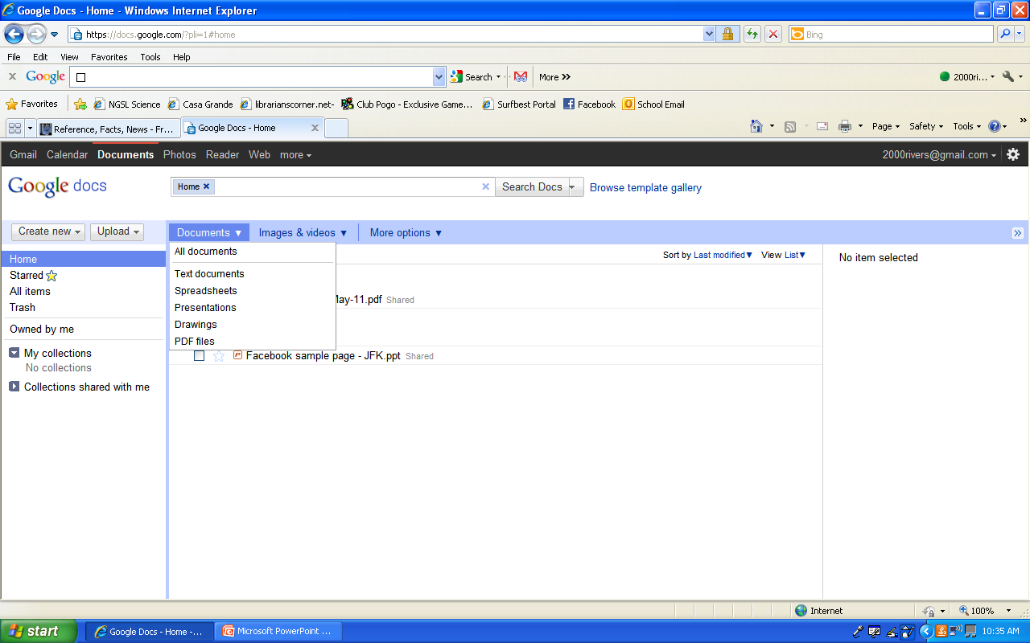
Web 2.0 and Community Service
Options Available with Google Docs
Notes:
Google Docs has tons of templates. Also, it increases your ability to do collaboration and you can go back to any version you wish.

Slide 10
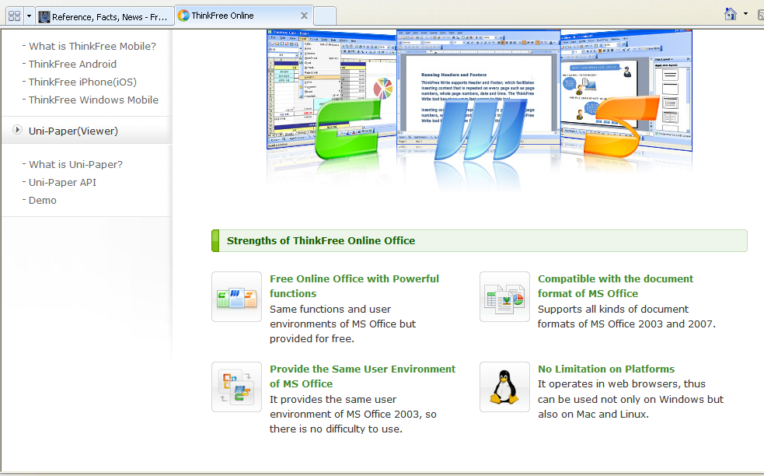
Web 2.0 and Community Service
ThinkFree

Slide 11



Web 2.0 and Community Service
Desktop Office Alternatives
Lotus Symphony (Windows)
Neo Office (Mac OS X)
(Windows, Mac OS X, Linux)
Calligra Suite has both office & graphic apps! (runs on Windows, Linux; as well as mobile version)
Notes:
Lotus is from IBM and only has docs, spreadsheets and presentations (PPT)
Open Office available in many languages and works on all common computers. It stores all your data in an international open standard format and can also read and write files from other common office software packages. It can be downloaded and used completely free of charge for any purpose.
Calligra: Adding images and graphs is as easy as dragging them into the document. If you don’t like the placement of the image, simply move it around and while you are moving it, the text will automatically wrap around it.

Slide 12






Web 2.0 and Community Service
Presentation (or PowerPoint) Tools:
Store there and share with others.
S Store there and share with others.
Le Let’s you gather social media from various sources and produce a slideshow you can post on your blog, website or directly on slidestaxx
Add photos, music, video, and audio, and share it publicly or privately
– trial
version
280 Slides
Animoto: load photos, and Animoto creates a video slideshow with music.
Notes:
You might want to show an example of a prezi & talk about its limitations. Slide Rocket pw tv7896

Slide 13
Web 2.0 and Community Service
Online File Storage
Store / Send Large File to Other Users
Megashares single session upload limit is 10GB
Send Space up to 300MB per document
Transfer Big Files 1 GB storage, up to 100 MB per document
Ge.tt "You can even share your file link while the upload is still underway"
Let’s Crate 1GB storage, 1000 downloads, & 50 MB file size limit
Notes:
Explain when would use.

Slide 14
Web 2.0 and Community Service
Online File Storage – Storage and Synchronization I
Dropbox (cross-platform and works with Linux, Mac, and Windows, but it can also be used on just the Web. Apps for popular devices such as Android, BlackBerry, iPhone, iPad) 2 GB
ZumoDrive (store and sync files online and between computers using their HybridCloud storage solution) 2 GB
Allway (Sync 30 languages and will sync all your computers and no limits on number or size of files)
Notes:
Dropbox has an attractive way to get more storage: for every other person that joins Dropbox because you invited them, you can get 250 MB of extra storage space for free, forever. If you’re a student, you can bump that up and get 500 MB of extra free space for everyone that joins because you invited them.

Slide 15
Web 2.0 and Community Service
Online File Storage – Storage and Synchronization II
SpiderOak (consolidated online backup, sync, sharing, access & storage solution for Windows, Mac OS X, and Linux ) 2 GB or $10/month for 100 GB. Students get 50% off and they offer +1GB for each referral up to 7GB.
4shared 10 GB storage PC World Rating of 93 Superior free storage for document files (doc, txt, pdf, rtf, xls), music file (mp3, ogg, wav, mid), video file (avi, mpg, mpeg), image file (jpg, gif, bmp, png)

Slide 16
Web 2.0 and Community Service
Online File Storage – Storage and Synchronization III
Adrive 50 GB storage (largest amount of free storage and backup on the Internet. Not meant for synchronizing computers!)
Drop Boks store files online securely and offers 1GB of storage space. Uploading/Downloading of files is limited to 50MB.

Slide 17
Web 2.0 and Community Service
Online File Storage – Storage and Synchronization IV
SnapDrive Offers up to 5GB of file storage, mobile phone upload through Snapit.mobi, share your photos, add music & videos, create direct links to download and access files to email, IM, web pages, and forum.
SkyDrive Microsoft Live’s offers 25GB of free storage, access anywhere and secure password protection features.

Slide 18
Web 2.0 and Community Service
Online File Storage – Storage and Synchronization V
Orbitfiles.com unlimited file storage $5/month
File Dropper 5 GB storage (Meets the basic needs of file sharing: upload, share, and download. Not meant for synchronizing computers!)
Notes:
If you are looking for more options go to: http://www.lifehack.org/articles/lifehack/introduction-to-90-online-file-storage-services.html

Slide 19
Web 2.0 and Community Service
Collaboration Tools
Criteria for Real Time Online Collaboration Tools:
* No software download is required.
* It’s free.
* No equipment is required other than, in some cases, a microphone. A webcam needs to be optional.
* Multiple users can collaborate at the same time.

Slide 20
Web 2.0 and Community Service
Free Tools for Collaboration Part I
Wiggio form online groups and create private listservs and web addresses; manage events with a shared calendar; send eMail, text, and voice messages; manage files in a shared folder; a to-do list feature, which allows users to assign tasks with due dates to group members, making for mini-projects within a larger project easier and ability of all members to share their computer screens over the network.
Basecamp free level includes only one project, two online whiteboards for collaboration, and 10MB of storage.

Slide 21
Web 2.0 and Community Service
Free Tools for Collaboration– Part II
Writeboard are shareable, web-based text documents that let you save every edit, roll back to any version, and easily compare changes.
Co-Sketch is a multi-user online whiteboard designed to give you the ability to quickly visualize and share your ideas as images.
Creately engine suggests connectors, does automatic groupings and defines data properties to take drawing to the next level.
Meetin.gs Uses existing tools (Word, Excel, etc.) for a shared meeting. No downloads, no registration, no installation. Login using Facebook. Create an agenda, share notes, and upload documents.

Slide 22
Web 2.0 and Community Service
Free Tools for Collaboration– Part III
Ace Project Five users on five projects for free with 250 MB free space and free time-tracking.
AnyMeeting Web conferences with two to 200 people with email invites, video broadcasting, and can display your presentations to others via screen sharing.
Rypple is all about managing and evaluating the work that gets done
TeamLab project management tools, document editing you can share, and ways to communicate with the team, from blogs to IMs to (coming soon) internal emails.

Slide 23
Web 2.0 and Community Service
More Collaboration Tools
Wiggio- share and manage files, manage a group calendar, poll your group, post links, set up conference calls (including voice, webcam, shared whiteboard space, and screen sharing), chat online, send out mass text messages, and send voicemail or email messages to the entire group.
Scriblink a free “online whiteboard” where up to five people can simultaneously work on and save a project.
Ideapi allows you to create briefs, proposals and documents quickly, share them easily with your team and/or clients, work together to create better content and share ideas. Invite those you need to work on a document and the system lets you create and collaborate together efficiently. No restrictions on number of documents, but each can only be up to 3MB. Stored online indefinitely. Service is free.

Slide 24
Web 2.0 and Community Service
What is wrong with these sites?
http://www.theworldsworstwebsiteever.com/
http://www.angelfire.com/super/badwebs/
These sites list or show examples of a majority of the mistakes that web designers make and that you should avoid!
Notes:
List the top three things that annoy you about that site with the person next to you.

Slide 25
Web 2.0 and Community Service
Researchers have found that for visual appeal & serious readability, the following colors are preferred:
  White Background
  Black Text
You can use other colors, but light background with a dark font is preferable.

Slide 26
Web 2.0 and Community Service
Use the same font, size, color, and page layout throughout your site.
  Consistency is important.
    Helps readability
    Readers know what to expect.
  Avoid using Fancy Fonts.
  Use commonly found fonts such as
    Times New Roman
    Arial
    Veranda
    Comic Sans
    Bookman Old Style
    Tahoma

Slide 27
Web 2.0 and Community Service
Free Website Creators
Wix
Hipero
Yola
EZ123
Weebly
Webnode
WebStarts
Moonfruit
Webs.com
UCOZ

Slide 28
Web 2.0 and Community Service
References & Resources
Auza, Jun. "8 of the Best Online Backup Services for Linux." Tech Source. N.p., 19 Jun 2010. Web. 22 Jul 2011. <http://www.junauza.com/2010/06/8-of-best-online-backup-services-for.html >.
Baker, Geneva. "The Good, the Bad and the Ugly: A recipe for a great educational website.." NGSL Science. N.p., 30 Apr 2011. Web. 15 May 2011. <https://docs.google.com/viewer?a=v&pid=sites&srcid=ZGVmYXVsdGRvbWFpbnxuZ3Nsc2NpZW5jZXxneDoxNDU4YWM2MzBiN2MyMjU3>.
Chan, Min Li, Fritz Holznagel, and Michael Krantz. "20 Things I Learned About Browsers and the Web." Google, 2010. Web. 22 Jul 2011. <http://www.20thingsilearned.com/en-US/>.
"Cloud computing." Wikipedia. 2011. Web. <http://en.wikipedia.org/wiki/Cloud_computing>.

Slide 29
Web 2.0 and Community Service
References & Resources Part II
Guay, Stephen . "100 Web Apps to Rule Them All." App Storm. N.p., 31 May 2011. Web. 23 Jul 2011. <http://web.appstorm.net/roundups/100-web-apps-to-rule-them-all/>.
“Microsoft Office.” Wikipedia. 2010. Web. <http://en.wikipedia.org/wiki/Microsoft_Office>.
Wordle. 23 Jul 2011. <http://www.worldle.com>.

