Slide 1
Web 2.0 and Community Service -- Part II
Presented by
Linda DeVore

Slide 2
Web 2.0 and Community Service
Today’s Agenda:
Free website creators and hosting
Free apps/tools to make your life easier!
Notes:
Not covering Skype, Voice Thread, or other well-known tools today. Voice Thread is VoiceThread: "A VoiceThread is an online media album that can hold essentially any type of media (images, documents and videos) and allows people to make comments in 5 different ways - using voice (with a microphone or telephone), text, audio file, or video (with a webcam) - and share them with anyone they wish."

Slide 3
Web 2.0 and Community Service
What is wrong with these sites?
http://www.theworldsworstwebsiteever.com/
http://www.angelfire.com/super/badwebs/
These sites list or show examples of a majority of the mistakes that web designers make and that you should avoid!
Notes:
Speaking with a partner what are the top 3 things that bother you the most?

Slide 4
Web 2.0 and Community Service
What is the “cloud”?

Slide 5
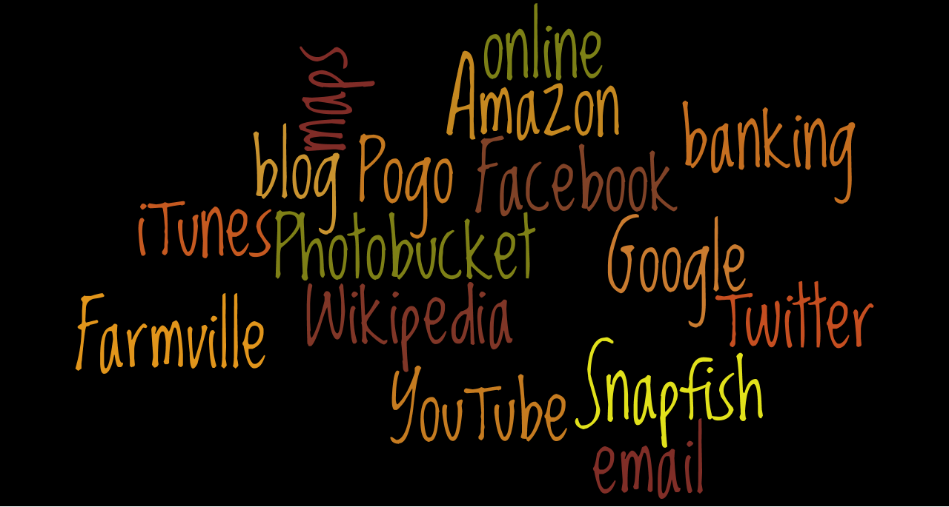
Web 2.0 and Community Service
You are in the “cloud”, if you

Slide 6
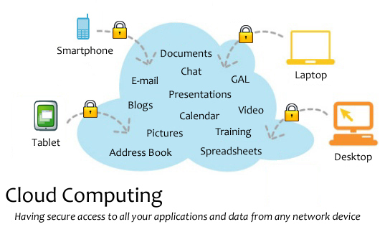
Web 2.0 and Community Service
<http://en.wikipedia.org/wiki/Cloud_computing>.

Slide 7
Web 2.0 and Community Service
What can you do online that you can’t do offline?
Everything– and more!

Slide 8
Web 2.0 and Community Service
Researchers have found that for visual appeal & serious readability, the following colors are preferred:
  White Background
  Black Text
You can use other colors, but light background with a dark font is preferable.

Slide 9
Web 2.0 and Community Service
Use the same font, size, color, and page layout throughout your site.
  Consistency is important.
    Helps readability
    Readers know what to expect.
  Avoid using Fancy Fonts.
  Use commonly found fonts such as
    Times New Roman
    Arial
    Veranda
    Comic Sans
    Bookman Old Style
    Tahoma

Slide 10
Web 2.0 and Community Service
Free Website Creators
Wix
Hipero
Yola
EZ123
Weebly
Webnode
WebStarts
Moonfruit
Webs.com
UCOZ

Slide 11
Web 2.0 and Community Service
Online File Storage
Store / Send Large File to Other Users
Megashares single session upload limit is 10GB
Send Space up to 300MB per document
Transfer Big Files 1 GB storage, up to 100 MB per document
Ge.tt "You can even share your file link while the upload is still underway"
Let’s Crate 1GB storage, 1000 downloads, & 50 MB file size limit
Notes:
When would you use and why?

Slide 12
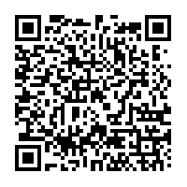
Web 2.0 and Community Service
QR Codes – What are they?
QR is short for Quick Response (they can be read quickly by a cell phone). They are used to take a piece of information from a transitory media, put it in to your cell phone. They are descendants of the UPC codes on your groceries, and the ISBN number codes on your books.
Kaywa generated this one for me.
To find a QR code reader for your phone go to
http://www.mobile-barcodes.com/qr-code-software/
Notes:
You may soon see QR Codes in a magazine advert, on a billboard, a web page or even on someone’s t-shirt. Once it is in your cell phone, it may give you details about that business (allowing users to search for nearby locations), or details about the person wearing the t-shirt, show you a URL which you can click to see a trailer for a movie, or it may give you a coupon which you can use in a local outlet.

Slide 13
Web 2.0 and Community Service
QR Codes – Where would you use them?
Business cards
Placed in the window or on the counter of a business
Print ads, billboards, mail
T-Shirts
Can take visitors to a video, blog post when on tour
Email sign-up – takes them to a form
Notes:
Lots of code generators out there. Go to Google and type in QR code generator.

Slide 14
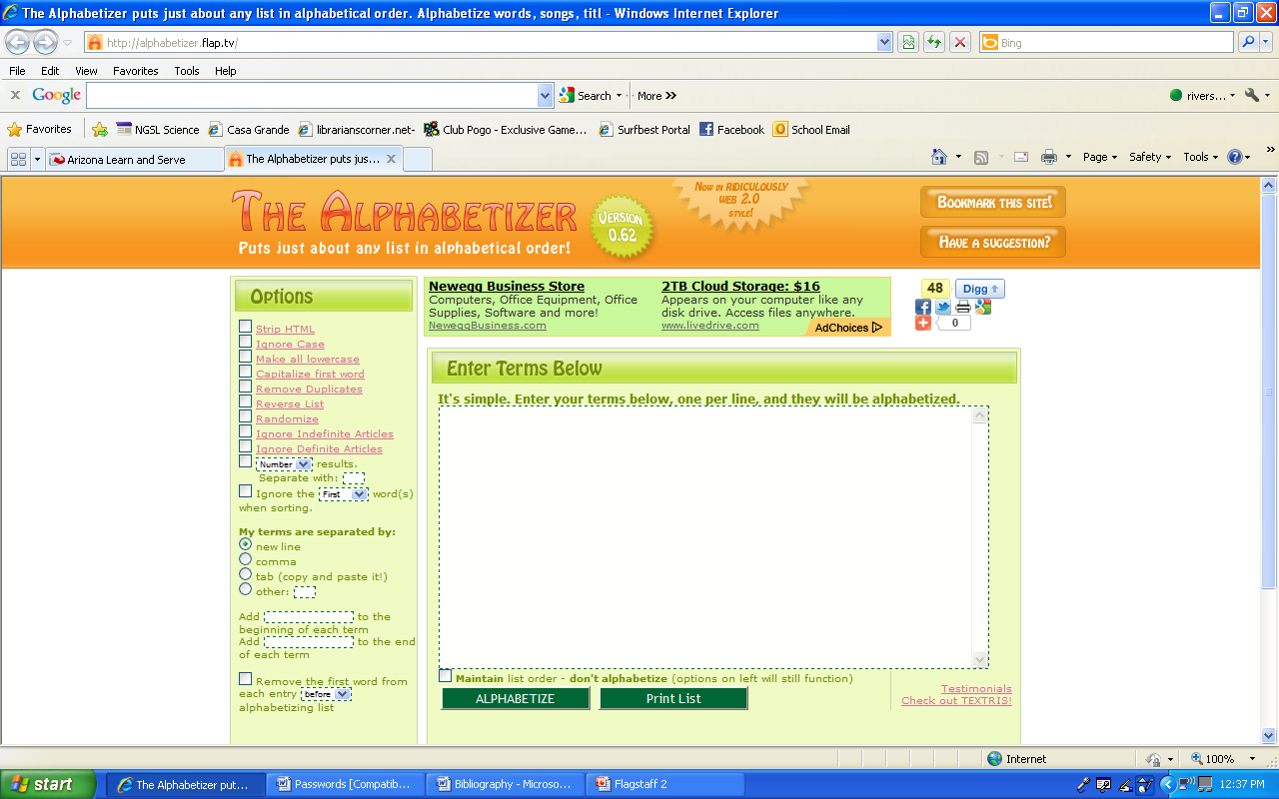
Web 2.0 and Community Service
The Alphabetizer
Notes:
Options include strip html, ignore case, make all lowercase, capitalize first word, remove duplicates, reverse list, randomize, ignore indefinite/indefinite articles. Separate terms by commas, new line, and remove the first word from each entry before alphabetizing.

Slide 15
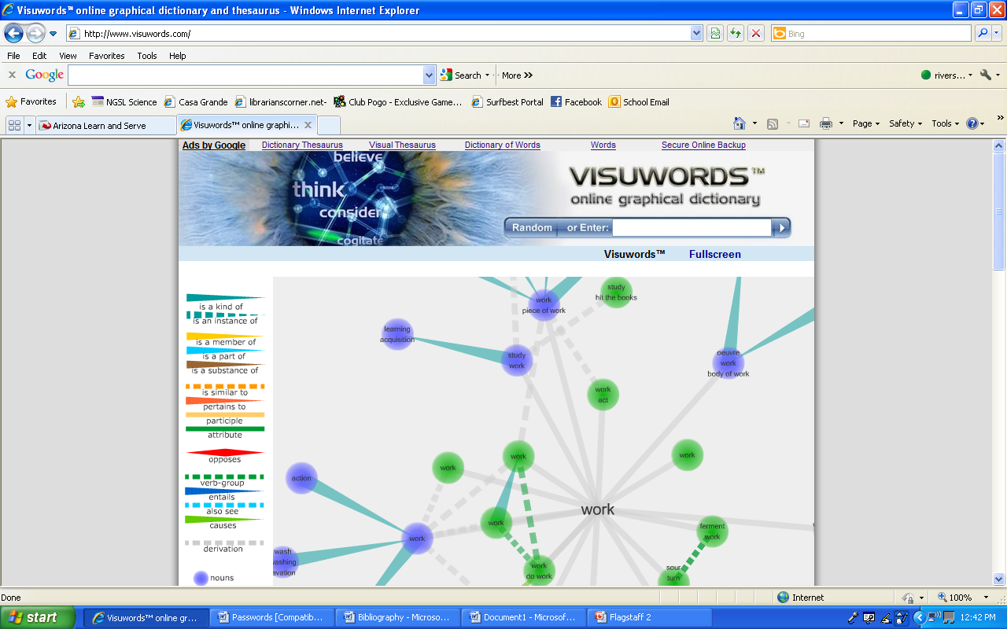
Web 2.0 and Community Service
Visuwords– Online Graphical Dictionary

Slide 16
Web 2.0 and Community Service
File Converters
PDF Converter 69 formats that are convertible to PDF (limit one document per 30 minutes)
Zamzar converts documents, video, images, music, e-books, compressed, and CAD.
DocsPal converts documents, video, audio, electronic books, images, and archives
Any Video Converter strictly video formats including iPad, Android, PSP, iPhone, 3G Phone, and MP4 player
Conversion of YouTube into other formats is no longer possible, folks! Google changed the policy.

Slide 17
Web 2.0 and Community Service
Save Your Bookmarks Online
ZooTool You can clip images from sites, organize bookmarked sites into packs, then flip through your shots of sites anytime for quick inspiration
IKeepBookmarks tool for desktop to make it easy
Linkagogo tool for desktop to make it easy
Diigo annotates URL, archives it (instead of merely saving the address of it), and share both your bookmarks and archived research with others.
Livebinder
Notes:
Why save your bookmarks online?? Livebinder pw kecici38

Slide 18
Web 2.0 and Community Service
Temporary & Disposable Email Addys
Mailinator
Spam Proof Email Generator
GuerrillaMail lasts 60 minutes
10 Minute Mail disappears in 10 minutes
Incognito Mail lasts 60 minutes
http://lists.econsultant.com/top-disposable-email-services-websites.html to find more
Notes:
Why and when would you use a spoof email? Discuss.

Slide 19
Web 2.0 and Community Service
Free Certificate Makers
1-2-3 Certificates
Certificate Creator
Certificate Street
Certificate Maker

Slide 20
Web 2.0 and Community Service
Alternatives to Google Images
4FreePhotos Public Domain and free photos from photographers who were willing to share
Free Digital Photos free photos and illustrations
Public Domain Photos 5,000 free photos & 8,000 free clip art
World Images 80,000 images from California State University
WP Clip Art photos and clip art
25 Places to Find Awesome Stock Photos — Free and Cheap!

Slide 21
Web 2.0 and Community Service
Video Resources
CamStudio Free streaming video software– you can easily record all your screen and audio activities.
Screenr Instant screencasts: Just click record.
Memoov make free 5 minute animated movie
Jaycut a spiffy time-line interface, the ability to work with all kinds of video (even Flash FLV files), and great transitions and text options.

Slide 22
Web 2.0 and Community Service
Fun Stuff!
Net Galley Free galleys of brand-new books for reviews
Virtual Tours explore 100 cities, famous landmarks and buildings, museums, campuses, and even outer space
WordItOut similar to Wordle or Tagxedo
Image Optimizer resize, compress and optimize
your image files
SumoPaint
Nature Sound Mixer
Big Huge Labs Do fun stuff with your digital photos!
Fat Paint free graphic design software and image editor. Paint and draw online.

Slide 23
Web 2.0 and Community Service
Miscellaneous– Part I
DisposableWebPage is a site where you can create a disposable page with any content you want and share it with others. Each page has a count down clock that you can start from anywhere. When the time finishes, the page stays for two more weeks before it is deleted forever.
Reverse Image Searching upload the image and TinEye will list all of the pages on which that certain image has been posted.
Read the Words write, copy and paste text, upload a document, or type in a URL. 15 voices. Can listen online, download an mp3 file for use offline, or embed your speech file elsewhere online.

Slide 24
Web 2.0 and Community Service
Miscellaneous– Part II
Wayback Machine
Woolfram Alpha do math; instantly get facts, calculators, unit conversions
LogMeIn Free offers basic remote control which allows you to open files, check your email, run programs, and run system diagnostics. Download software.
Inflation Calculator from 1666 to 2011
Text Finder "Line Break Removal Tool", put text in alphabetical order, remove white space or tabs, change to text to uppercase or lower case, capitalize sentences, plus online HTML tools.

Slide 25
Web 2.0 and Community Service
References & Resources I
8 of the Best Online Backup Services for Linux. Auza, Jun. 22 Jul 2011. Tech Source <http://www.junauza.com/2010/06/8-of-best-online-backup-services-for.html >
"40+ Temporary & Disposable Email Services, Quickies!." To the PC. N.p., 105 Apr 2008. Web. 24 Jul 2011. <http://www.tothepc.com/archives/40-temporary-disposable-email-services-quickies/>.
Baker, Daniela. "How to Use QR Codes to Promote Your Business." Social Media Today. N.p., 13 Jun 2011. Web. 24 Jul 2011. <http://socialmediatoday.com/daniela-baker/305969/how-use-qr-codes-promote-your-business>.

Slide 26
Web 2.0 and Community Service
References & Resources II
Chan, Min Li, Fritz Holznagel, and Michael Krantz. "20 Things I Learned About Browsers and the Web." Google, 2010. Web. 22 Jul 2011. <http://www.20thingsilearned.com/en-US/>.
"Cloud computing." Wikipedia. 2011. Web. <http://en.wikipedia.org/wiki/Cloud_computing>.
Fitzppatrick, Jason. "Five Best Bookmark Management Tools." Lifehackers. 15 May 2010. Web. 23 Jul 2011. <http://lifehacker.com/5540019/five-best-bookmark-management-tools>.

Slide 27
Web 2.0 and Community Service
References & Resources III
Griffith, Eric. "The Best Free Web Apps of 2011." PC Magazine. N.p., 13 Jul 2011. Web. 22 Jul 2011. <http://www.pcmag.com/article2/0,2817,2388384,00.asp>.
Guay, Stephen . "100 Web Apps to Rule Them All." App Storm. N.p., 31 May 2011. Web. 23 Jul 2011. <http://web.appstorm.net/roundups/100-web-apps-to-rule-them-all/>.
Hamilton, Charles. "QR Codes 101: Make Links to Your Website from Anywhere." Gigaom. 04 Jan 2011. Web. 24 Jul 2011. <http://gigaom.com/collaboration/qr-codes-101-make-links-to-your-website-from-anywhere/>.

Slide 28
Web 2.0 and Community Service
References & Resources IV
Karaoğlu, Özge. "A-Z Web tools:A+B." TL Advisor Blog . Tech Learning, 22 Jan 2011. Web. 24 Jul 2011. <http://www.techlearning.com/blogs/35972>.
Karaoğlu, Özge. "A-Z Web tools:C+D." TL Advisor Blog . Tech Learning, 02 Mar 2011. Web. 03 Mar 2011. http://www.techlearning.com/blogs/37254.
Lyne, Mark. "What is a QR code and why do you need one?." Search Engine Land. N.p., 15 Oct 2009. Web. 03 Mar 2011. <http://searchengineland.com/what-is-a-qr-code-and-why-do-you-need-one-27588>.

