Slide 1
Web 2.0 and Community Service
Presented by
Linda DeVore

Slide 2
Web 2.0 and Community Service
Today’s Agenda:
Free replacements for Microsoft Office
Free online file storage
Free collaboration apps
Free apps/tools to make your life easier!
Share your tools and apps!

Slide 3
Web 2.0 and Community Service
What is the “cloud”?

Slide 4
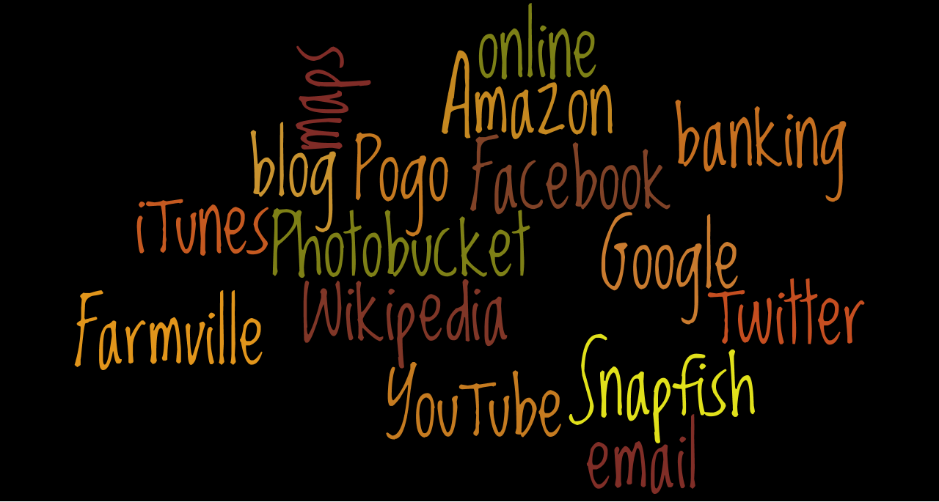
Web 2.0 and Community Service
You are in the cloud, if you:

Slide 5
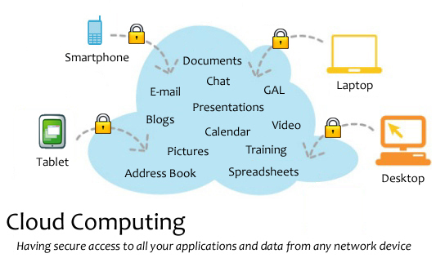
Web 2.0 and Community Service

Slide 6
Web 2.0 and Community Service
What can you do online that you can’t do offline?
Everything– and more!

Slide 7
Web 2.0 and Community Service
Tools and Applications
Save Your Bookmarks Online
Livebinders (riverstrainings)
Only2clicks.com
ZooTool You can clip images from sites, organize bookmarked sites into packs, then flip through your shots of sites anytime for quick inspiration
IKeepBookmarks tool for desktop to make it easy

Slide 8
Web 2.0 and Community Service
Microsoft Office
Started in 1990 as the term for a set of applications that originally only included Word, Excel, and PowerPoint.
As of 2009 eighty percent of enterprises were using some form of Office.
If you buy a home version, it’s $279 from Microsoft, however, the professional version for businesses is $499. (Microsoft site pricing)
What can be used as a substitute???

Slide 9


Web 2.0 and Community Service
Online Office Options :
(Web-based) Max. file 10GB
          (Web-based)
          Microsoft Office Web Apps to access need Hotmail account.

Slide 10
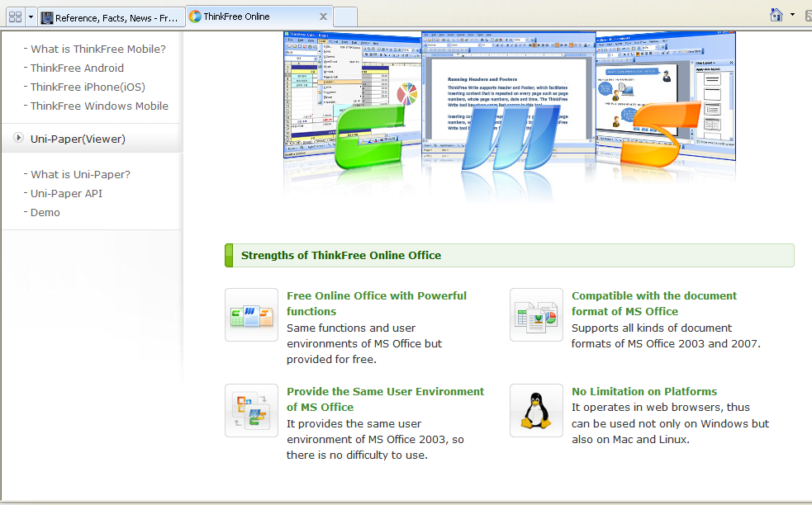
Web 2.0 and Community Service
ThinkFree

Slide 11



Web 2.0 and Community Service
Downloadable Options
Lotus Symphony (Windows)
Neo Office (Mac OS X)
(Windows, Mac OS X, Linux)
Calligra Suite has both office & graphic apps! (runs on Windows, Linux; as well as mobile version)

Slide 12






Web 2.0 and Community Service
PowerPoint Alternatives:
Store there and share with others.
Store and share there with others.
Let’s you gather social media from various sources and produce a slideshow you can post on your blog, website or directly on slidestaxx
Add photos, music, video, and audio, and share it publicly or privately.
Allows easy insertion of video, audio, and images from popular places like YouTube and Flicker.

Slide 13
Web 2.0 and Community Service
Online File Storage
Store / Send Large File to Other Users
Megashares single session upload limit is 10GB
Send Space up to 300MB per document
Transfer Big Files 1 GB storage, up to 100 MB per document
Ge.tt "You can even share your file link while the upload is still underway"
Let’s Crate 1GB storage, 1000 downloads, & 50 MB file size limit
Boxify.Me each box has its own addy that can be shared with friends for uploads and downloads.

Slide 14
Web 2.0 and Community Service
Online File Storage – Storage and Synchronization
SpiderOak (consolidated online backup, sync, sharing, access & storage solution for Windows, Mac OS X, and Linux ) 2 GB or $10/month for 100 GB. Students get 50% off and they offer +1GB for each referral up to 7GB.
4shared 10 GB storage PC World rating of 93 Superior free storage for document files (doc, txt, pdf, rtf, xls), music file (mp3, ogg, wav, mid), video file (avi, mpg, mpeg), image file (jpg, gif, bmp, png)
Dropbox (cross-platform and works with Linux, Mac, and Windows, but it can also be used on just the Web. Apps for popular devices such as Android, BlackBerry, iPhone, iPad) 2 GB
SkyDrive Microsoft Live’s offers 25GB of free storage, access anywhere and secure password protection features.

Slide 15
Web 2.0 and Community Service
Collaboration Tools
Criteria for Real Time Online Collaboration Tools:
* No software download is required.
* It’s free.
* No equipment is required other than, in some cases, a microphone. A webcam needs to be optional.
* Multiple users can collaborate at the same time.

Slide 16
Web 2.0 and Community Service
Free Tools for Collaboration Part I
Wiggio form online groups and create private listservs and web addresses; manage events with a shared calendar; send eMail, text, and voice messages; manage files in a shared folder; a to-do list feature, which allows users to assign tasks with due dates to group members, making for mini-projects within a larger project easier and ability of all members to share their computer screens over the network.
Basecamp free level includes only one project, two online whiteboards for collaboration, and 10MB of storage.

Slide 17
Web 2.0 and Community Service
Free Tools for Collaboration– Part II
Writeboard are shareable, web-based text documents that let you save every edit, roll back to any version, and easily compare changes.
Co-Sketch is a multi-user online whiteboard designed to give you the ability to quickly visualize and share your ideas as images.
Creately engine suggests connectors, does automatic groupings and defines data properties to take drawing to the next level.
Meetin.gs Uses existing tools (Word, Excel, etc.) for a shared meeting. No downloads, no registration, no installation. Login using Facebook. Create an agenda, share notes, and upload documents.

Slide 18
Web 2.0 and Community Service
More Collaboration Ideas!
Scriblink a free “online whiteboard” where up to five people can simultaneously work on and save a project.
Ideapi allows you to create briefs, proposals and documents quickly, share them easily with your team and/or clients, work together to create better content and share ideas. Invite those you need to work on a document and the system lets you create and collaborate together efficiently. No restrictions on number of documents, but each can only be up to 3MB. Stored online indefinitely. Service is free.

Slide 19
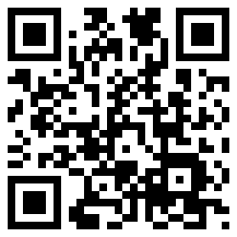
Web 2.0 and Community Service
QR Codes – What are they?
QR is short for Quick Response (they can be read quickly by a cell phone). They are used to take a piece of information from a transitory media, put it in to your cell phone. They are descendants of the UPC codes on your groceries, and the ISBN number codes on your books.
Kaywa generated this one for me.
To find a QR code reader for your phone, if you don’t have one go to
http://www.mobile-barcodes.com/qr-code-software/

Slide 20
Web 2.0 and Community Service
QR Codes – Where would you use them?
Business cards
Placed in the window or on the counter of a business
Print ads, billboards, mail
T-Shirts
They can take visitors to a video, blog post when on tour
Use for easy email sign-up – take them to a form.

Slide 21
Web 2.0 and Community Service
Temporary & Disposable Email Addys
Mailinator
Spam Proof Email Generator
GuerrillaMail lasts 60 minutes
10 Minute Mail disappears in 10 minutes
Incognito Mail lasts 60 minutes
http://lists.econsultant.com/top-disposable-email-services-websites.html to find more

Slide 22
Web 2.0 and Community Service
Free Certificate Makers
1-2-3 Certificates
Certificate Creator
Certificate Street
Certificate Maker

Slide 23
Web 2.0 and Community Service
Alternatives to Google Images
4FreePhotos Public Domain and free photos from photographers who were willing to share
Free Digital Photos free photos and illustrations
Public Domain Photos 5,000 free photos & 8,000 free clip art
World Images 80,000 images from California State University
WP Clip Art photos and clip art
25 Places to Find Awesome Stock Photos — Free and Cheap!

Slide 24
Web 2.0 and Community Service
Video Resources
CamStudio Free streaming video software– you can easily record all your screen and audio activities.
Screenr Instant screencasts: Just click record.
Memoov make free 5 minute animated movie
Jaycut a spiffy time-line interface, the ability to work with all kinds of video (even Flash FLV files), and great transitions and text options.

Slide 25
Web 2.0 and Community Service
Fun Stuff!
Net Galley Free galleys of brand-new books for reviews
Virtual Tours explore 100 cities, famous landmarks and buildings, museums, campuses, and even outer space
WordItOut similar to Wordle or Tagxedo
Image Optimizer resize, compress and optimize
your image files
SumoPaint
Nature Sound Mixer
Big Huge Labs Do fun stuff with your digital photos!
Fat Paint free graphic design software and image editor. Paint and draw online.

Slide 26
Web 2.0 and Community Service
More Stuff!
DisposableWebPage is a site where you can create a disposable page with any content you want and share it with others. Each page has a countdown clock that you can start from anywhere. When the time finishes, the page stays for two more weeks before it is deleted forever.
Reverse Image Searching upload the image and TinEye will list all of the pages on which that certain image has been posted.
Read the Words write, copy and paste text, upload a document, or type in a URL. 15 voices. Can listen online, download an mp3 file for use offline, or embed your speech file elsewhere online.

Slide 27
Web 2.0 and Community Service
And, More Stuff
Wayback Machine
LogMeIn Free offers basic remote control which allows you to open files, check your email, run programs, and run system diagnostics. Download software.
Text Finder "Line Break Removal Tool", put text in alphabetical order, remove white space or tabs, change to text to uppercase or lower case, capitalize sentences, plus online HTML tools.
All My Faves

Slide 28
Web 2.0 and Community Service
Bonus Slide 1: Google Hints
Type view:timeline and your search topic to find a timeline of the topic.
To use Google’s built-in calculator function, simply enter the calculation you’d like to
do into the search box. Example: 5*9+(sqrt 10)^3=
Find a PowerPoint presentation on volunteers. Type volunteers filetype:ppt. Works on any topic!

Slide 29
Web 2.0 and Community Service
Bonus Slide 1: Google Hints
weather las vegas NV Will give the local weather for Las Vegas Nevada.
fly JFK LAX Links to flight information from JFK airport to LAX airport. Or fly new york to los angeles] Link to flight information from New York to Los Angeles
Convert: old units in new units 300 Euros in USD, 130 lbs in kg, etc.
Find the time in a city: time paris

Slide 30
Web 2.0 and Community Service
What are your
best tools?

Slide 31
Web 2.0 and Community Service
References & Resources I
8 of the Best Online Backup Services for Linux. Auza, Jun. 22 Jul 2011. Tech Source <http://www.junauza.com/2010/06/8-of-best-online-backup-services-for.html >
"40+ Temporary & Disposable Email Services, Quickies!." To the PC. N.p., 105 Apr 2008. Web. 24 Jul 2011. <http://www.tothepc.com/archives/40-temporary-disposable-email-services-quickies/>.
Baker, Daniela. "How to Use QR Codes to Promote Your Business." Social Media Today. N.p., 13 Jun 2011. Web. 24 Jul 2011. <http://socialmediatoday.com/daniela-baker/305969/how-use-qr-codes-promote-your-business>.

Slide 32
Web 2.0 and Community Service
References & Resources II
Chan, Min Li, Fritz Holznagel, and Michael Krantz. "20 Things I Learned About Browsers and the Web." Google, 2010. Web. 22 Jul 2011. <http://www.20thingsilearned.com/en-US/>.
"Cloud computing." Wikipedia. 2011. Web. <http://en.wikipedia.org/wiki/Cloud_computing>.
Fitzppatrick, Jason. "Five Best Bookmark Management Tools." Lifehackers. 15 May 2010. Web. 23 Jul 2011. <http://lifehacker.com/5540019/five-best-bookmark-management-tools>.

Slide 33
Web 2.0 and Community Service
References & Resources III
Griffith, Eric. "The Best Free Web Apps of 2011." PC Magazine. N.p., 13 Jul 2011. Web. 22 Jul 2011. <http://www.pcmag.com/article2/0,2817,2388384,00.asp>.
Guay, Stephen . "100 Web Apps to Rule Them All." App Storm. N.p., 31 May 2011. Web. 23 Jul 2011. <http://web.appstorm.net/roundups/100-web-apps-to-rule-them-all/>.
Hamilton, Charles. "QR Codes 101: Make Links to Your Website from Anywhere." Gigaom. 04 Jan 2011. Web. 24 Jul 2011. <http://gigaom.com/collaboration/qr-codes-101-make-links-to-your-website-from-anywhere/>.

Slide 34
Web 2.0 and Community Service
References & Resources IV
Karaoğlu, Özge. "A-Z Web tools:A+B." TL Advisor Blog . Tech Learning, 22 Jan 2011. Web. 24 Jul 2011. <http://www.techlearning.com/blogs/35972>.
Karaoğlu, Özge. "A-Z Web tools:C+D." TL Advisor Blog . Tech Learning, 02 Mar 2011. Web. 03 Mar 2011. http://www.techlearning.com/blogs/37254.
Lyne, Mark. "What is a QR code and why do you need one?." Search Engine Land. N.p., 15 Oct 2009. Web. 03 Mar 2011. <http://searchengineland.com/what-is-a-qr-code-and-why-do-you-need-one-27588>.

