Slide 1
Web 2.0 and You –
What Can You Do With It?
Presented by
Linda DeVore

Slide 2
Web 2.0 and You –
What Can You Do With It?
Today’s Agenda:
Free replacements for Microsoft Office
Free online file storage
Free collaboration apps
Free apps/tools to make your life easier!
Share your tools and apps!

Slide 3
Web 2.0 and You –
What Can You Do With It?
What is Web 2.0 and how is it different from the “web”?
The term was first used in 1999 but did not start to take off until 2003. Web 1.0 users are limited to viewing materials that someone has created. With Web 2.0 the user is the creator and collaborator of what they see and use on the Web. Examples include blogs, wikis, video sharing sites, mashups, etc.

Slide 4

Web 2.0 and You –
What Can You Do With It?
What is the “cloud”?

Slide 5
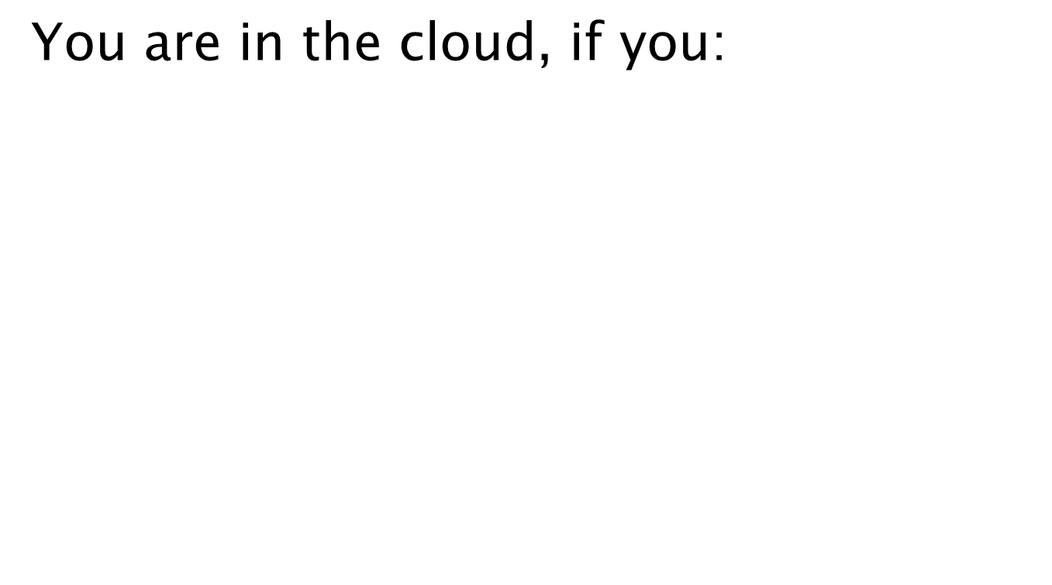
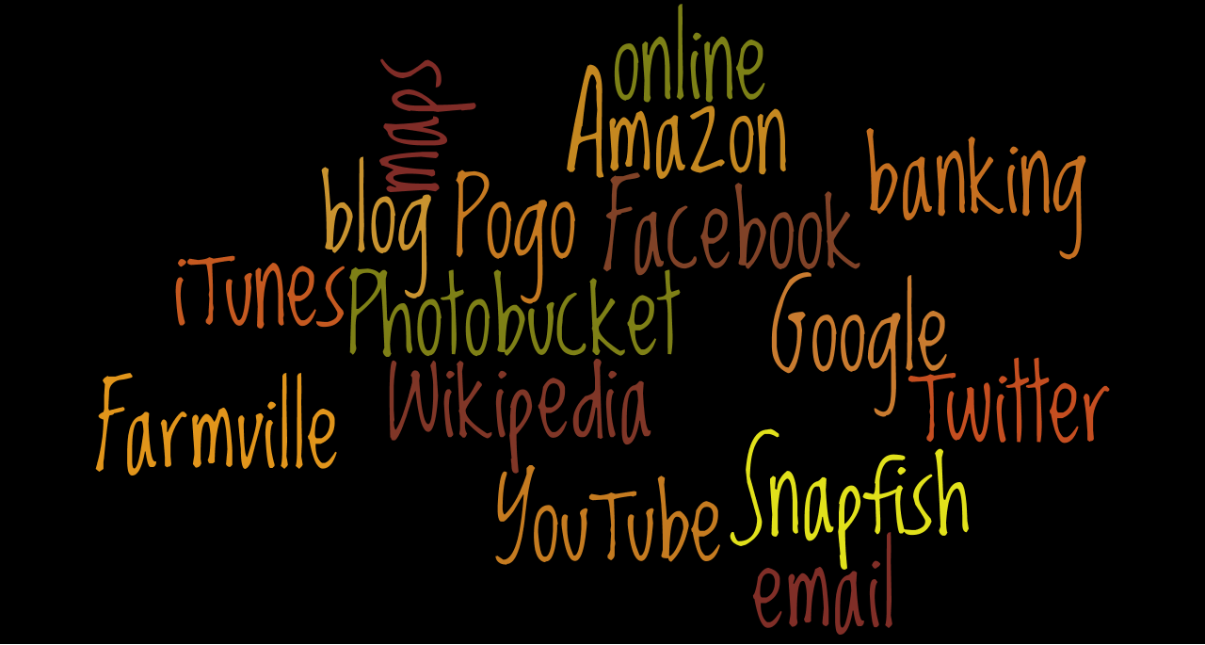
Web 2.0 and You –
What Can You Do With It?

Slide 6
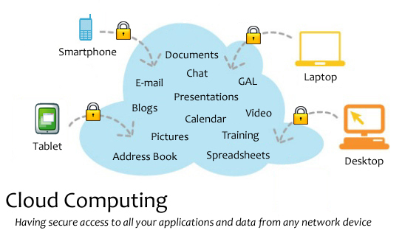
Web 2.0 and You –
What Can You Do With It?

Slide 7
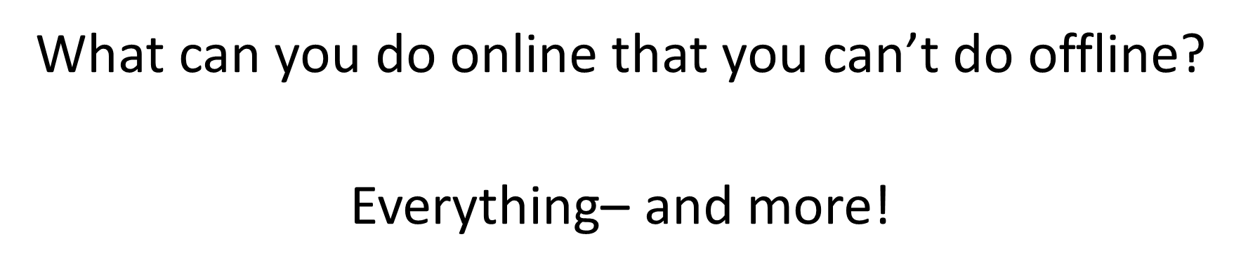
Web 2.0 and You –
What Can You Do With It?

Slide 8
Web 2.0 and You –
What Can You Do With It?
Microsoft Office
Started in 1990 as the term for a set of applications that originally only included Word, Excel, and PowerPoint.
As of 2009 eighty percent of enterprises were using some form of Office.
If you buy a home version, it’s $279 from Microsoft, however, the professional version for businesses is $499. (Microsoft site pricing)
What can be used as a substitute???

Slide 9


Web 2.0 and You –
What Can You Do With It?
Online Office Options :
(Web-based) Max. file 10GB
(Web-based)
Microsoft Office Web Apps to access need Hotmail account.
Don’t have Office on your computer but someone sends you a file, use Quickoffice!

Slide 10
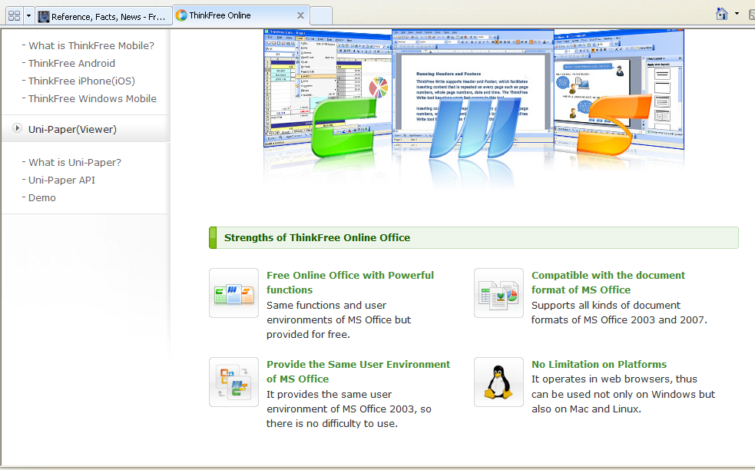
Web 2.0 and You –
What Can You Do With It?
ThinkFree

Slide 11



Web 2.0 and You –
What Can You Do With It?
Downloadable Options
Lotus Symphony (Windows)
Neo Office (Mac OS X)
(Windows, Mac OS X, Linux)
Calligra Suite has both office & graphic apps! (runs on Windows, Linux; as well as mobile version)

Slide 12






Web 2.0 and You –
What Can You Do With It?
PowerPoint Alternatives:
Store there and share with others.
Let’s you gather social media from various sources and produce a slideshow you can post on your blog, website or directly on slidestaxx.
Add photos, music, video, and audio, and share it publicly or privately.
Allows easy insertion of video, audio, and images from popular places like YouTube and Flicker.

Slide 13
Web 2.0 and You –
What Can You Do With It?
Online File Storage
Store / Send Large File to Other Users
Megashares single session upload limit is 10GB
Send Space up to 300MB per document
Transfer Big Files 1 GB storage, up to 100 MB per document
Ge.tt "You can even share your file link while the upload is still underway"
Let’s Crate 1GB storage, 1000 downloads, & 50 MB file size limit
Boxify.Me each box has its own addy that can be shared with friends for uploads and downloads.

Slide 14
Web 2.0 and You –
What Can You Do With It?
Online File Storage – Storage AND Synchronization
SpiderOak (consolidated online backup, sync, sharing, access & storage solution for Windows, Mac OS X, and Linux ) 2 GB or $10/month for 100 GB. Students get 50% off and they offer +1GB for each referral up to 7GB.
4shared 10 GB storage PC World rating of 93 Superior free storage for document files (doc, txt, pdf, rtf, xls), music file (mp3, ogg, wav, mid), video file (avi, mpg, mpeg), image file (jpg, gif, bmp, png)
Dropbox (cross-platform and works with Linux, Mac, and Windows, but it can also be used on just the Web. Apps for popular devices such as Android, BlackBerry, iPhone, iPad) 2 GB
SkyDrive Microsoft Live’s offers 25GB of free storage, access anywhere and secure password protection features.

Slide 15
Web 2.0 and You –
What Can You Do With It?
Collaboration Tools
Criteria for Real Time Online Collaboration Tools:
* No software download is required.
* It’s free.
* No equipment is required other than, in some cases, a microphone. A webcam needs to be optional.
* Multiple users can collaborate at the same time.

Slide 16
Web 2.0 and You –
What Can You Do With It?
Free Tools for Collaboration Part I
Wiggio form online groups and create private listserves and web addresses; manage events with a shared calendar; send email, text, and voice messages; manage files in a shared folder; a to-do list feature, which allows users to assign tasks with due dates to group members, making for mini-projects within a larger project easier and ability of all members to share their computer screens over the network.
Basecamp free level includes only one project, two online whiteboards for collaboration, and 10MB of storage.

Slide 17
Web 2.0 and You –
What Can You Do With It?
Free Tools for Collaboration– Part II
Writeboard shareable, web-based text documents that let you save every edit, roll back to any version, and easily compare changes.
Co-Sketch is a multi-user online whiteboard designed to give you the ability to quickly visualize and share your ideas as images.
Creately engine suggests connectors, does automatic groupings and defines data properties to take drawing to the next level.
Meetin.gs Uses existing tools (Word, Excel, etc.) for a shared meeting. No downloads, no registration, no installation. Login using Facebook. Create an agenda, share notes, and upload documents.

Slide 18
Web 2.0 and You –
What Can You Do With It?
More Collaboration Ideas!
Scriblink a free “online whiteboard” where up to five people can simultaneously work on and save a project.
Ideapi allows you to create briefs, proposals and documents quickly, share them easily with your team and/or clients, work together to create better content and share ideas. Invite those you need to work on a document and the system lets you create and collaborate together efficiently. No restrictions on number of documents, but each can only be up to 3MB. Stored online indefinitely. Service is free.

Slide 19
Web 2.0 and You –
What Can You Do With It?
Save Your Bookmarks Online
Livebinders
Only2clicks.com
ZooTool You can clip images from sites, organize bookmarked sites into packs, then flip through your shots of sites anytime for quick inspiration
IKeepBookmarks tool for desktop to make it easy

Slide 20
Web 2.0 and You –
What Can You Do With It?
Temporary & Disposable Email Addys
Mailinator
Spam Proof Email Generator
GuerrillaMail lasts 60 minutes
10 Minute Mail disappears in 10 minutes
Incognito Mail lasts 60 minutes
http://lists.econsultant.com/top-disposable-email-services-websites.html to find more

Slide 21
Web 2.0 and You –
What Can You Do With It?
Alternatives to Google/Bing Images
4FreePhotos Public Domain and free photos from photographers who were willing to share
Free Digital Photos free photos and illustrations
Public Domain Photos 5,000 free photos & 8,000 free clip art
World Images 80,000 images from California State University
WP Clip Art photos and clip art
25 Places to Find Awesome Stock Photos — Free and Cheap!

Slide 22
Web 2.0 and You –
What Can You Do With It?
Google Hints:
Type view:timeline and your search topic to find a timeline for the topic.
To use Google’s built-in calculator function, simply enter the calculation you’d like to do into the search box. Example: 5*9+(sqrt 10)^3=
Search for a specific filetype, i.e. find a PowerPoint presentation on chemistry. Type chemistry filetype:ppt. Works for xls, pdf, swf, doc, xml, txt, etc.
weather las vegas NV will give the local weather for Las Vegas Nevada.
Convert: old units in new units 300 Euros in USD, 130 lbs in kg, etc.

Slide 23
Web 2.0 and You –
What Can You Do With It?
Video Creators
CamStudio Free streaming video software– you can easily record all your screen and audio activities.
Screenr Instant screencasts: Just click record.
Memoov make free 5 minute animated movie
Jaycut a spiffy time-line interface, the ability to work with all kinds of video (even Flash FLV files), and great transitions and text options.

Slide 24
Web 2.0 and You –
What Can You Do With It?
Photo Editors:
Image Optimizer resize, compress and optimize your image files
WordItOut similar to Wordle or Tagxedo
Pixlr includes Pixlr Editor, Pixlr Express, and Pixlr-O-Matic– acts similarly to PhotoShop.
Kizoa – takes your photos and creates collages or slide shows
Lunapic- edits your photos from Tumblr, Twitter, and Facebook. Effects include reflecting animation, pasting images into other photos, creating Christmas bulbs and cartooning yourself amongst others.
Image Chef Create banners, buttons, signs, license plates, bling and a host of other graphics
Big Huge Labs Do fun stuff with your digital photos!
Fat Paint free graphic design software and image editor. Paint and draw online.

Slide 25
Web 2.0 and You –
What Can You Do With It?
Tools for the Classroom
DisposableWebPage is a site where you can create a disposable page with any content you want and share it with others. Each page has a countdown clock that you can start from anywhere. When the time finishes, the page stays for two more weeks before it is deleted forever.
Alternative- Dinky Page which doesn’t expire but you can change the URL and edit the page.
Reverse Image Searching upload the image and TinEye will list all of the pages on which that certain image has been posted.
Read the Words write, copy and paste text, upload a document, or type in a URL. 15 voices. Can listen online, download an mp3 file for use offline, or embed your speech file elsewhere online.
Academic Earth – free access to video courses and academic lectures from leading colleges and universities.

Slide 26
Web 2.0 and You –
What Can You Do With It?
Miscellaneous Tools and Applications
Popurls – perfect site for the news junkie!
Timeglider– web-based timeline software
Alice- free 3-D animation programming software for middle school through college
Howjsay- a free online talking pronunciation dictionary
MyWay- web portal and search engine like Yahoo! but without any banners, pop-ups or spam!
FindSounds – search engine for sound effects on the Net
InternetDrugCoupons- search for coupons to reduce the cost of your prescriptions!
VitalCheck go here for birth, death, marriage and divorce certificates across the US

Slide 27
Web 2.0 and You –
What Can You Do With It?
Fun Stuff!
Net Galley Free galleys of brand-new books for reviews
Virtual Tours explore 100 cities, famous landmarks and buildings, museums, campuses, and even outer space
SumoPaint
Nature Sound Mixer
Floorplanner – create and share floorplans for free with basic plan. Can be upgraded.
Calendar Labs – Don’t have Publisher and need a calendar? This is your place!
All My Faves

Slide 28
Web 2.0 and You –
What Can You Do With It?
References & Resources I
8 of the Best Online Backup Services for Linux. Auza, Jun. 22 Jul 2011. Tech Source <http://www.junauza.com/2010/06/8-of-best-online-backup-services-for.html >
"40+ Temporary & Disposable Email Services, Quickies!." To the PC. N.p., 105 Apr 2008. Web. 24 Jul 2011. <http://www.tothepc.com/archives/40-temporary-disposable-email-services-quickies/>.
Baker, Daniela. "How to Use QR Codes to Promote Your Business." Social Media Today. N.p., 13 Jun 2011. Web. 24 Jul 2011. <http://socialmediatoday.com/daniela-baker/305969/how-use-qr-codes-promote-your-business>.

Slide 29
Web 2.0 and You –
What Can You Do With It?
References & Resources II
Chan, Min Li, Fritz Holznagel, and Michael Krantz. "20 Things I Learned About Browsers and the Web." Google, 2010. Web. 22 Jul 2011. <http://www.20thingsilearned.com/en-US/>.
"Cloud computing." Wikipedia. 2011. Web. <http://en.wikipedia.org/wiki/Cloud_computing>.
Fitzppatrick, Jason. "Five Best Bookmark Management Tools." Lifehackers. 15 May 2010. Web. 23 Jul 2011. <http://lifehacker.com/5540019/five-best-bookmark-management-tools>.

Slide 30
Web 2.0 and You –
What Can You Do With It?
References & Resources III
Griffith, Eric. "The Best Free Web Apps of 2011." PC Magazine. N.p., 13 Jul 2011. Web. 22 Jul 2011. <http://www.pcmag.com/article2/0,2817,2388384,00.asp>.
Guay, Stephen . "100 Web Apps to Rule Them All." App Storm. N.p., 31 May 2011. Web. 23 Jul 2011. <http://web.appstorm.net/roundups/100-web-apps-to-rule-them-all/>.
Hamilton, Charles. "QR Codes 101: Make Links to Your Website from Anywhere." Gigaom. 04 Jan 2011. Web. 24 Jul 2011. <http://gigaom.com/collaboration/qr-codes-101-make-links-to-your-website-from-anywhere/>.

Slide 31
Web 2.0 and You –
What Can You Do With It?
References & Resources IV
Karaoğlu, Özge. "A-Z Web tools:A+B." TL Advisor Blog . Tech Learning, 22 Jan 2011. Web. 24 Jul 2011. <http://www.techlearning.com/blogs/35972>.
Karaoğlu, Özge. "A-Z Web tools:C+D." TL Advisor Blog . Tech Learning, 02 Mar 2011. Web. 03 Mar 2011. http://www.techlearning.com/blogs/37254.
Lyne, Mark. "What is a QR code and why do you need one?." Search Engine Land. N.p., 15 Oct 2009. Web. 03 Mar 2011. <http://searchengineland.com/what-is-a-qr-code-and-why-do-you-need-one-27588>.

